Slide 1
Human metabolism of the semi-synthetic cannabinoids hexahydrocannabinol, hexahydrocannabiphorol and their acetates using hepatocytes and urine samples
Supplementary Information 2:
Mass Spectra and Chromatograms for (9R)-HHC-O in Human Hepatocytes
Karin Lindbom^{1,=}, Caitlyn Norman^{1,=}, Steven Baginski², Lucas Krebs³, Darta Stalberga¹, Tobias Rautio⁴, Xiongyu Wu⁴, Robert Kronstrand^{1,5}, and Henrik Green^{1,5*}
¹ Division of Clinical Chemistry and Pharmacology, Department of Biomedical and Clinical Sciences, Linköping University, Linköping, Sweden
² Leverhulme Research Centre for Forensic Science, School of Science and Engineering, University of Dundee, Dundee, UK
³ Institute for Chemistry and Bioanalytics, School of Life Sciences, University of Applied Sciences Northwestern Switzerland, Muttenz, Switzerland
⁴ Department of Physics, Chemistry and Biology, Linköping university, Linköping, Sweden.
⁵ Department of Forensic Genetics and Forensic Toxicology, National Board of Forensic Medicine, Linköping, Sweden
* Corresponding author: henrik.green@liu.se
⁼ These authors contributed equally to this work.

Slide 2
Overlaid chromatogram of metabolites from 9R-HHCO in human hepatocytes
x10
5
3.2
(9R)-HHC-O
3
2.8
2.6
2.4
2.2
2
HO1_{A}
1.8
Abundance (au)
1.6
1.4
1.2
1
HO1_{B}
0.8
HO2
0.6
HO3_{A}
HO4
(9R)-HHC
0.4
HO3_{B}
0.2
HO3_{C}
HO5
0
0
0.5
1
1.5
2
2.5
3
3.5
4
4.5
5
5.5
6
6.5
7
7.5
8
8.5
9
9.5
10
10.5
11
11.5
12
12.5
13
13.5
14
14.5
15
Time (min)

Slide 3
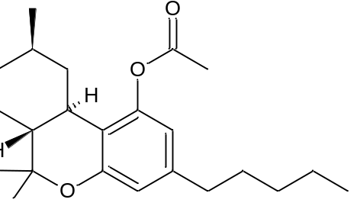
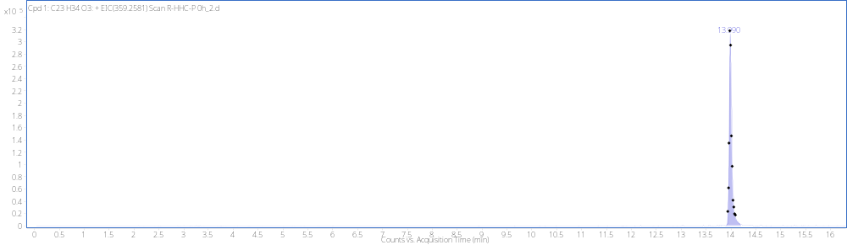
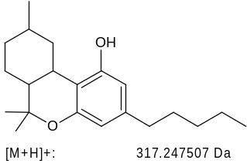
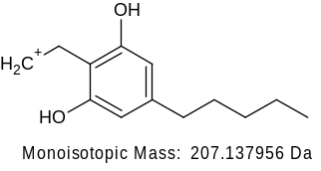
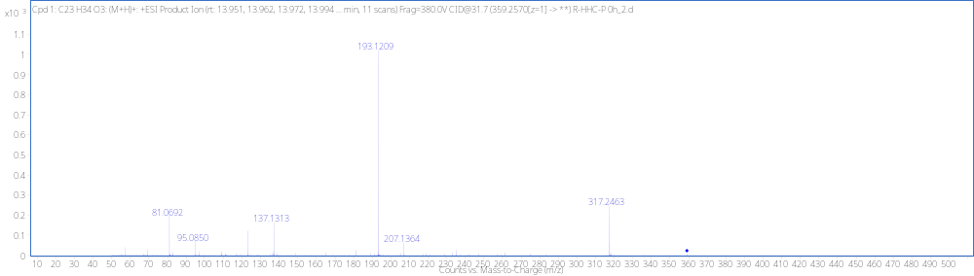
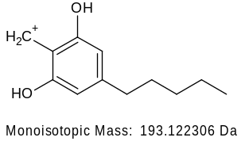
9R-HHC-O RT 14.00min
[M + H]⁺ (m/z)
Formula
359.2573
C₂₃H₃₄O₃

Slide 4
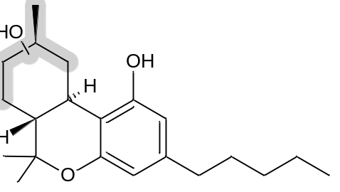
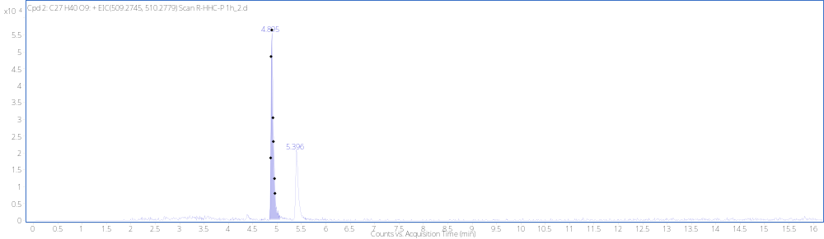
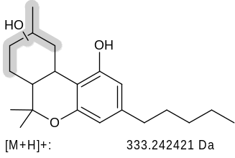
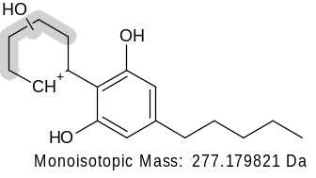
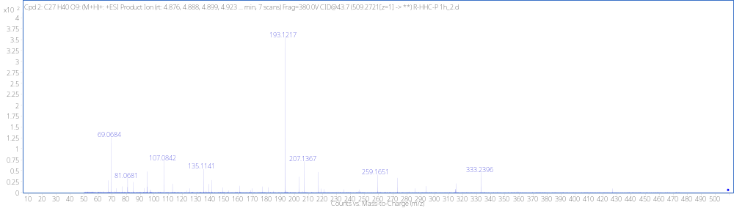
Acetate loss + MonoOH+ GLUC HO1_{A} RT 4.90min
+GLUC
[M + H]⁺ (m/z)
Formula
509.2732
C₂₇H₄₀O₉
(not detected)
-H₂O
259.1693

Slide 5
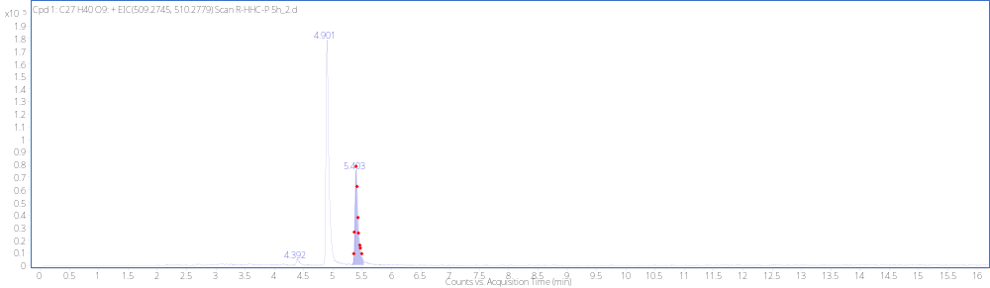
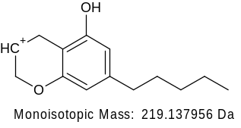
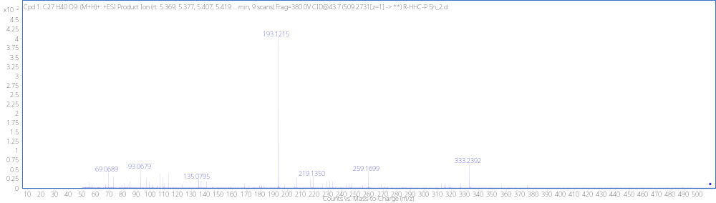
Acetate loss+MonoOH+GLUC HO1_{B} RT5.40min
+GLUC
[M + H]⁺ (m/z)
Formula
509.2730
C₂₇H₄₀O₉

Slide 6
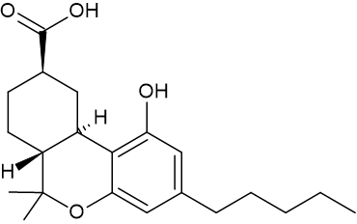
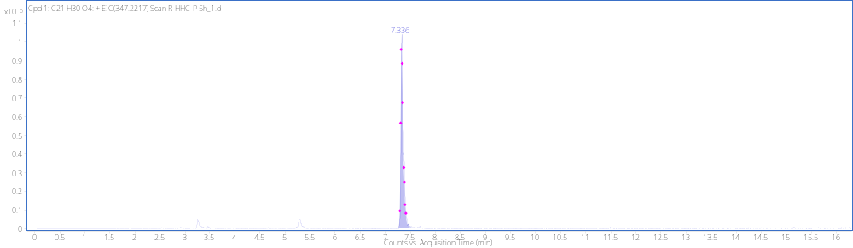
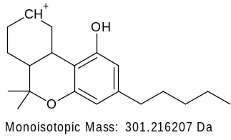
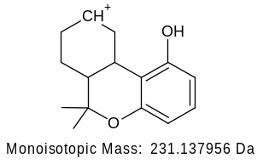
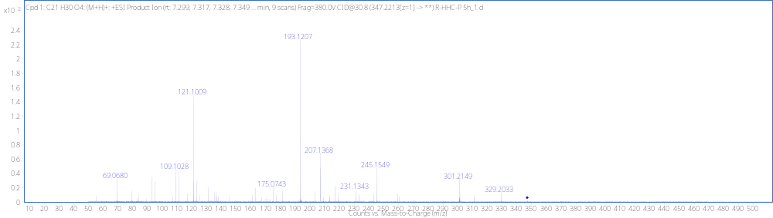
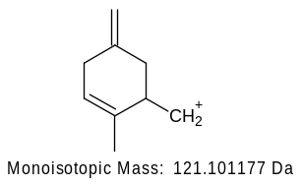
Acetate loss+Carboxylic Acid (9R) HO2 RT 7.33min
[M + H]⁺ (m/z)
Formula
347.2209
C₂₁H₃₀O₄

Slide 7
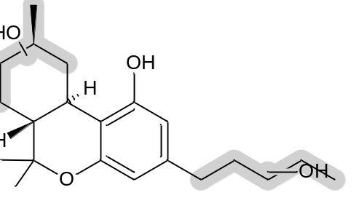
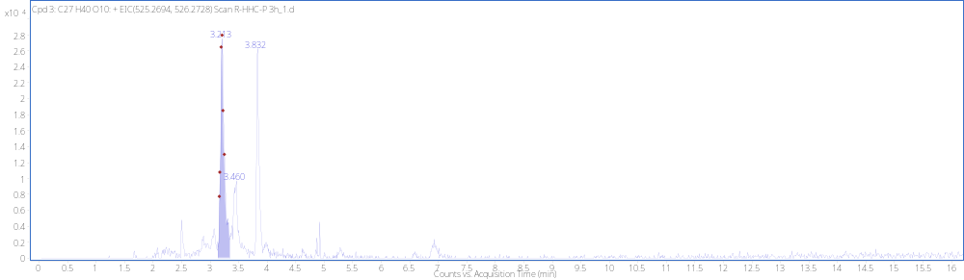
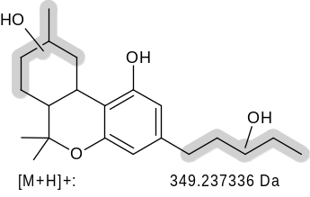
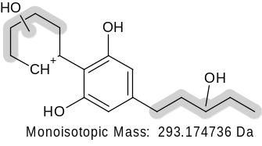
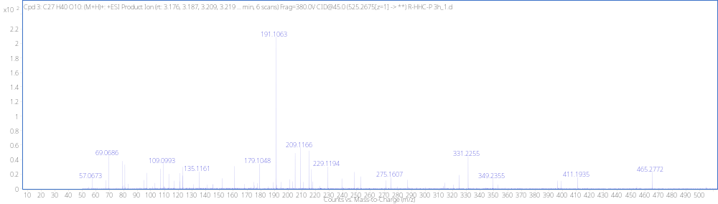
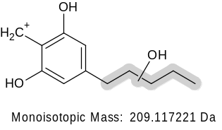
Acetate loss+DiOH+GLUC HO3_{A} RT 3.21min
+GLUC
[M + H]⁺ (m/z)
Formula
525.2678
C₂₇H₄₀O₁₀
-H₂O
331.2268
(not detected)
-H₂O
275.1642
-H₂O
191.1067

Slide 8
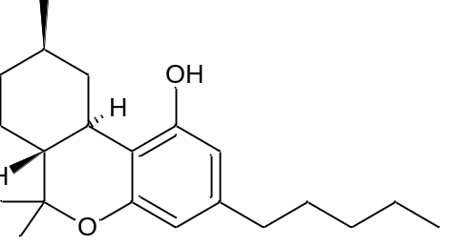
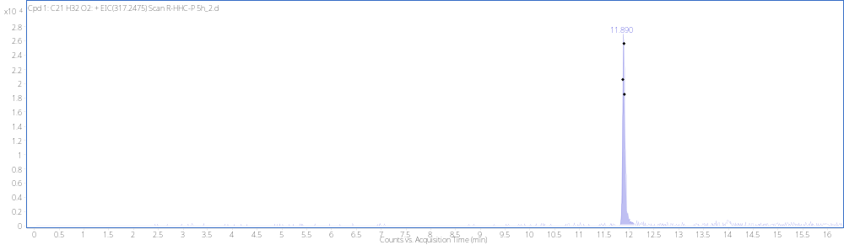
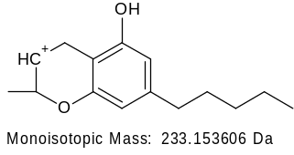
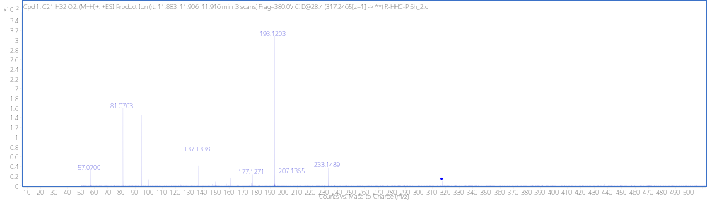
Acetate Loss (9R-HHC) HO4 RT 11.90
[M + H]⁺ (m/z)
Formula
317.2466
C₂₁H₃₂O₂

Slide 9
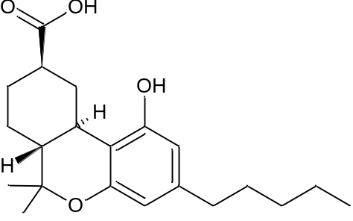
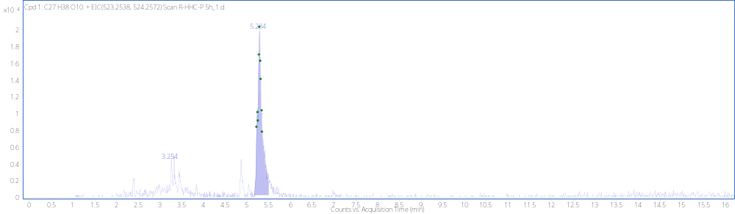
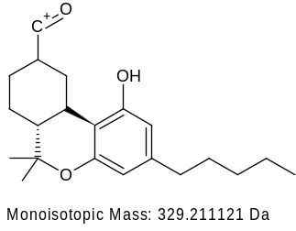
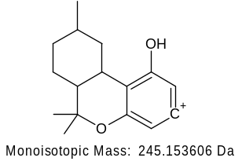
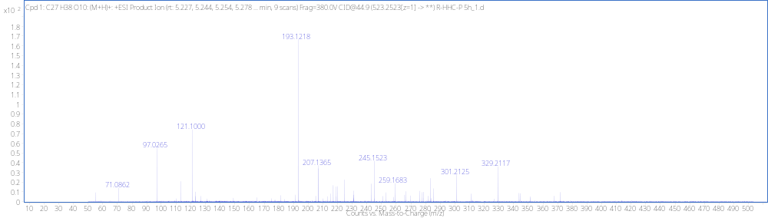
Acetate loss +Dehyd+DiOH+GLUC HO5 RT 5.29
+GLUC
[M + H]⁺ (m/z)
Formula
523.2521
C₂₇H₃₈O₁₀

Slide 10
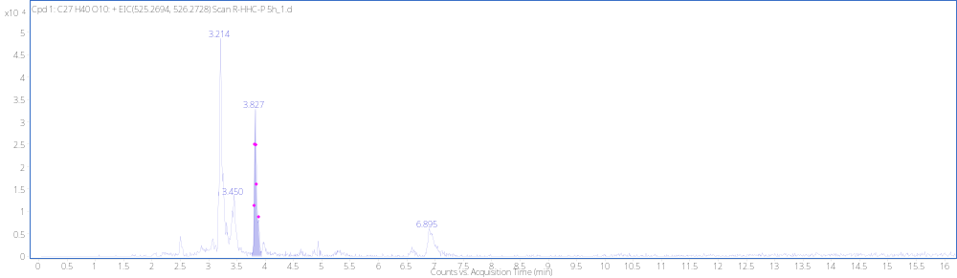
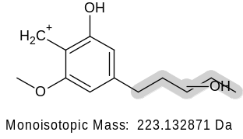
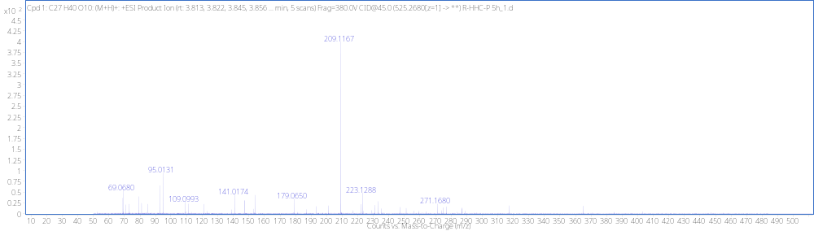
Acetate loss+DiOH+Gluc HO3_{B} RT 3.83min
+GLUC
[M + H]⁺ (m/z)
Formula
525.2675
C₂₇H₄₀O₁₀

Slide 11
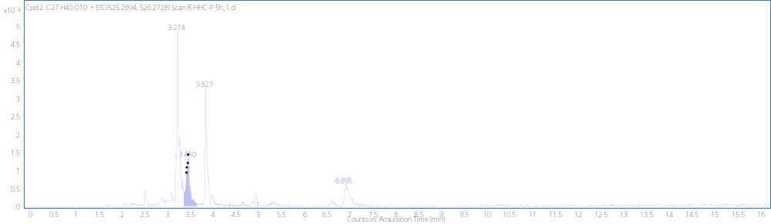
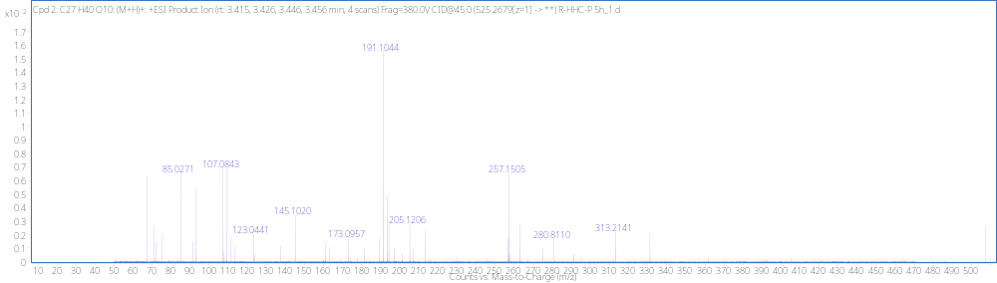
Acetate loss+DiOH+GLUC HO3_{C} RT 3.45min
+GLUC
[M + H]⁺ (m/z)
Formula
525.2677
C₂₇H₄₀O₁₀
(not detected)
-H₂O
275.1642
257.1536
-H₂O
(not detected)
-H₂O
191.1067

Slide 12
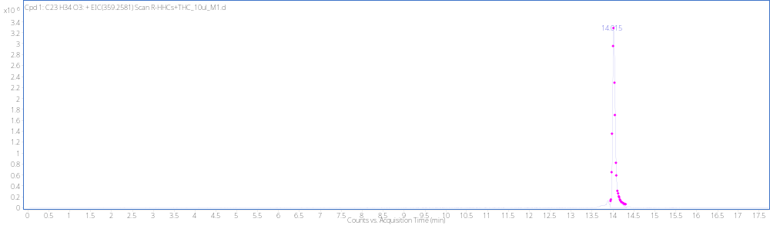
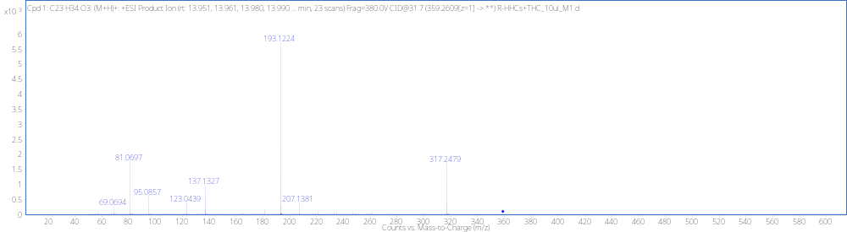
Reference Standard 9R-HHC-O RT 14.02min
[M + H]⁺ (m/z)
Formula
359.2581
C₂₃H₃₄O₃

Slide 13
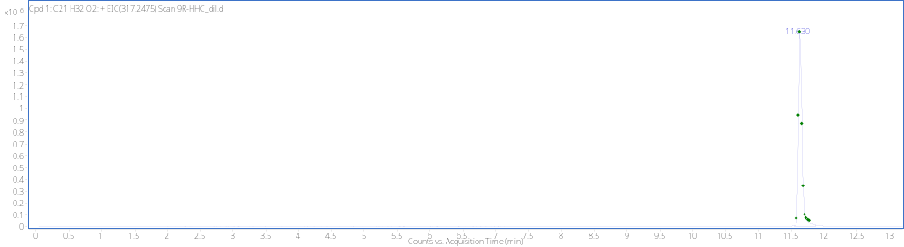
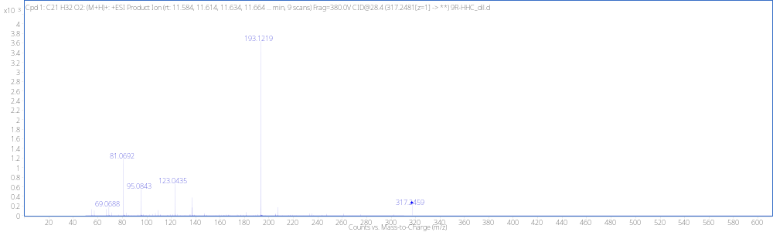
9R-HHC Reference Standard RT 11.63min
[M + H]⁺ (m/z)
Formula
317.2459
C₂₁H₃₂O₂

Slide 14
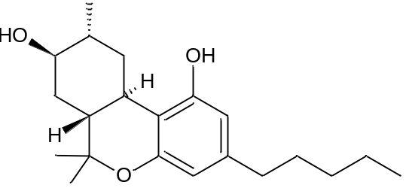
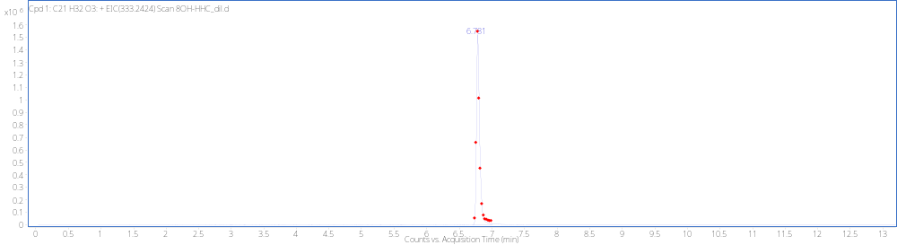
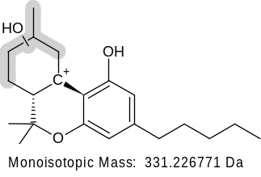
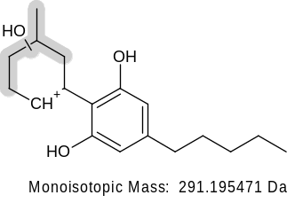
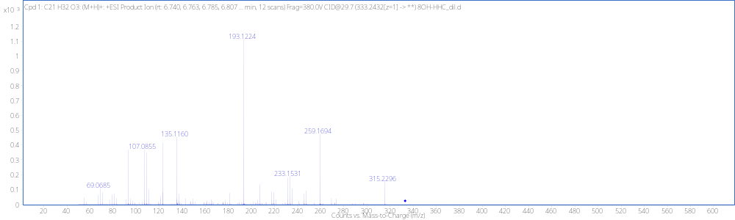
9R-8OH Reference Standard RT 6.78 min
+GLUC
[M + H]⁺ (m/z)
Formula
333.2424
C₂₁H₃₂O₃
(not detected)
-H₂O
315.2319
(not detected)
-H₂O
259.1693
207.1376

Slide 15
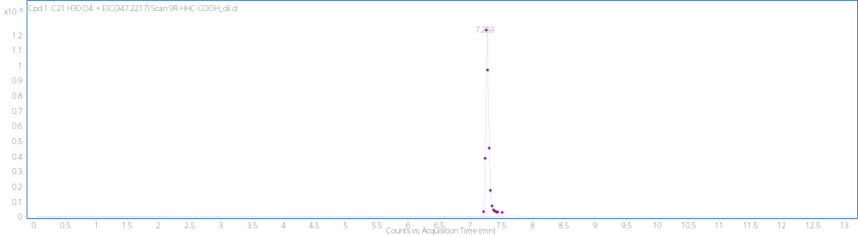


Reference standard 9R-Carboxylic acid RT 7.26min
[M + H]⁺ (m/z)
Formula
347.2217
C₂₇H₄₀O₉

