Slide 1
Human metabolism of the semi-synthetic cannabinoids hexahydrocannabinol, hexahydrocannabiphorol and their acetates using hepatocytes and urine samples
Supplementary Information 6:
Mass Spectra and Chromatograms for HHC in Hydrolysed Urine Samples
Karin Lindbom^{1,=}, Caitlyn Norman^{1,=}, Steven Baginski², Lucas Krebs³, Darta Stalberga¹, Tobias Rautio⁴, Xiongyu Wu⁴, Robert Kronstrand^{1,5}, and Henrik Green^{1,5*}
¹ Division of Clinical Chemistry and Pharmacology, Department of Biomedical and Clinical Sciences, Linköping University, Linköping, Sweden
² Leverhulme Research Centre for Forensic Science, School of Science and Engineering, University of Dundee, Dundee, UK
³ Institute for Chemistry and Bioanalytics, School of Life Sciences, University of Applied Sciences Northwestern Switzerland, Muttenz, Switzerland
⁴ Department of Physics, Chemistry and Biology, Linköping university, Linköping, Sweden.
⁵ Department of Forensic Genetics and Forensic Toxicology, National Board of Forensic Medicine, Linköping, Sweden
* Corresponding author: henrik.green@liu.se
⁼ These authors contributed equally to this work.

Slide 2
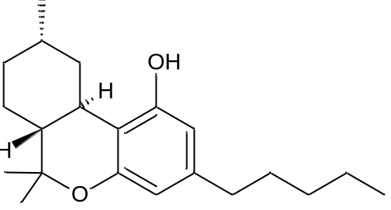
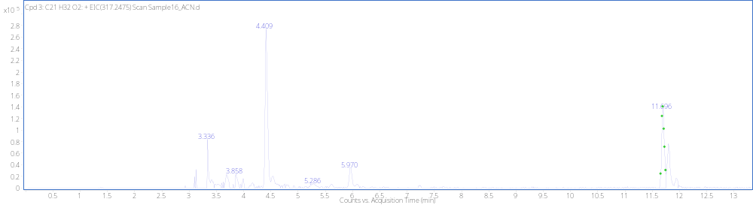
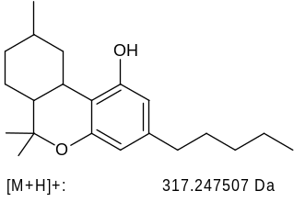
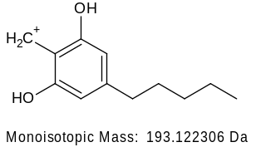
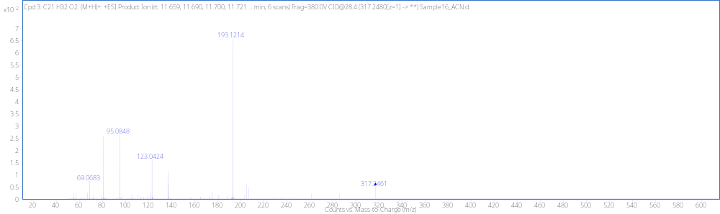
(9S)-HHC RT 11.69min
[M + H]⁺ (m/z)
Formula
317.2475
C₂₁H₃₂O₂

Slide 3
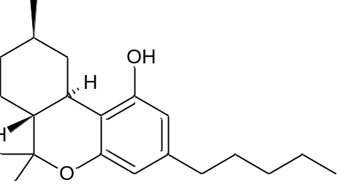
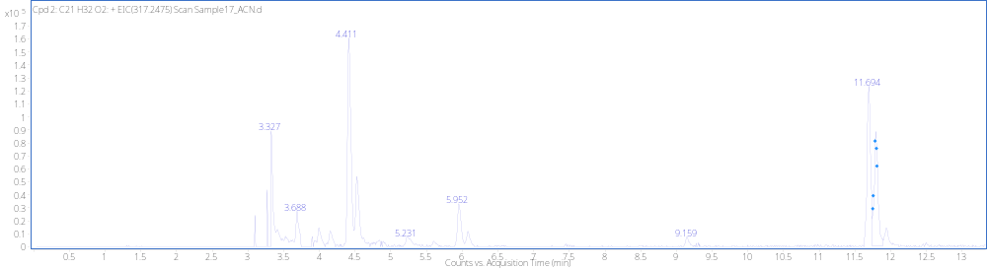
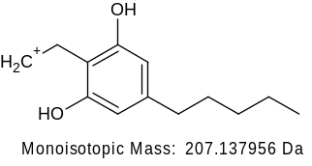
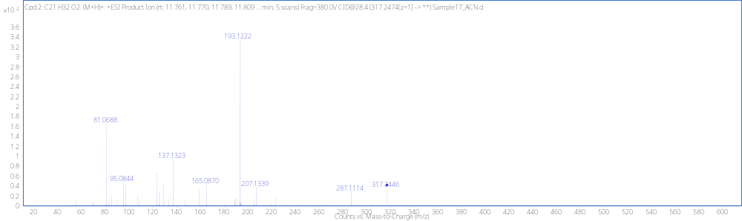
(9R)-HHC RT11.795 min
[M + H]⁺ (m/z)
Formula
317.2474
C₂₁H₃₂O₂

Slide 4
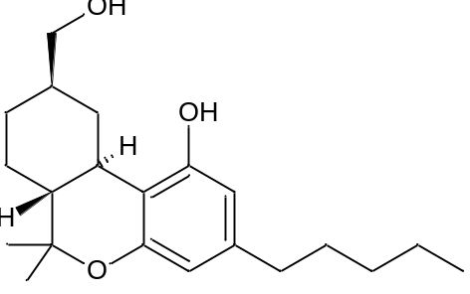
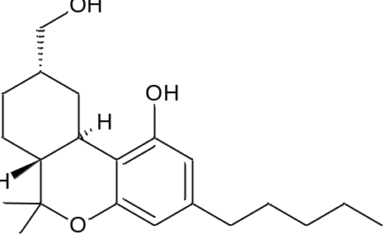
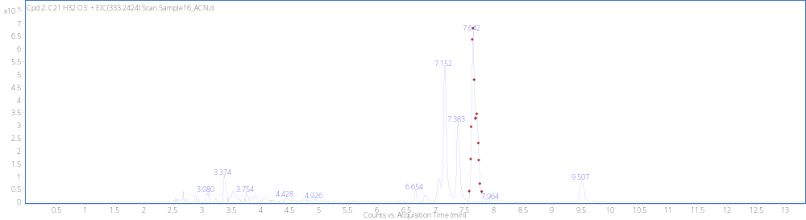
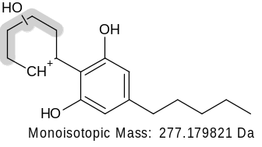
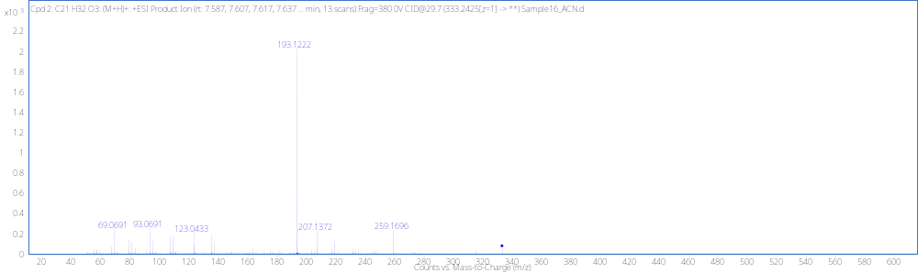
MonoOH (11) M1_{A} RT 7.67min
[M + H]⁺ (m/z)
Formula
333.2425
C₂₁H₃₂O₃
(not detected)
-H₂O
259.1693

Slide 5
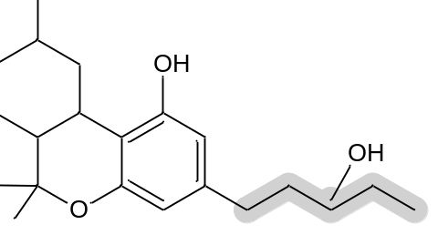
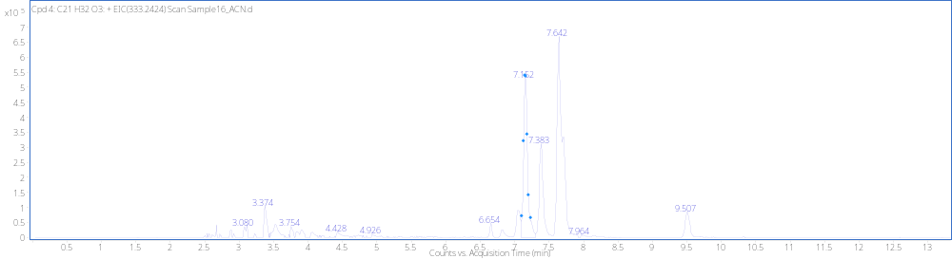
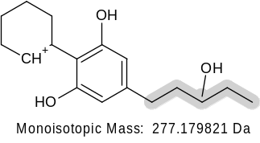
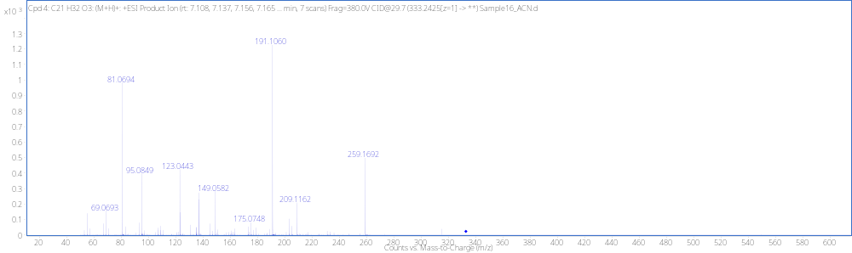
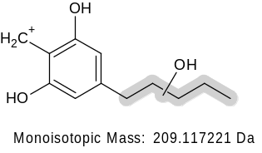
MonoOH (Tail) M2_{A} RT 7.09min (Tail)
[M + H]⁺ (m/z)
Formula
333.2425
C₂₁H₃₂O₃
(not detected)
-H₂O
259.1693
-H₂O
191.1067

Slide 6
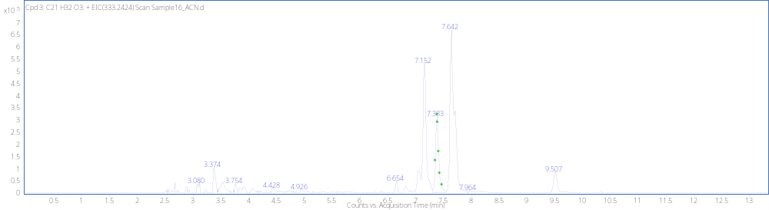
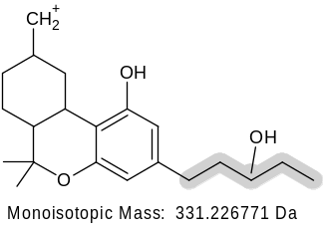
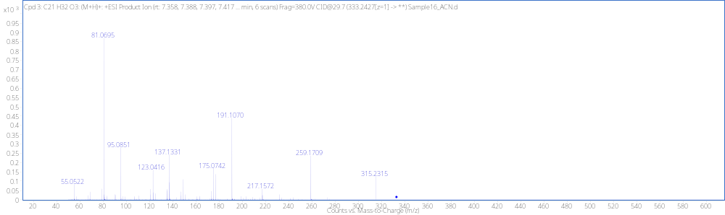
MonoOH (Tail) M2_{B} RT 7.37min Tail
O
H
O
H
O
[M + H]⁺ (m/z)
Formula
333.2427
C₂₁H₃₂O₃
(not detected)
-H₂O
315.2319
(not detected)
259.1693
-H₂O
(not detected)
-H₂O
191.1067

Slide 7
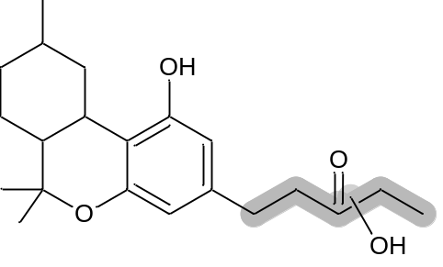
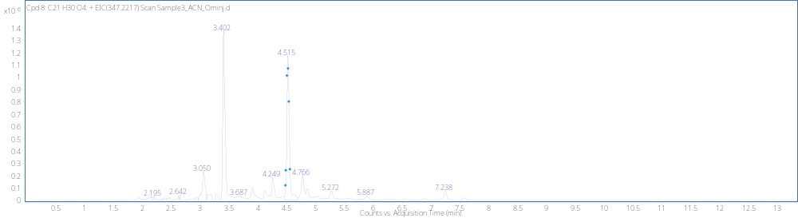
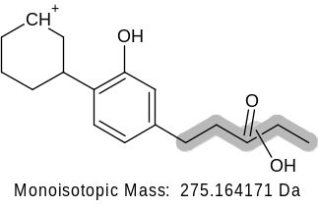
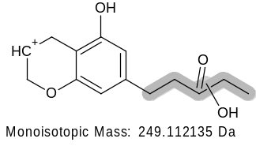
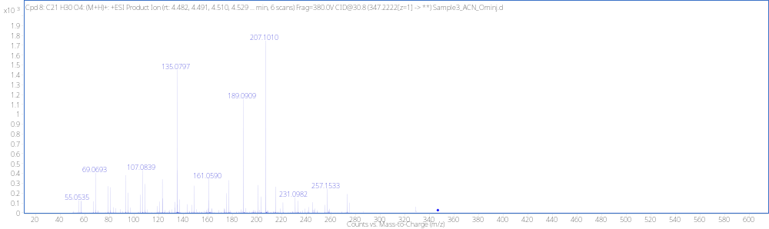
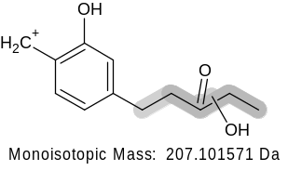
Dehyd+DiOH M3_{A} RT4.53min
[M + H]⁺ (m/z)
Formula
347.2222
C₂₁H₃₀O₄
(not detected)
-H₂O
257.1536
(not detected)
231.1016
-H₂O
-H₂O
189.0910

Slide 8
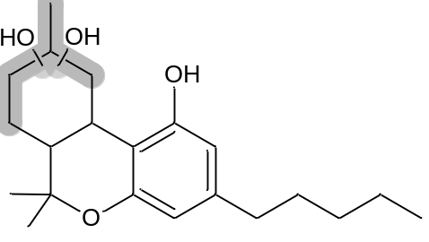
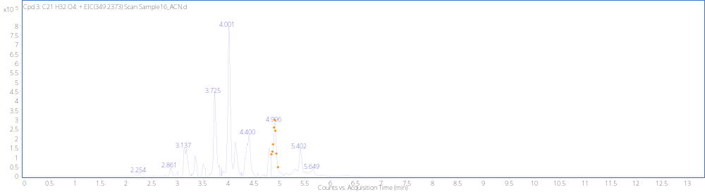
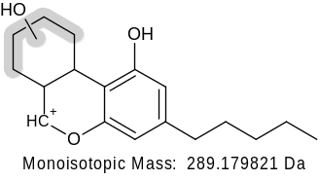
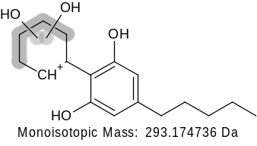
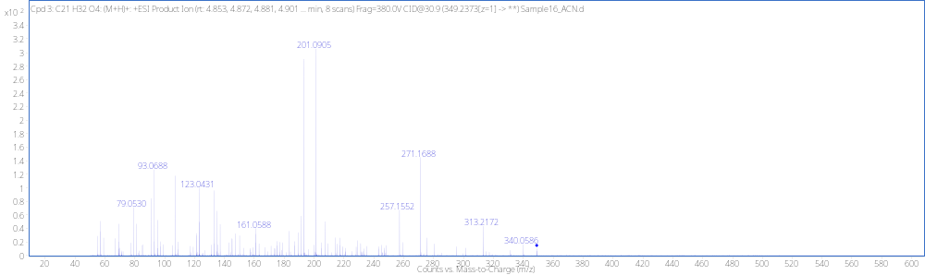
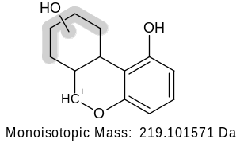
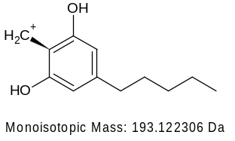
DiOH M4_{A} RT 4.89min
[M + H]⁺ (m/z)
Formula
349.2374
C₂₁H₃₂O₄
(not detected)
271.1693
-H₂O
(not detected)
-H₂O
193.1221
291.1693
257.1536
(not detected)
-H₂O
(not detected)
201.0910
-H₂O

Slide 9
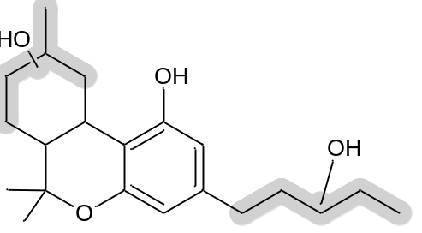
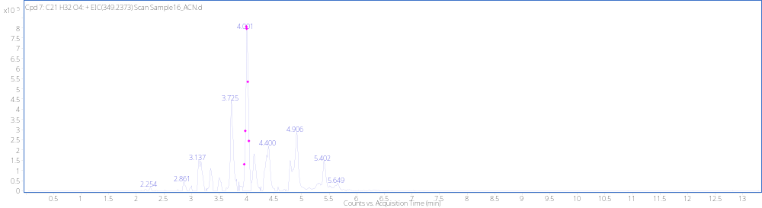
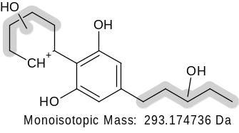
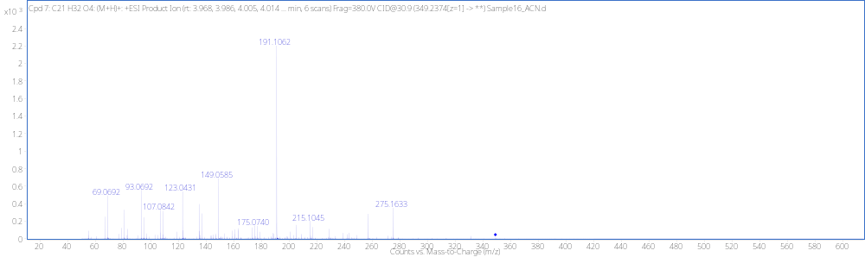
DiOH M4_{B} RT4.00min
[M + H]⁺ (m/z)
Formula
349.2379
C₂₁H₃₂O₄
(not detected)
-H₂O
275.1642
(not detected)
-H₂O
191.1067

Slide 10
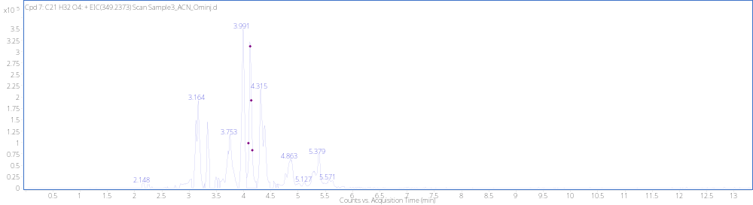
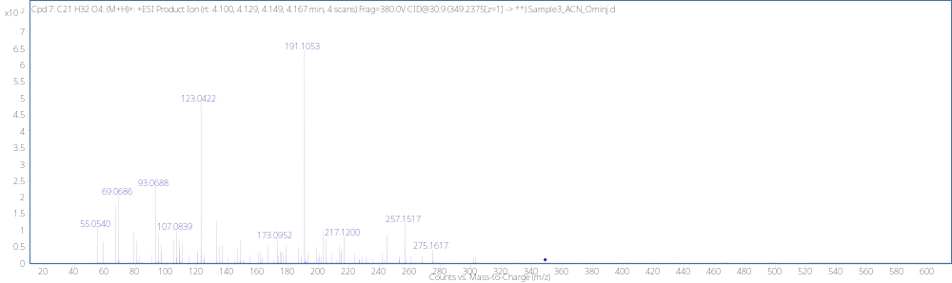
DiOH M4_{C} RT4.13min
[M + H]⁺ (m/z)
Formula
349.2379
C₂₁H₃₂O₄
(not detected)
-H₂O
275.1642
-H₂O
257.1536
(not detected)
-H₂O
191.1067

Slide 11
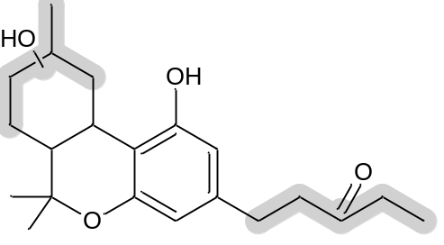
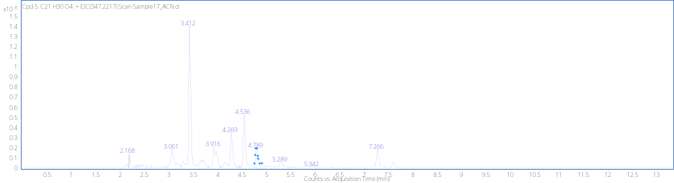
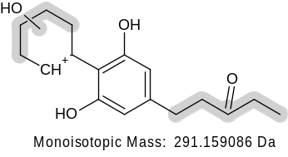
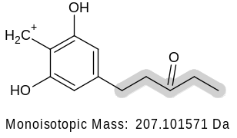
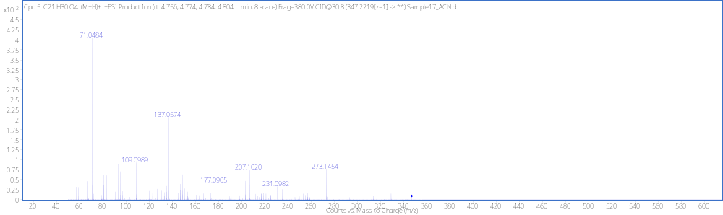
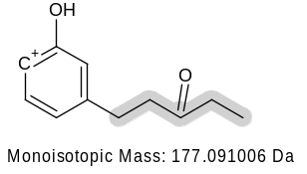
Dehyd+ DiOH M3_{B} RT 4.78min
[M + H]⁺ (m/z)
Formula
347.2224
C₂₁H₃₀O₄
(not detected)
-H₂O
273.1485

Slide 12
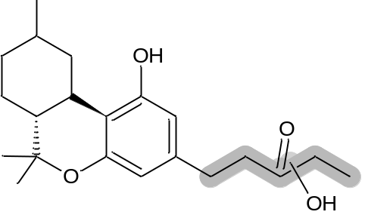
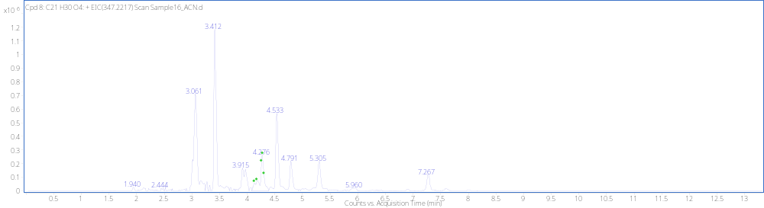
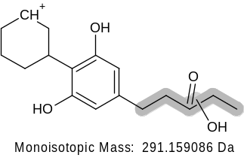


Dehyd+DiOH M3_{C} RT 4.26min
[M + H]⁺ (m/z)
Formula
347.2222
C₂₁H₃₀O₄
(not detected)
-H₂O
273.1485
-H₂O
189.0910

Slide 13





(9R)-Carboxylic acid M5_{A} RT 7.27min
[M + H]⁺ (m/z)
Formula
347.2223
C₂₁H₃₀O₄

Slide 14



(9S)-Carboxylic acid M5_{B} RT 7.58min
[M + H]⁺ (m/z)
Formula
347.2219
C₂₁H₃₀O₄

Slide 15





DiOH M4_{D} RT 5.40min
[M + H]⁺ (m/z)
Formula
349.2375
C₂₁H₃₂O₄
(not detected)
-H₂O
259.1693
(not detected)
-H₂O
207.1016
-H₂O
189.0910

Slide 16


MonoOH M1_{B} RT 6.81min
[M + H]⁺ (m/z)
Formula
No spec
C₂₁H₃₂O₃
333.2424

Slide 17


MonoOH (Tail) M2_{C} RT 5.80min
[M + H]⁺ (m/z)
Formula
333.2424
C₂₁H₃₂O₃
(not detected)
-H₂O
259.1693
-H₂O
191.1067

Slide 18


DiOH M4_{E} RT4.40min
[M + H]⁺ (m/z)
Formula
349.2380
C₂₁H₃₂O₄
(not detected)
-H₂O
275.1642
257.1536
-H₂O
(not detected)
-H₂O
191.1067

Slide 19






MonoOH M1_{C} RT 9.51min
[M + H]⁺ (m/z)
Formula
333.2424
C₂₁H₃₂O₃
315.2319
-H₂O
259.1693
(not detected)
-H₂O

Slide 20




MonoOH (8) M1_{D} RT 7.04min
[M + H]⁺ (m/z)
Formula
333.2426
C₂₁H₃₂O₃
315.2319
(not detected)
-H₂O
(not detected)
-H₂O
259.1693

Slide 21



MonoOH (8) M1_{E} RT 6.65min
[M + H]⁺ (m/z)
Formula
333.2423
C₂₁H₃₂O₃
315.2319
(not detected)
-H₂O
(not detected)
259.1693
-H₂O

Slide 22


(9S)-HHC Reference Standard RT 11.53min
[M + H]⁺ (m/z)
Formula
317.2475
C₂₁H₃₂O₂

Slide 23


(9R)-HHC Reference Standard RT 11.63min
[M + H]⁺ (m/z)
Formula
317.2459
C₂₁H₃₂O₂
207.1374

Slide 24



(9R)-8OH Reference Standard RT 6.78 min
+GLUC
[M + H]⁺ (m/z)
Formula
333.2424
C₂₁H₃₂O₃
(not detected)
-H₂O
315.2319
(not detected)
-H₂O
259.1693
207.1376

Slide 25


(9R)-11OH Reference Standard RT 6.78 min
[M + H]⁺ (m/z)
Formula
333.2424
C₂₁H₃₂O₃

Slide 26




(9R)-Carboxylic acid Reference standard RT 7.26min
[M + H]⁺ (m/z)
Formula
347.2217
C₂₇H₄₀O₉

Slide 27


(S)-Carboxylic acid Reference Standard RT 7.59min
[M + H]⁺ (m/z)
Formula
347.2217
C₂₁H₃₀O₄

