Slide 1
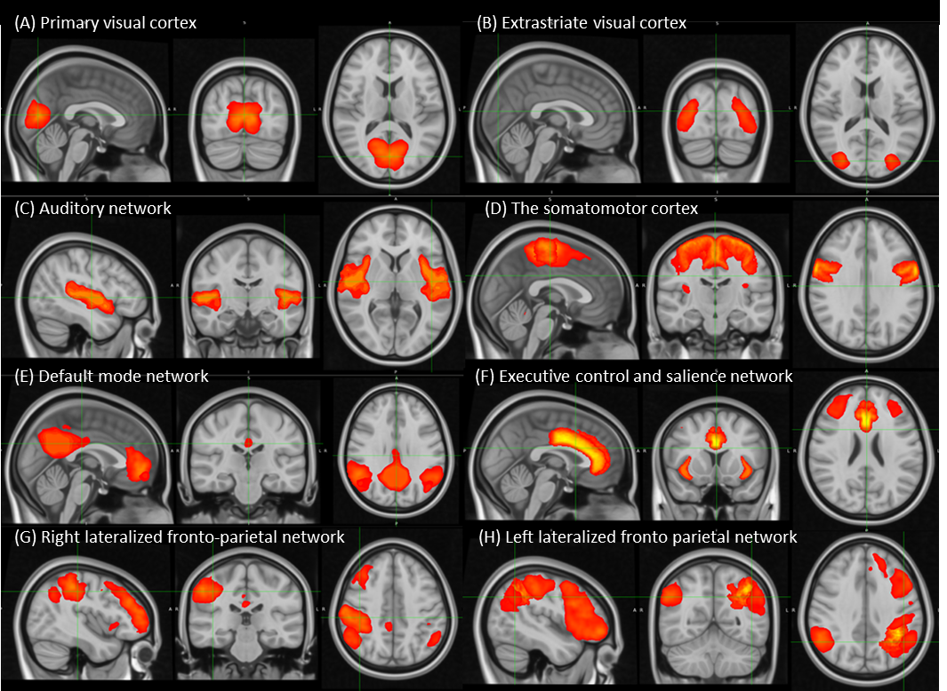
MELODIC generated 112 ICs. Out of the 112 ICs, only eight RS networks were
Found. (A) ICA 3 - extrastriate visual cortex; (B) ICA 4 - Primary Visual Cortex; (C) ICA 6 - Auditory Network; (D) ICA 16 - The Default Mode Network; (E) ICA 14 - Executive Control/ Salience; (F) ICA 2 - The Somatomotor Cortex; (G) ICA 25 - Left Frontal Parietal Network; (H) ICA 18 - Right Frontal Parietal Network

