Slide 1
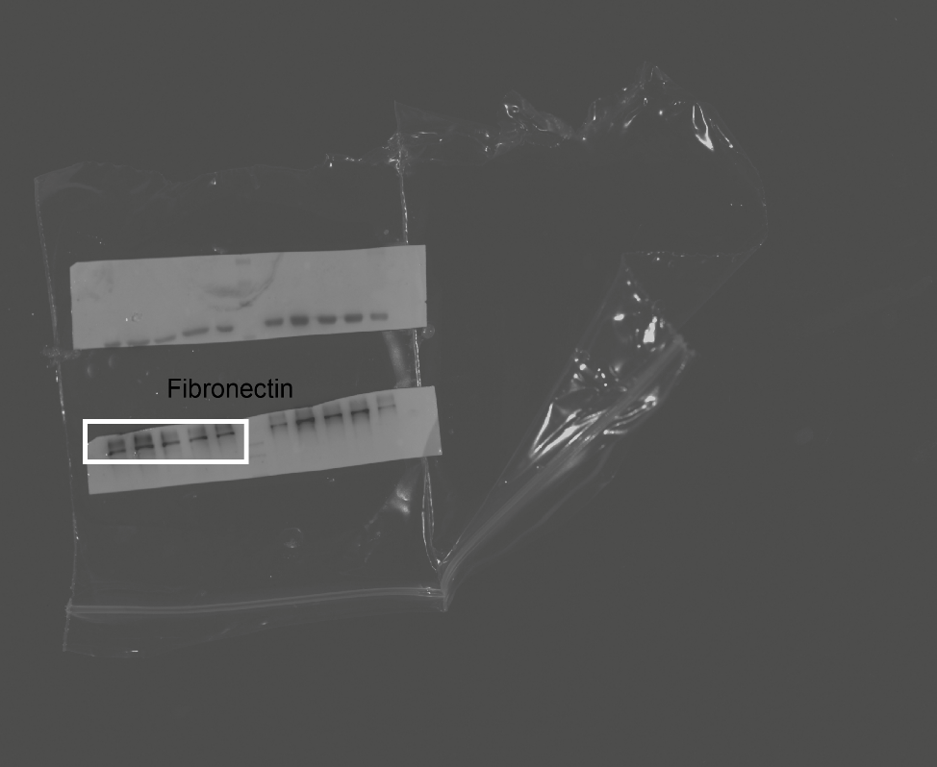
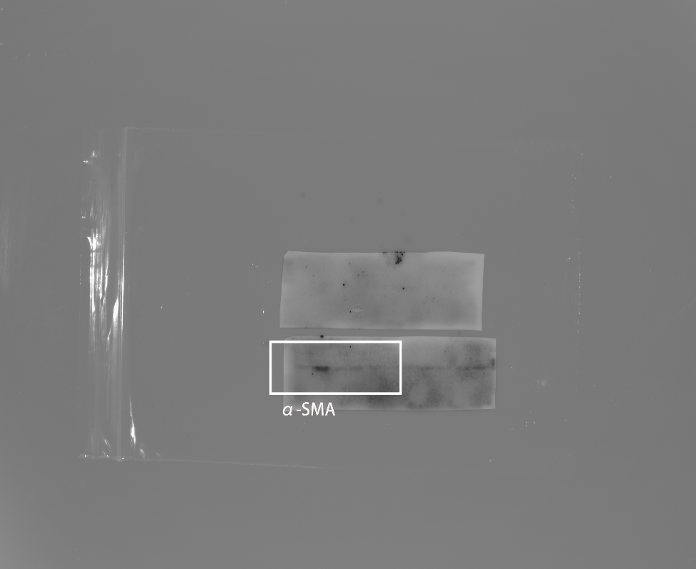
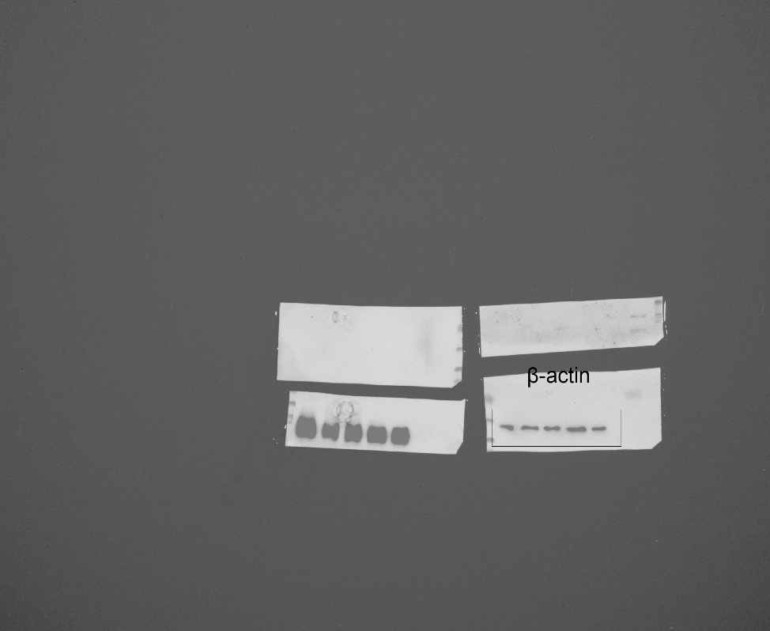
Figure 3G.
Sequence of protein bands from western blot:
1: Primary lung fibroblasts treated with vehicle;
2: Primary lung fibroblasts treated with TGF-β;
3: Primary lung fibroblasts treated with ACPA (10 μM);
4：Primary lung fibroblasts treated with ACPA (30 μM);
5：Primary lung fibroblasts treated with ACPA (100 μM).
1 2 3 4 5
1 2 3 4 5
Fibronectin
α-SMA
1 2 3 4 5
1 2 3 4 5
Collagen
β-actin

