Slide 1
Human metabolism of the semi-synthetic cannabinoids hexahydrocannabinol, hexahydrocannabiphorol and their acetates using hepatocytes and urine samples
Supplementary Information 1:
Mass Spectra and Chromatograms for (9R)-HHC in Human Hepatocytes
Karin Lindbom^{1,=}, Caitlyn Norman^{1,=}, Steven Baginski², Lucas Krebs³, Darta Stalberga¹, Tobias Rautio⁴, Xiongyu Wu⁴, Robert Kronstrand^{1,5}, and Henrik Green^{1,5*}
¹ Division of Clinical Chemistry and Pharmacology, Department of Biomedical and Clinical Sciences, Linköping University, Linköping, Sweden
² Leverhulme Research Centre for Forensic Science, School of Science and Engineering, University of Dundee, Dundee, UK
³ Institute for Chemistry and Bioanalytics, School of Life Sciences, University of Applied Sciences Northwestern Switzerland, Muttenz, Switzerland
⁴ Department of Physics, Chemistry and Biology, Linköping university, Linköping, Sweden.
⁵ Department of Forensic Genetics and Forensic Toxicology, National Board of Forensic Medicine, Linköping, Sweden
* Corresponding author: henrik.green@liu.se
⁼ These authors contributed equally to this work.

Slide 2
Overlaid chromatogram of metabolites from 9R-HHC in human hepatocytes
x10
5
2.2
H1_{A}
2
1.8
1.6
1.4
Abundance (au)
H1_{B}
1.2
1
H2
0.8
H3_{A}
0.6
H3_{C}
0.4
H4
9R-HHC
0.2
H3_{C}
H1_{C}
11.889
0
1
1.5
2
2.5
3
3.5
4
4.5
5
5.5
6
6.5
7
7.5
8
8.5
9
9.5
10
10.5
11
11.5
12
12.5
Time (min)

Slide 3
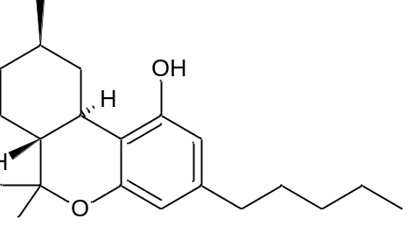
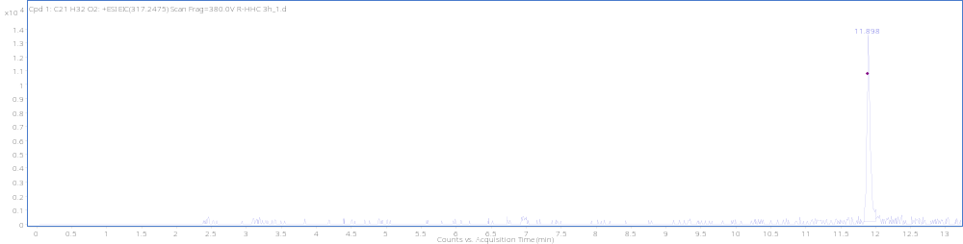
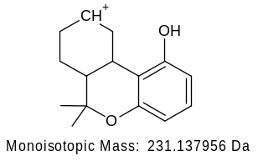
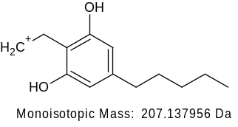
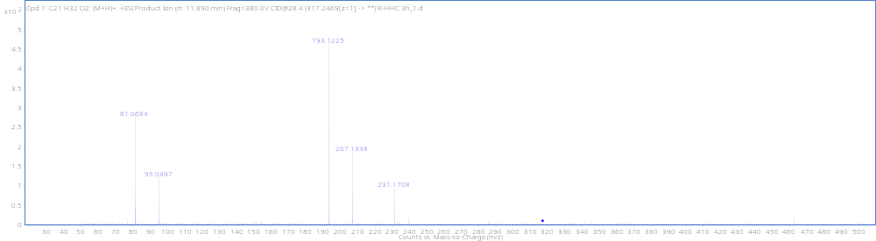
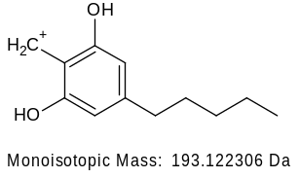
(9R)-HHC RT 11.90 min
[M + H]⁺ (m/z)
Formula
317.2477
C₂₁H₃₂O₂

Slide 4
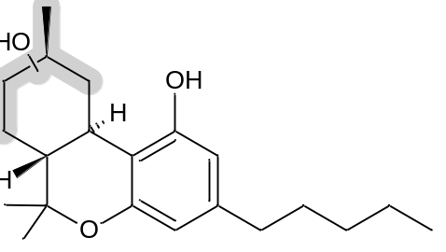
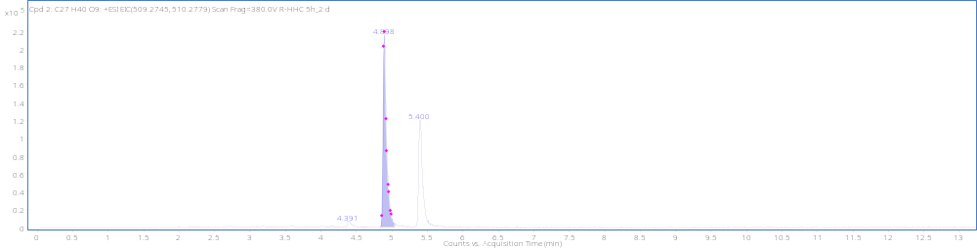
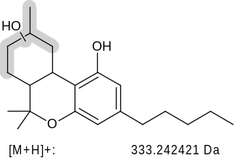
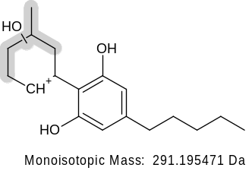
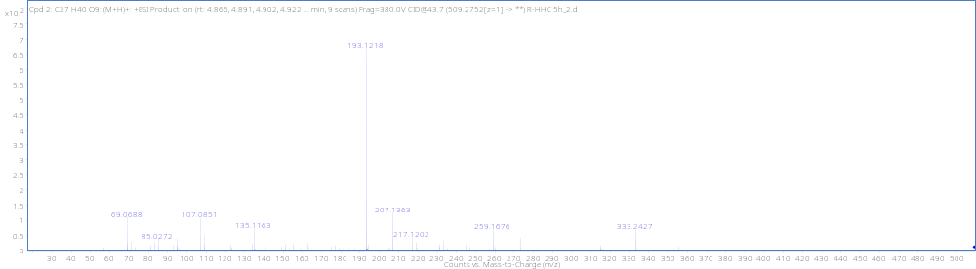
MonoOH+ GLUC H1_{A} RT4.89min
+GLUC
[M + H]⁺ (m/z)
Formula
509.2747
C₂₇H₄₀O₉
(not detected)
-H₂O
259.1693

Slide 5
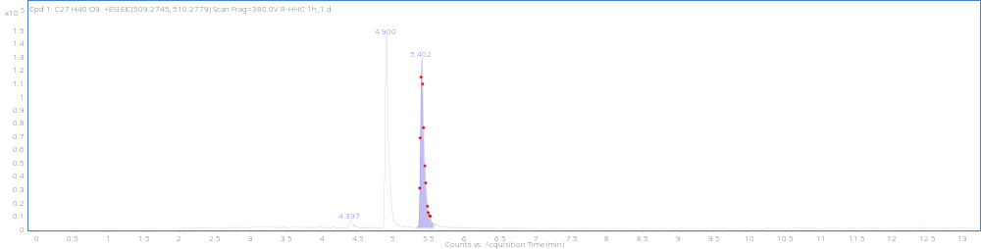
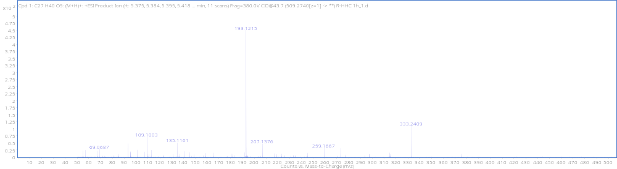
MonoOH+ GLUC H1_{B} RT5.40min
+GLUC
[M + H]⁺ (m/z)
Formula
509.2748
C₂₇H₄₀O₉
(not detected)
-H₂O
259.1693

Slide 6
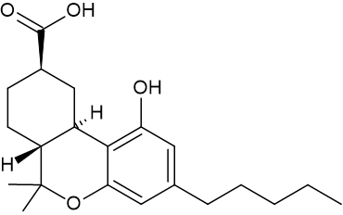
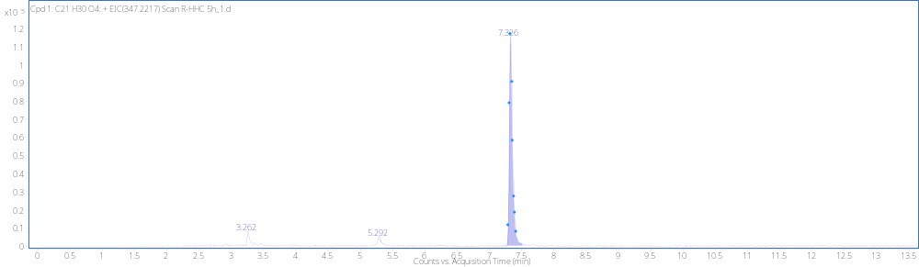
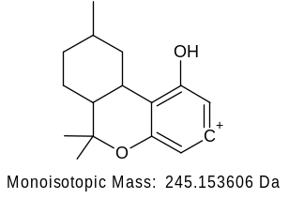
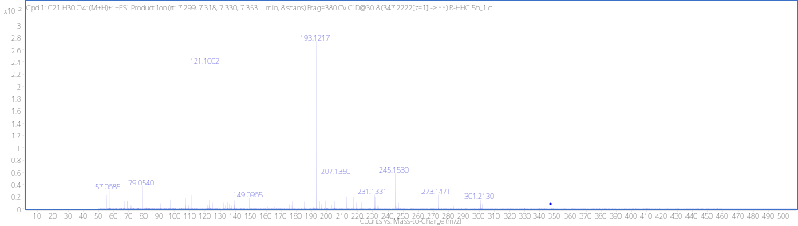
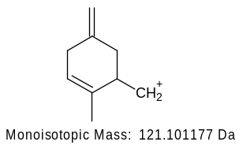
9R-Carboxylic acid H2, RT 7.33min
[M + H]⁺ (m/z)
Formula
347.2218
C₂₇H₄₀O₉

Slide 7
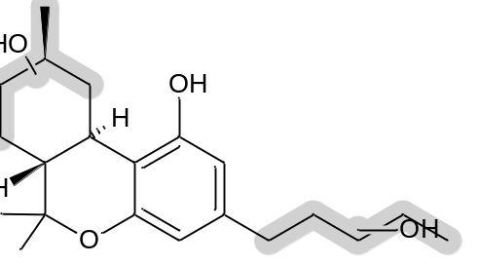
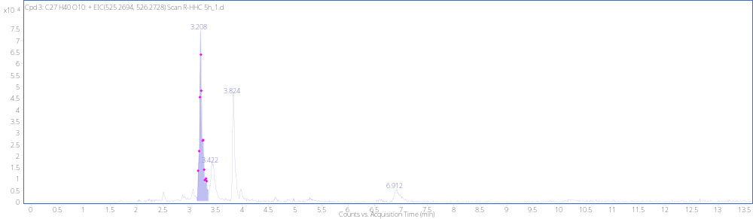
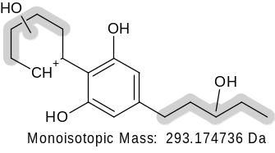
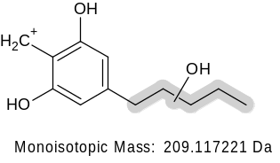
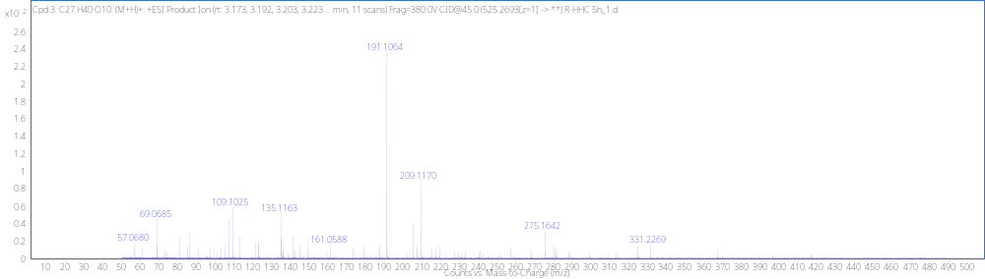
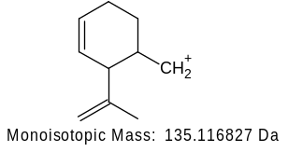
DiOH+ GLUC H3_{A} RT 3.21MIN
[M + H]⁺ (m/z)
Formula
525.2692
C₂₇H₄₀O₁₀
(not detected)
-H₂O
275.1642
-H₂O
191.1067

Slide 8
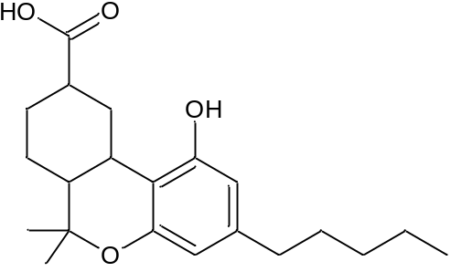
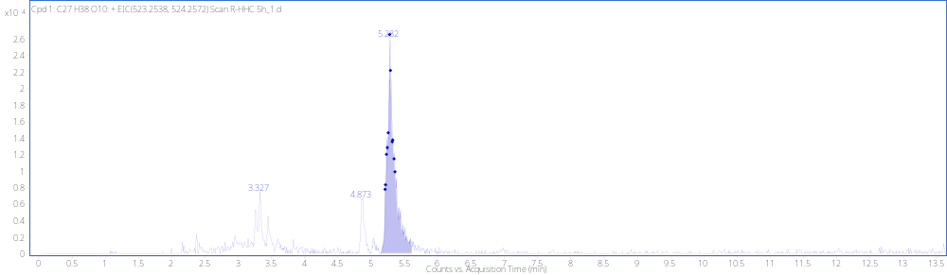
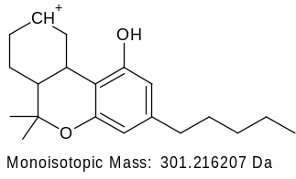
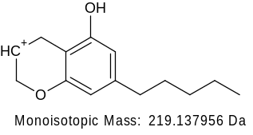
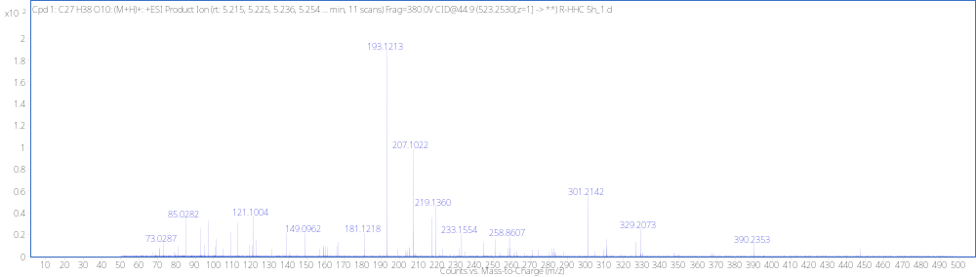
Dehyd+DiOH+GLUC H4 RT 5.29min
+GLUC
[M + H]⁺ (m/z)
Formula
C₂₇H₃₈O₁₀
523.2534

Slide 9
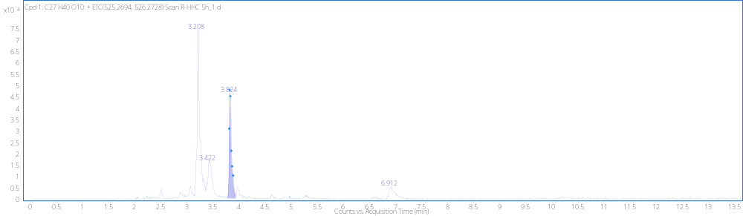
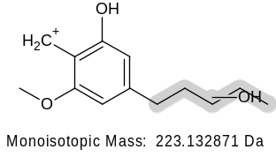
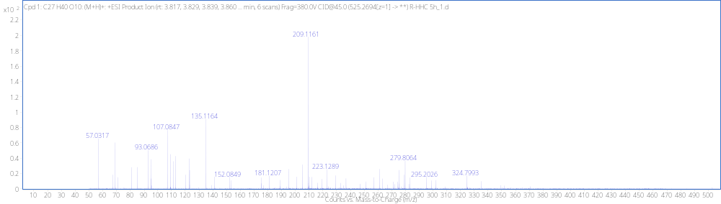
DiOH+ GLUC H3_{B} RT 3.83min
+GLUC
[M + H]⁺ (m/z)
Formula
525.2692
C₂₇H₄₀O₁₀

Slide 10
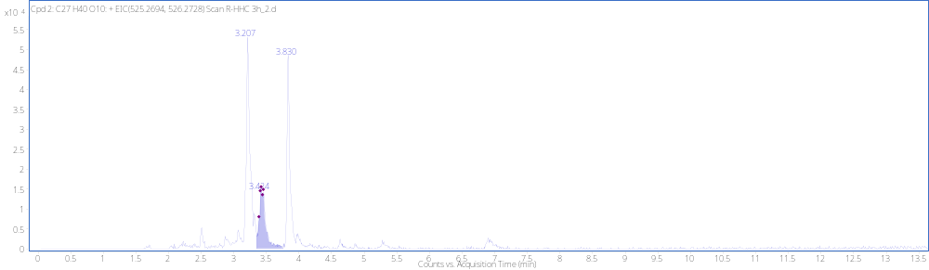
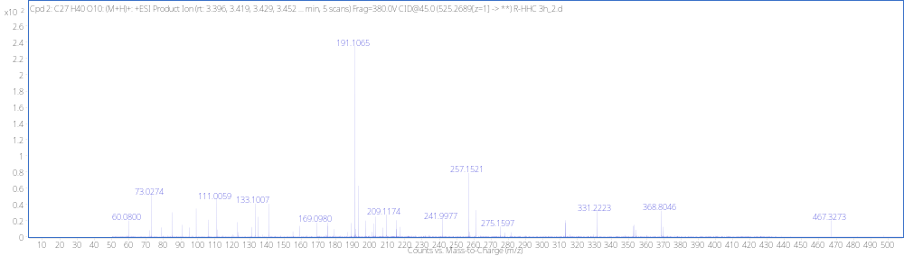
DiOH+ GLUC H3_{C} RT 3.42min
+GLUC
[M + H]⁺ (m/z)
Formula
525.2694
C₂₇H₄₀O₁₀
(not detected)
-H₂O
275.1642
257.1536
-H₂O
-H₂O
191.1067

Slide 11
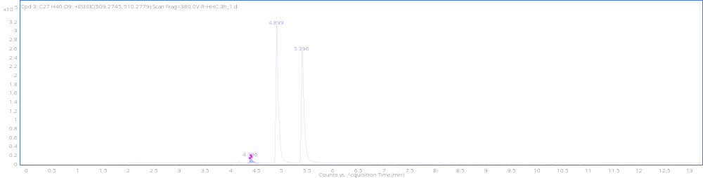
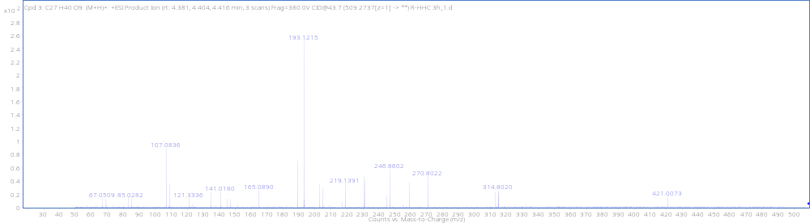
MonoOH+ GLUC H1_{C} RT4.39min
+GLUC
[M + H]⁺ (m/z)
Formula
509.2739
C₂₇H₄₀O₉

Slide 12
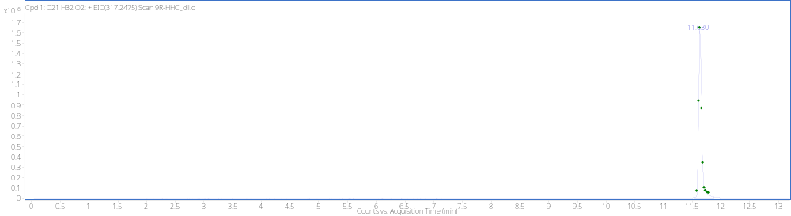
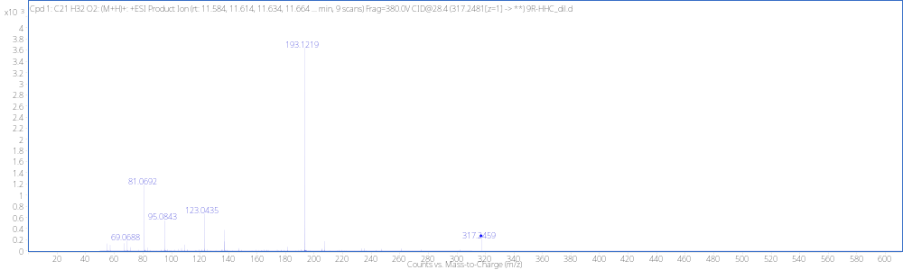
9R-HHC Reference Standard RT 11.63min
[M + H]⁺ (m/z)
Formula
317.2459
C₂₁H₃₂O₂

Slide 13
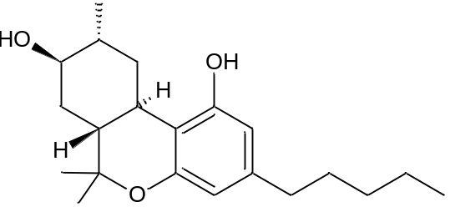
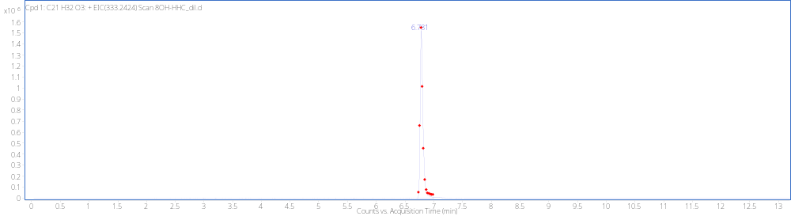
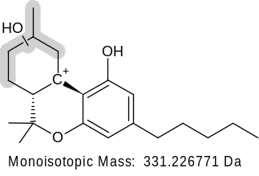
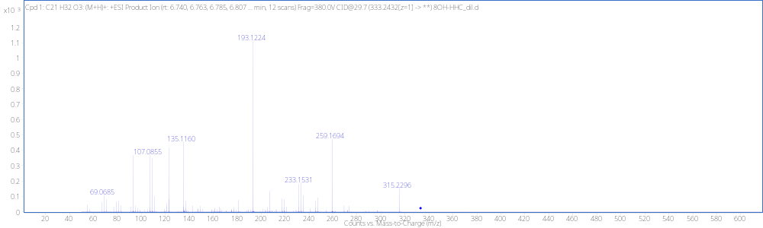
9R-8OH Reference Standard RT 6.78 min
+GLUC
[M + H]⁺ (m/z)
Formula
333.2424
C₂₁H₃₂O₃
(not detected)
-H₂O
315.2319
(not detected)
-H₂O
259.1693
207.1376

Slide 14
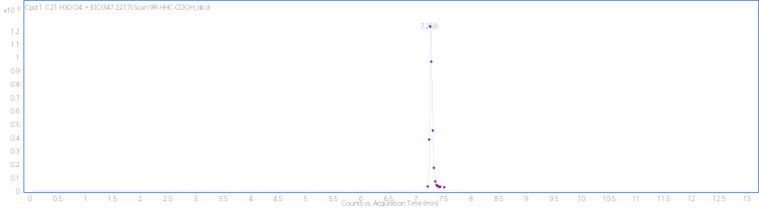
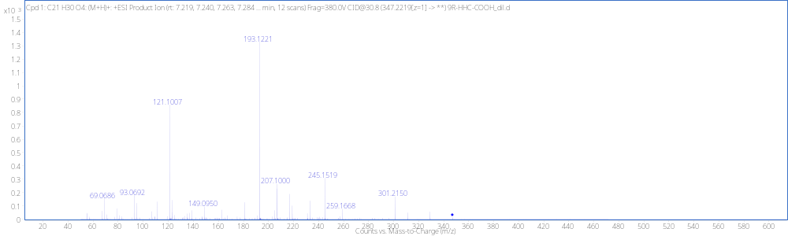
Reference standard 9R-Carboxylic acid RT 7.26min
[M + H]⁺ (m/z)
Formula
347.2217
C₂₇H₄₀O₉

