Slide 1
Supplementary
S1: Cannabinoids have no effect on the viability of RAW 264.7 cells
S1: Cannabinoids have no cytotoxic effect on the viability of RAW 264.7 cells.
The graph represents the viability of mouse macrophages (RAW 264.7) that were treated with high THC-containing extracts, termed THC-A (dark blue line), THC-B (red line), THC-C (grey line) and high CBD-containing extracts, termed CBD-X (green line), CBD-Y (yellow line) and CBD-Z (light blue line). Standard deviations were calculated in ratio to vehicle treated cells, and data were analyzed by one-way ANOVA (Fisher’s LSD test with values p < 0.05 considered statistically significant, (*p <0.05, **p < 0.01, *** p < 0.001).

Slide 2
S2: Dose response effect of CBD-X extract on the viability of human neutrophils.
*
S2: Cannabinoids have no cytotoxic effect on the viability of human neutrophils. The graph represents the viability of human-derived neutrophils that were treated with 1-4 μg/ml CBD-X (LPS (+)/1, LPS (+)/2, LPS (+)/3 LPS (+)/4), LPS (LPS (+)/vehicle) or vehicle only (LPS(-)/vehicle). The means were calculated from healthy donors (black line) in ratio to vehicle treated cells and each dot represents one case. Data were analyzed by one-way ANOVA (Fisher’s LSD test with values p < 0.05 considered statistically significant, (*p <0.05, **p < 0.01, *** p < 0.001).

Slide 3
S3: Dose response effect of CBD-X extract on the viability of PBMCs
S3: Cannabinoids have no cytotoxic effect on the viability of PBMCs.
The graph represents the viability of human-derived PBMCs that were treated with 2 or 4 μg/ml CBD-X (T-cell activation/2), (T-cell activation/4), vehicle only (T-cell activation/DMSO) or left untreated (Control/-). The means were calculated from healthy donors (black line) in ratio to activated control and each dot represents one case. data were analyzed by one-way ANOVA (Fisher’s LSD test with values p < 0.05 considered statistically significant, (*p <0.05, **p < 0.01, *** p < 0.001).

Slide 4
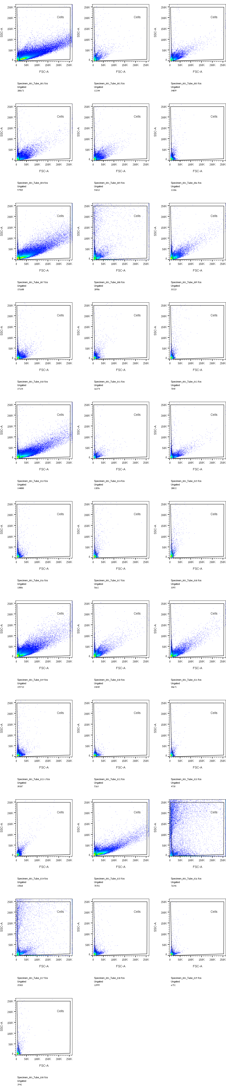
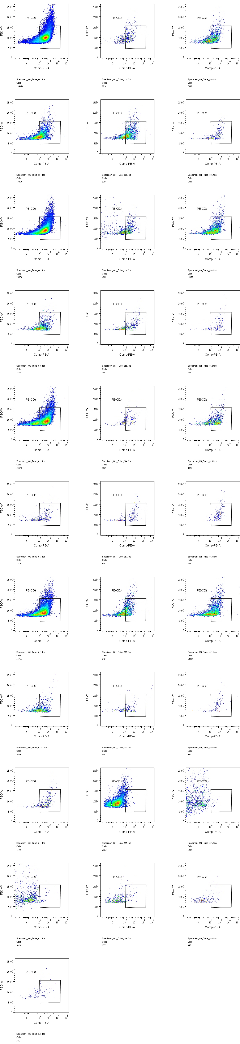
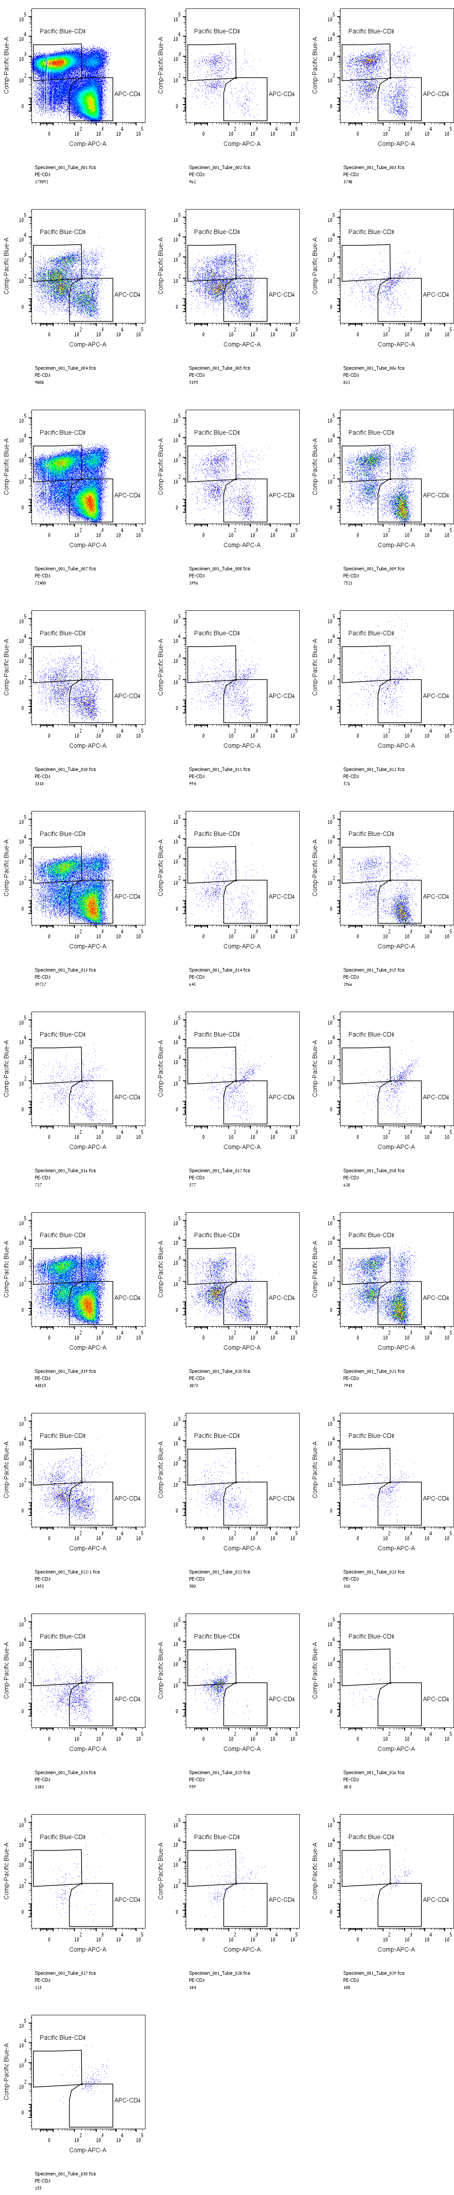
S4: Migration of human PBMC-derived T-cells.
Insert
SDF1 (100 nM)
CBD-X
(-)
(-)
(-)
(+)
(-)
(-)
(+)
(+)
(-)
(+)
(+)
1 µg/ ml
(+)
(+)
2 µg/ ml
(+)
(+)
3 µg/ ml
FSC/ SSC
FSC-W/PE- CD3
PB-CD8 /APC- CD4
S4: Migration of human PBMC-derived T-cells. Shown results are representative scatter plots of the flow cytometry of migrated PBMC-derived T-cells. Cells were cultivated on a pore membrane in the upper chamber of a 24-well Boyden chamber (insert) and allowed to migrate to the chemoattractant SDF1 after treatment with 1-3 µg/ml CBD-X ([(+), (+), 1 µg/ml], [(+), (+), 2 µg/ml] [(+), (+), 3 µg/ml]), vehicle ([(+), (-), (-)]) or left untreated ([(-), (-) ,(-)]). Scatter plots representing Forward scatter (FSC) against Side scatter (SSC) are shown in the upper panel, scatter plots representing Forward scatter width (FSC-W) against CD3+ T-cells stained with PE (PE-CD3) in the middle panel and scatter plots representing CD8+ T‑cells stained with PE (PE-CD8) against APC-CD4 in the lower panel.

Slide 5
S5: CBD-X extract effect on leukocytes, T cells and neutrophils count in the baseline state.
(A)
(B)
(C)
Vehicle
SSC
SSC
CD3
(E)
FSC
CD45
(D)
CBD-X
LY6G
S5: CBD-X extract effect on leukocytes, T cells and neutrophils count in the baseline state. C57Black mice were injected with CBD-X (100 mg/Kg) or Vehicle two times a week for two months' period, intraperitoneal. Blood was drained from the tail, centrifuged and pellet was treated for 5 minutes with ACK lysing buffer (0.5 ml) to remove red blood cells. Cells were stained with TruStain FcX™ (anti-mouse CD16/32), anti-mouse APC-CD45, anti- mouse BV786-LY6G and anti-mouse FITC-CD3 for flow cytometry analysis. The gating strategy is (A) FSC vs SSC, (B) APC-CD45 vs SSC and (C-D) BV786-LY6G vs FITC-CD3. (C) Vehicle-treated control cells are shown in the upper panel and (D) CBD-X treated cells in the lower panel. (E) The means and standard deviations of leukocytes, T cells and neutrophils were calculated and data were analyzed by one-way ANOVA (Fisher’s LSD test with values p < 0.05 considered statistically significant, (*p <0.05, **p < 0.01, *** p < 0.001). NS=not significant

Slide 6
S6: CBD-X extract effect on cytokine secretion in the baseline state.
NS
S6: CBD-X extract effect on cytokine secretion in the baseline state. C57Black mice were injected with CBD-X (100mg/Kg) or Vehicle two times a weak for two months’s period, intraperitoneal.
Mice were sacrificed, blood was drained and levels of TNF-α, MCP-1 and IL-6 were detected by ELISA. The means and standard deviations were calculated from each group. Data were analyzed by one-way ANOVA (Fisher’s LSD test with values p < 0.05 considered statistically significant, (*p <0.05, **p < 0.01, *** p < 0.001). NS= not significant.

