Slide 1
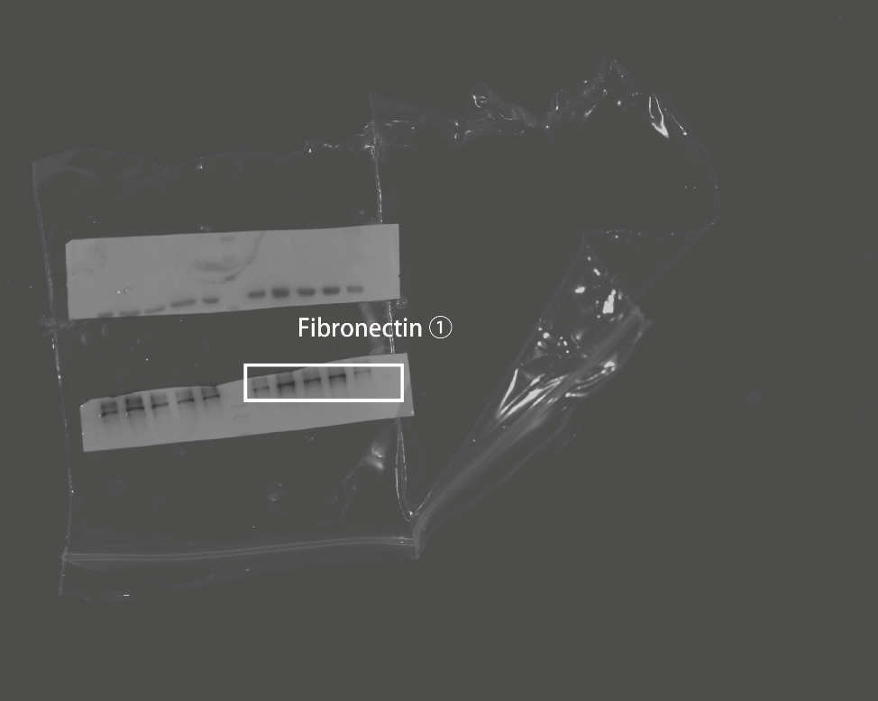
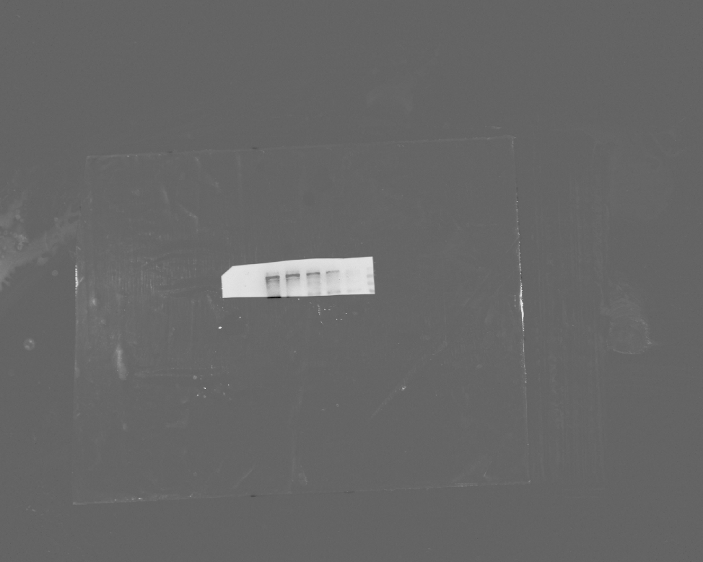
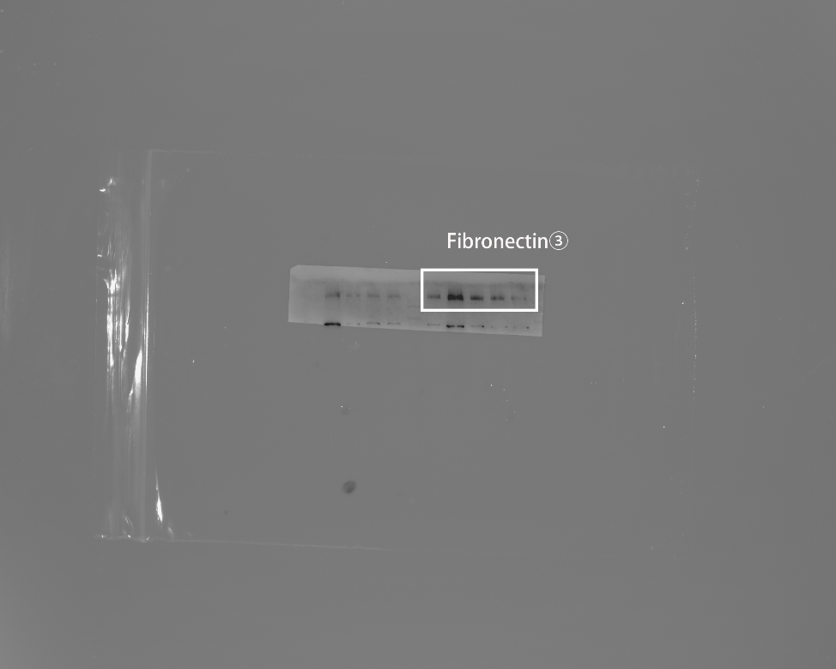
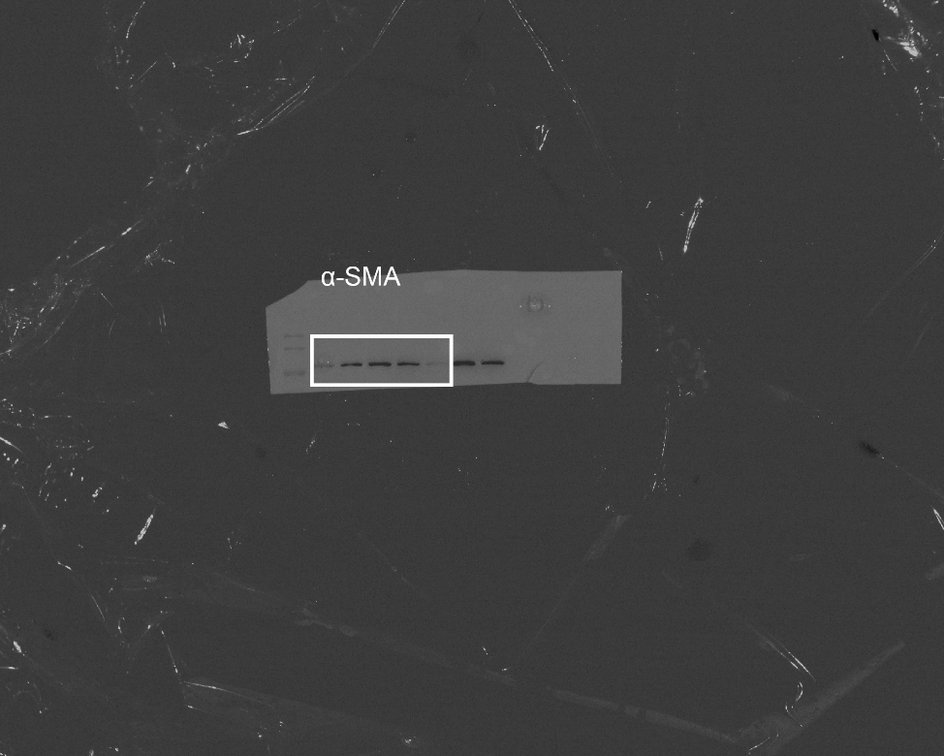
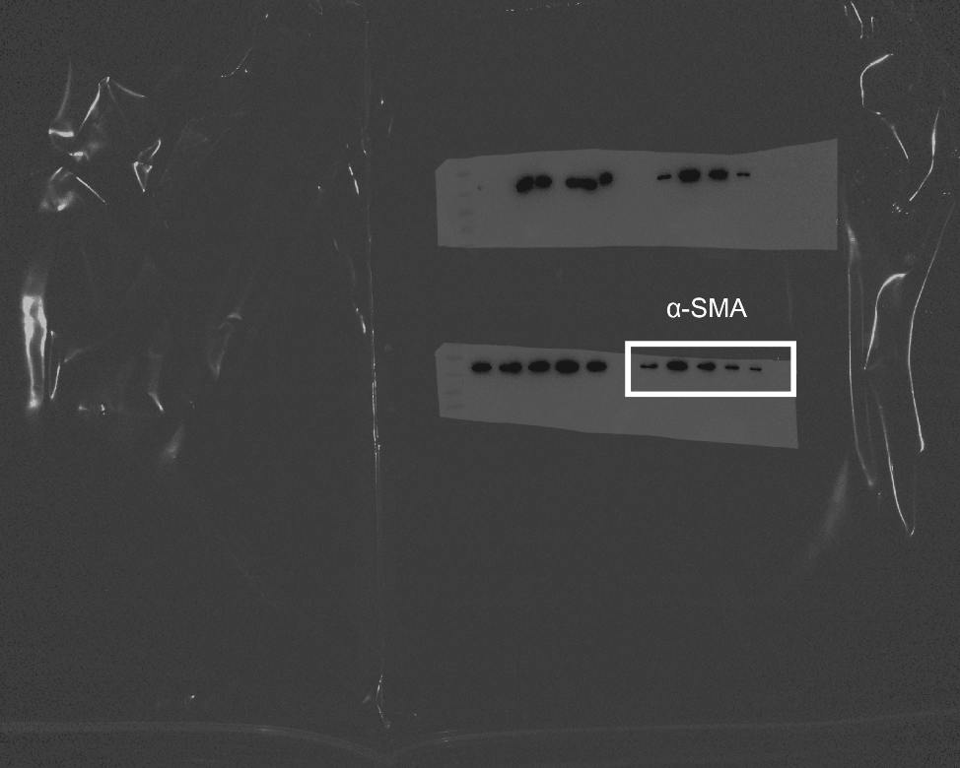
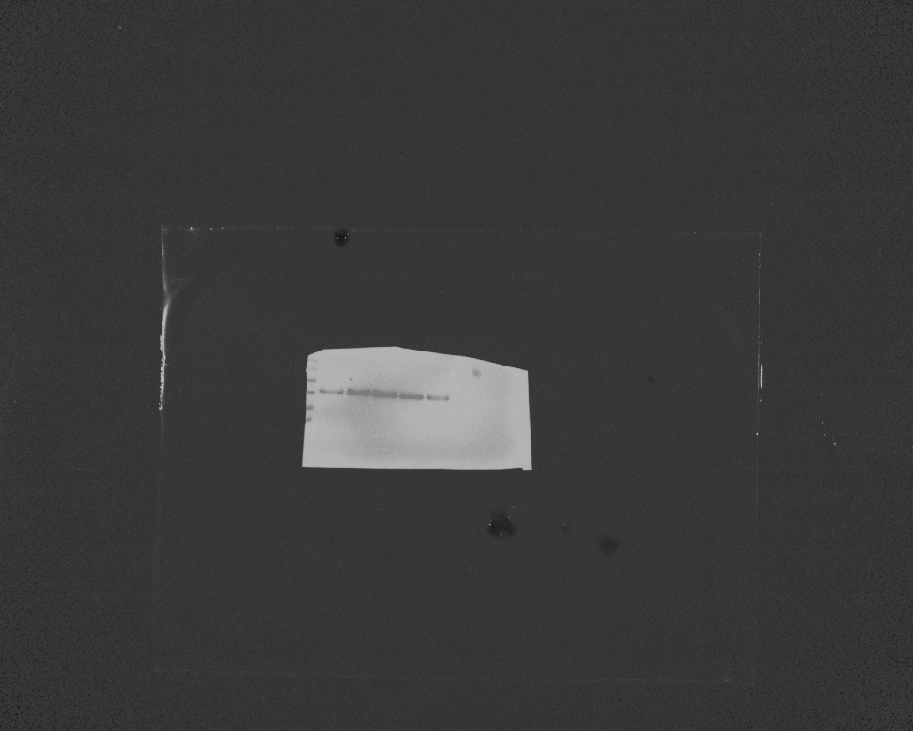
Figure 3C.
Sequence of protein bands from western blot:
1: Primary lung fibroblasts treated with vehicle;
2: Primary lung fibroblasts treated with TGF-β;
3: Primary lung fibroblasts treated with TGF-β+ACPA (10 μM);
4：Primary lung fibroblasts treated with TGF-β+ACPA (30 μM);
5：Primary lung fibroblasts treated with TGF-β+ACPA (100 μM).
Sample ①
Sample ②
Sample ③
Fibronectin
1 2 3 4 5
1 2 3 4 5
1 2 3 4 5
α-SMA
1 2 3 4 5
1 2 3 4 5
1 2 3 4 5

Slide 2
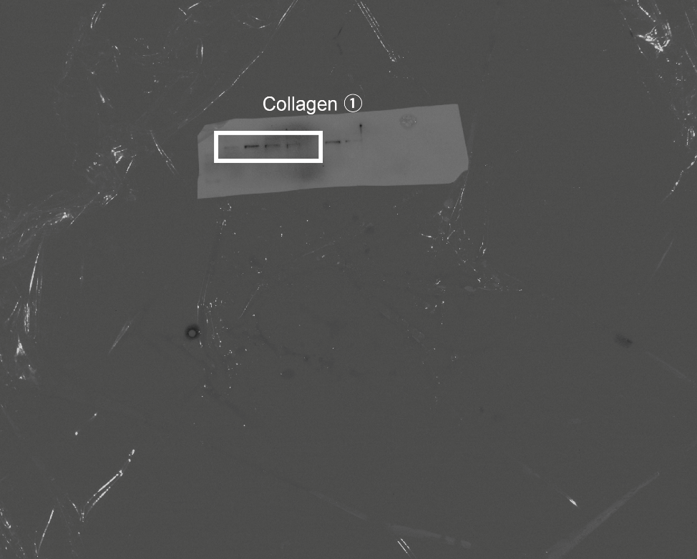
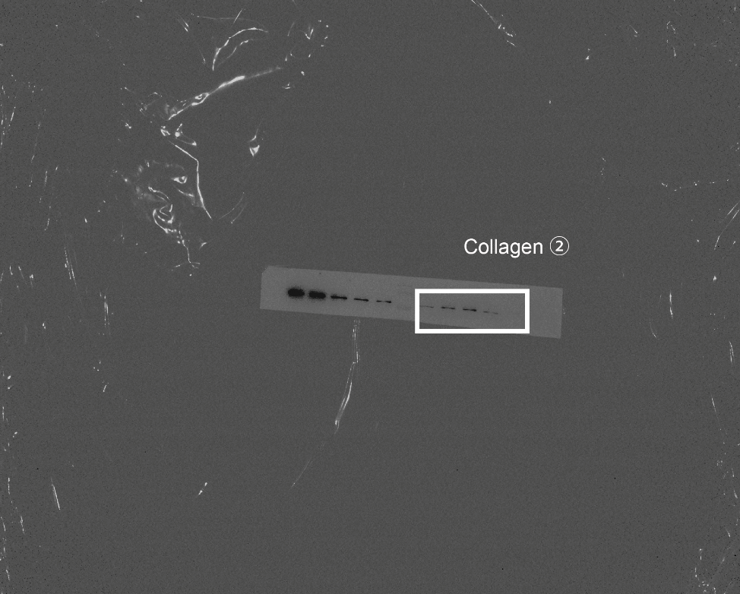
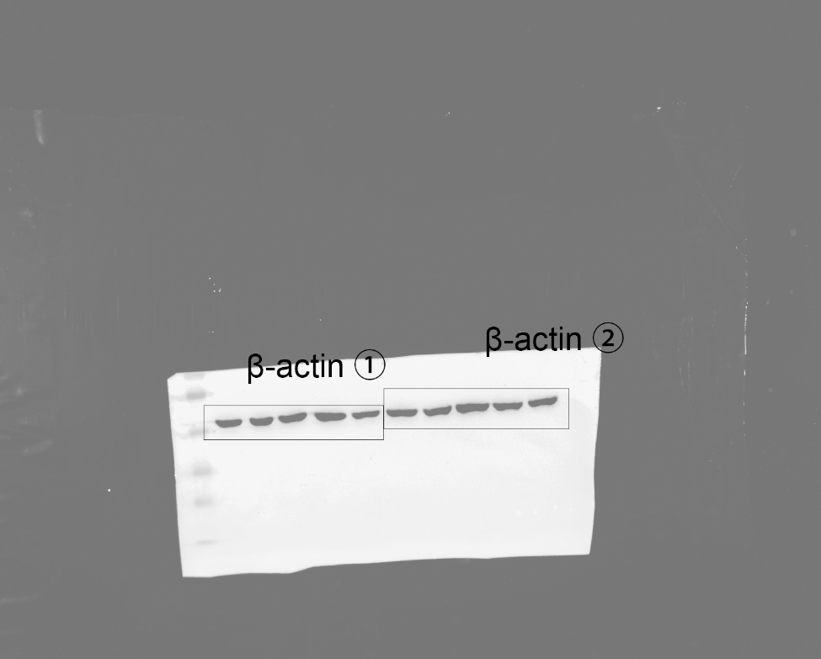

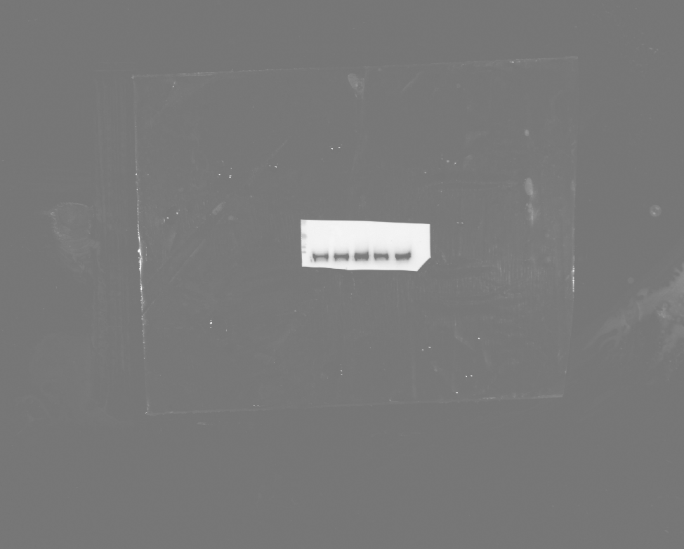
Figure 3C.
Sample ①
Sample ②
Sample ③
Collagen
β-actin

