Slide 1
Human metabolism of the semi-synthetic cannabinoids hexahydrocannabinol, hexahydrocannabiphorol and their acetates using hepatocytes and urine samples
Supplementary Information 5:
Mass Spectra and Chromatograms for HHC in Non-Hydrolysed Urine Samples
Karin Lindbom^{1,=}, Caitlyn Norman^{1,=}, Steven Baginski², Lucas Krebs³, Darta Stalberga¹, Tobias Rautio⁴, Xiongyu Wu⁴, Robert Kronstrand^{1,5}, and Henrik Green^{1,5*}
¹ Division of Clinical Chemistry and Pharmacology, Department of Biomedical and Clinical Sciences, Linköping University, Linköping, Sweden
² Leverhulme Research Centre for Forensic Science, School of Science and Engineering, University of Dundee, Dundee, UK
³ Institute for Chemistry and Bioanalytics, School of Life Sciences, University of Applied Sciences Northwestern Switzerland, Muttenz, Switzerland
⁴ Department of Physics, Chemistry and Biology, Linköping university, Linköping, Sweden.
⁵ Department of Forensic Genetics and Forensic Toxicology, National Board of Forensic Medicine, Linköping, Sweden
* Corresponding author: henrik.green@liu.se
⁼ These authors contributed equally to this work.

Slide 2
Overlaid Chromatogram
x10
5
4.880
7.5
3.440
7
6.5
6
5.5
4.001
4.528
5
5.325
4.5
Abundance (au)
4
3.907
3.5
3.203
3
3.506
2.5
6.681
2
4.784
6.920
7.259
1.5
3.583
3.820
4.134
4.392
1
3.753
4.296
4.631
5.143
7.633
0.5
0
3.1
3.2
3.3
3.4
3.5
3.6
3.7
3.8
3.9
4
4.1
4.2
4.3
4.4
4.5
4.6
4.7
4.8
4.9
5
5.1
5.2
5.3
5.4
5.5
5.6
5.7
5.8
5.9
6
6.1
6.2
6.3
6.4
6.5
6.6
6.7
6.8
6.9
7
7.1
7.2
7.3
7.4
7.5
7.6
7.7
7.8
7.9
8
Time (min)

Slide 3
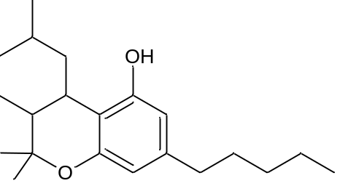
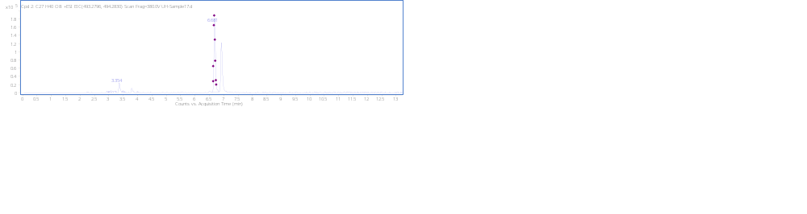
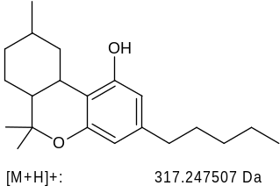
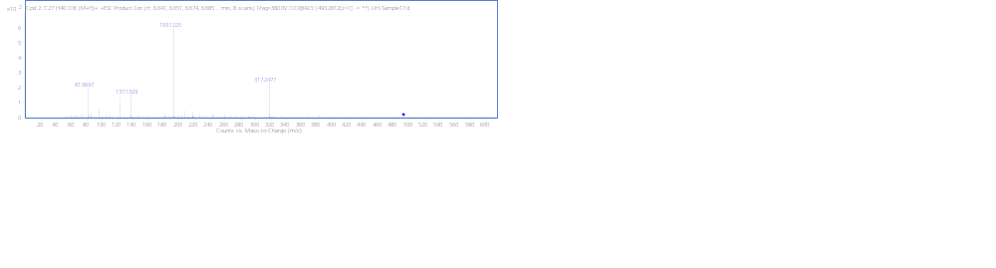
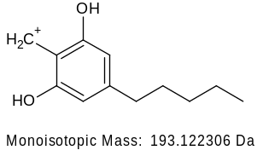
HHC+GLUC N1_{A} RT 6.68min
+GLUC
[M + H]⁺ (m/z)
Formula
493.2803
C₂₇H₄₀O₈

Slide 4
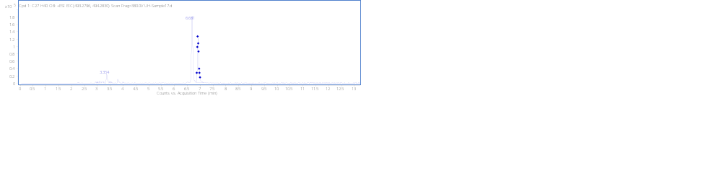
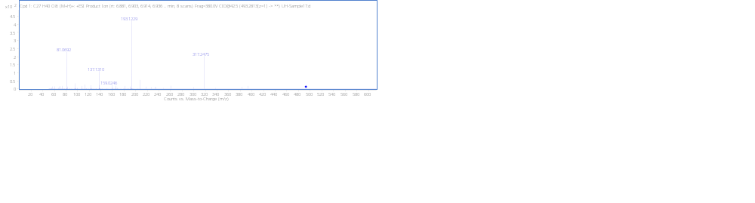
HHC+GLUC N1_{B} 6.91min
+GLUC
[M + H]⁺ (m/z)
Formula
493.2803
C₂₇H₄₀O₈

Slide 5
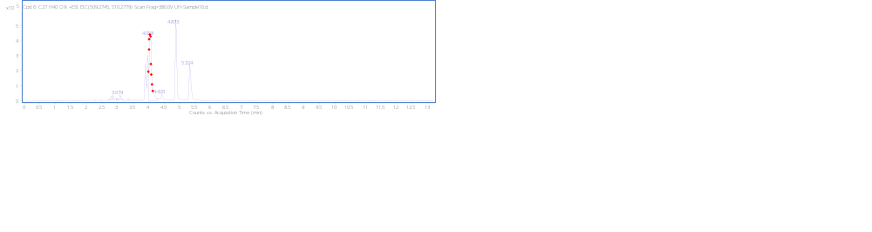
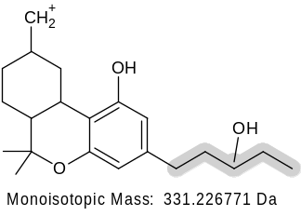
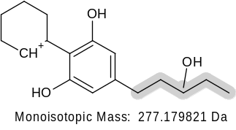
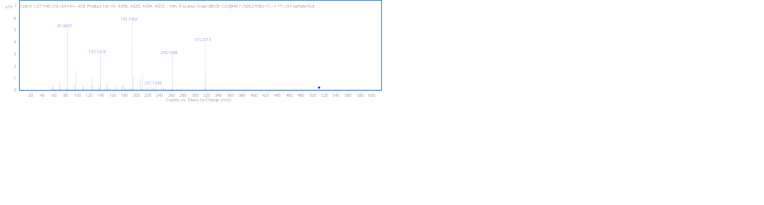
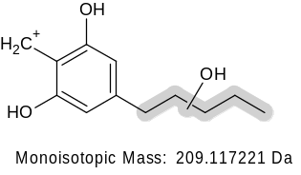
MonoOH (Tail) +GLUC N2 4.06 min
O
H
+GLUC
O
H
O
[M + H]⁺ (m/z)
Formula
509.2750
C₂₇H₄₀O₉
(not detected)
-H₂O
315.2319
(not detected)
-H₂O
259.1693
(not detected)
-H₂O
191.1067

Slide 6
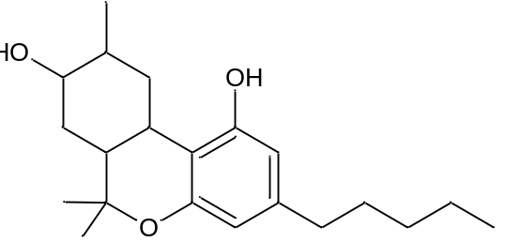
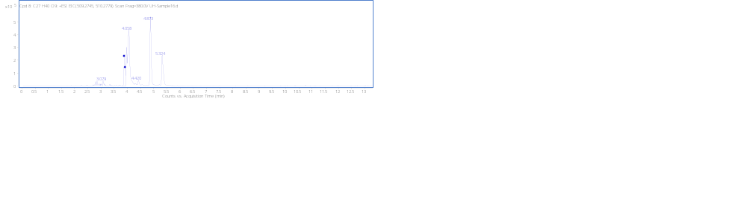
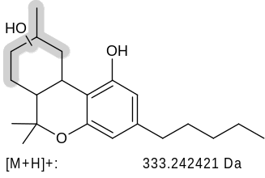
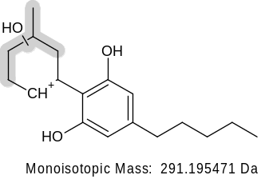
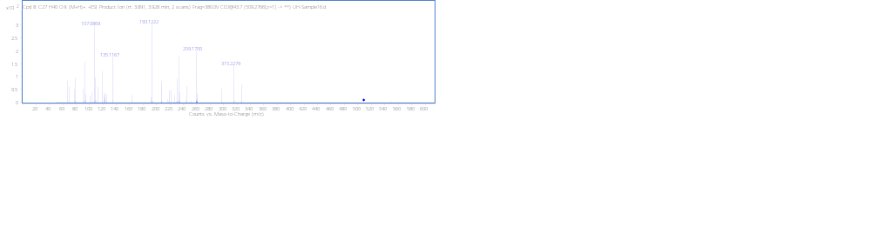
MonoOH (8) +GLUC N3_{A} 3.90min
+GLUC
[M + H]⁺ (m/z)
Formula
509.2747
C₂₇H₄₀O₉
(not detected)
315.2319
-H₂O
(not detected)
-H₂O
259.1693

Slide 7
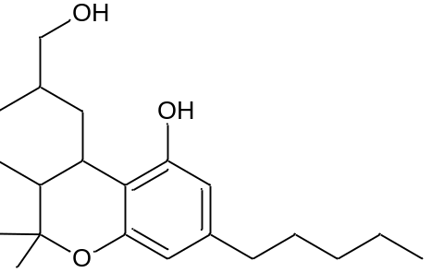
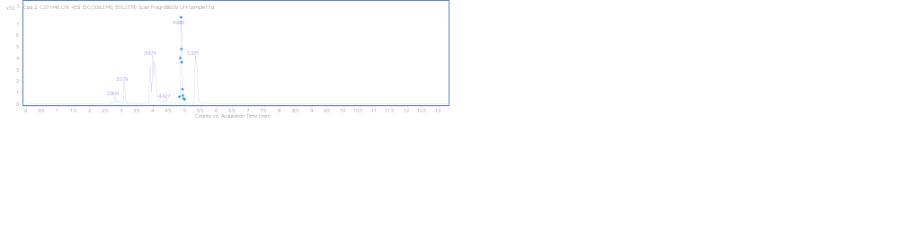
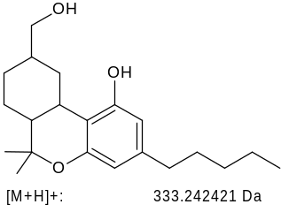
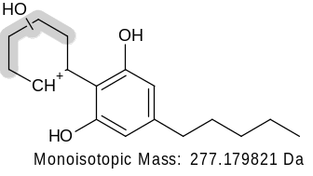
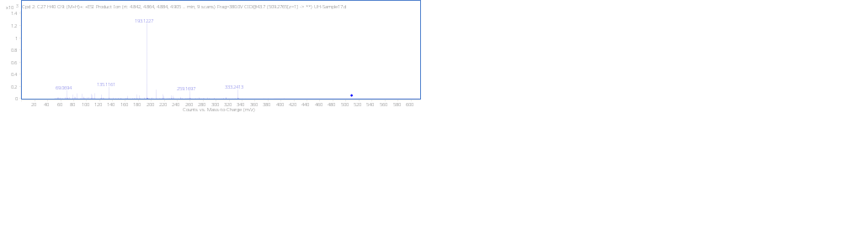
MonoOH (11) +GLUC N3_{B} 4.88 min
+GLUC
[M + H]⁺ (m/z)
Formula
509.2753
C₂₇H₄₀O₉
(not detected)
-H₂O
259.1693

Slide 8
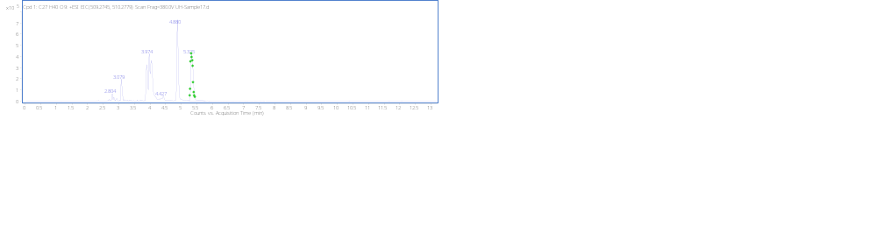
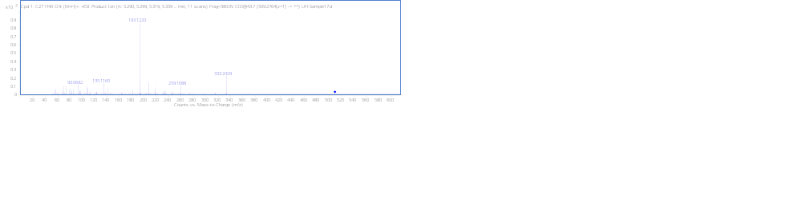
MonoOH (11) +GLUC N3_{C} RT 5.35min
+GLUC
[M + H]⁺ (m/z)
Formula
509.2750
C₂₇H₄₀O₉
(not detected)
-H₂O
259.1693

Slide 9
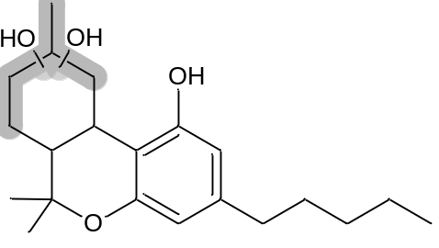
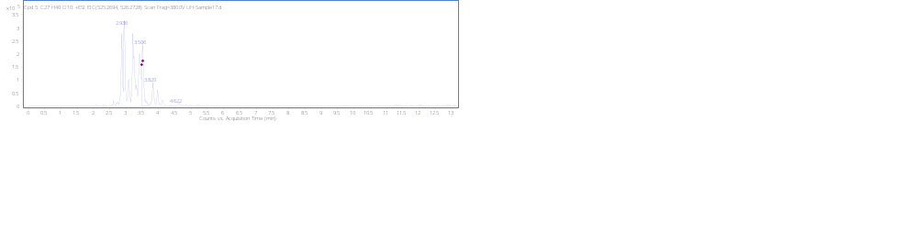
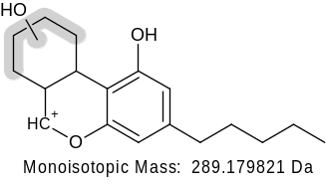
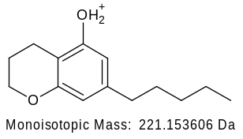
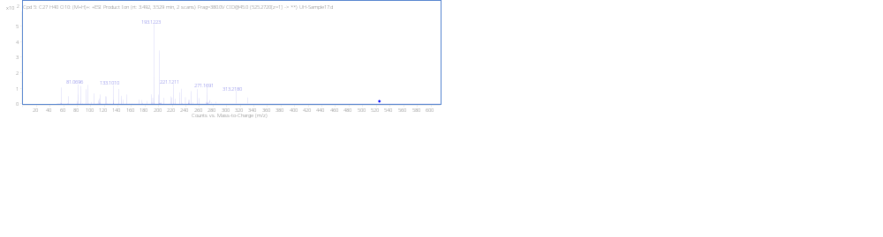
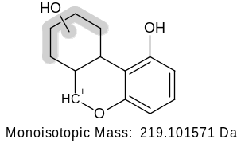
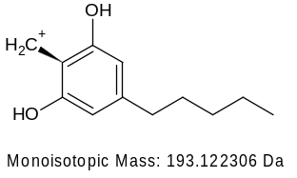
DiOH+GLUC N4_{A} RT 3.51min
+GLUC
[M + H]⁺ (m/z)
Formula
525.2703
C₂₇H₄₀O₁₀
(not detected)
-H₂O
271.1693
201.0906
(not detected)
-H₂O
201.0910

Slide 10
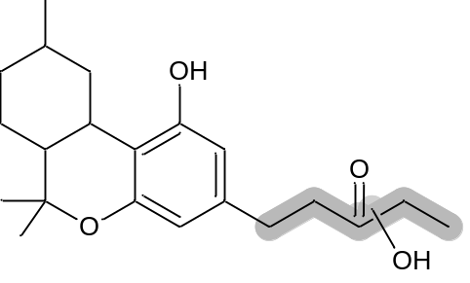
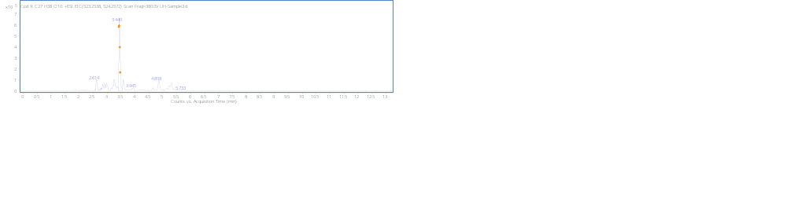
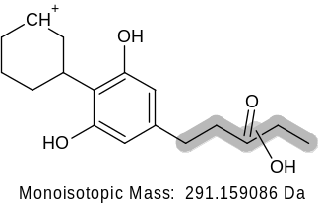
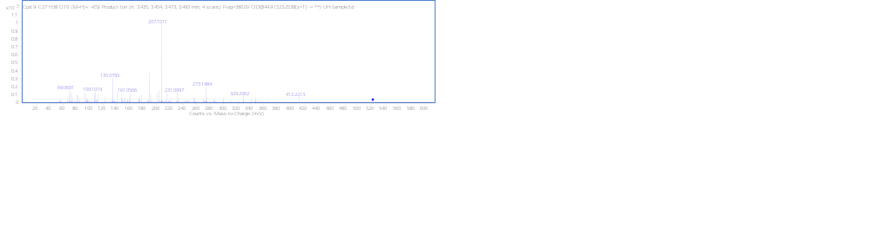
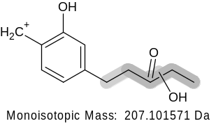
Dehyd+DiOH+GLUC N5_{A} RT3.44 min
+GLUC
[M + H]⁺ (m/z)
Formula
523.2535
C₂₇H₃₈O₁₀
(not detected)
-H₂O
273.1485

Slide 11

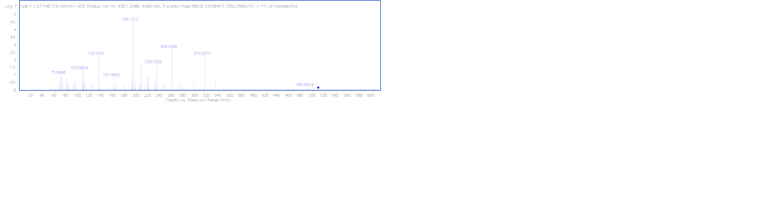
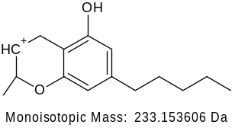
MonoOH (8) +GLUC N3_{D} RT3.98 min
+GLUC
[M + H]⁺ (m/z)
Formula
509.2752
C₂₇H₄₀O₉
315.2319
(not detected)
-H₂O
(not detected)
-H₂O
259.1693

Slide 12
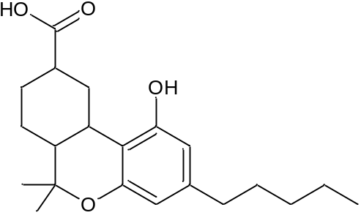
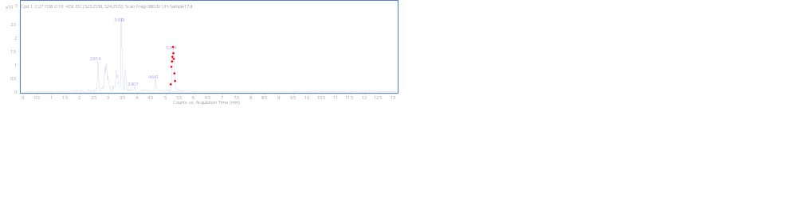
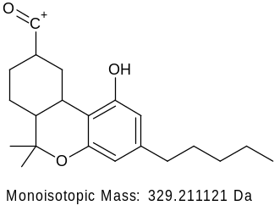
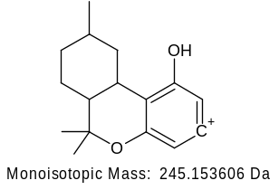
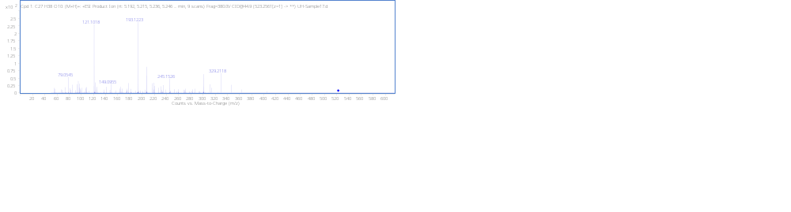
Carboxylic acid +GLUC N6 RT 5.27min
+GLUC
[M + H]⁺ (m/z)
Formula
523.2541
C₂₇H₃₈O₁₀

Slide 13
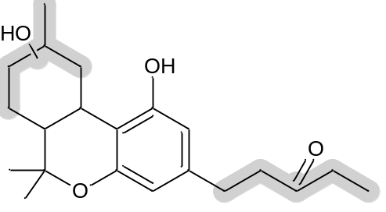
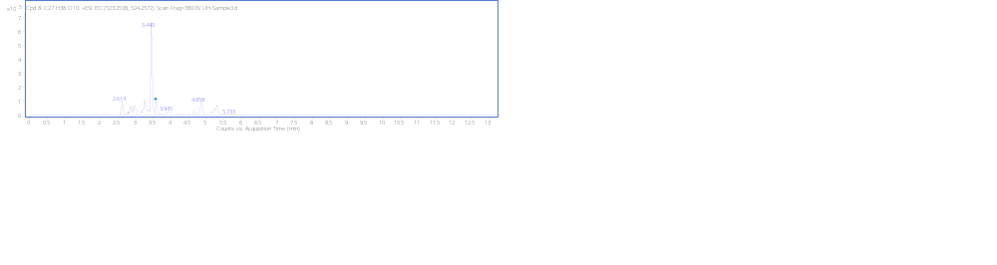
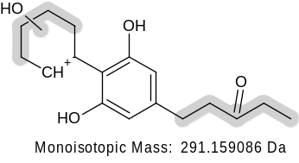
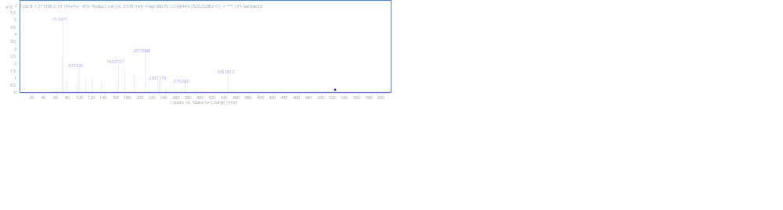
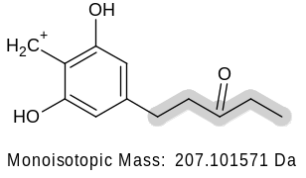
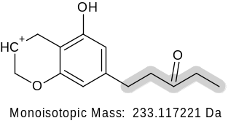
Dehyd+DiOH+GLUC N5_{B} RT 3.59min
+GLUC
[M + H]⁺ (m/z)
Formula
523.2533
C₂₇H₃₈O₁₀
(not detected)
273.1485
-H₂O

Slide 14
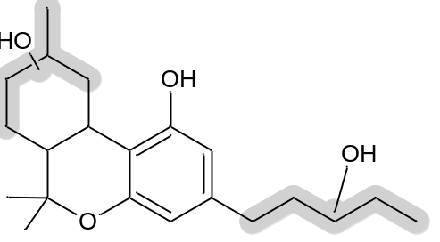



DiOH+GLUC N4_{B} RT 3.42min
+GLUC
[M + H]⁺ (m/z)
Formula
525.2700
C₂₇H₄₀O₁₀
(not detected)
-H₂O
275.1642
257.1536
-H₂O
(not detected)
-H₂O
191.1067

Slide 15




DiOH+GLUC N4_{C} RT 3.20min
+GLUC
[M + H]⁺ (m/z)
Formula
525.2700
C₂₇H₄₀O₁₀
(not detected)
-H₂O
331.2268
(not detected)
-H₂O
275.1642
257.1536
(not detected)
-H₂O
(not detected)
-H₂O
215.1067
(not detected)
-H₂O
191.1067

Slide 16



Carboxylic acid (9R) N7_{A} RT 7.27min
[M + H]⁺ (m/z)
Formula
347.2220
C₂₁H₃₀O₄

Slide 17




Dehyd+DiOH+GLUC N5_{C} RT 4.86 min
+GLUC
[M + H]⁺ (m/z)
Formula
523.2533
C₂₇H₃₈O₁₀
(not detected)
-H₂O
259.1693
207.1025
259.1671

Slide 18


DiOH RT N8_{A} 4.00min
[M + H]⁺ (m/z)
Formula
349.2380
C₂₁H₃₂O₄
(not detected)
-H₂O
275.1642
257.1536
(not detected)
-H₂O
(not detected)
-H₂O
215.1067
(not detected)
-H₂O
191.1067

Slide 19





Dehyd+DiOH N9 RT 4.53min
[M + H]⁺ (m/z)
Formula
347.2222
C₂₁H₃₀O₄
(not detected)
-H₂O
273.1485
-H₂O
189.0908
189.0910

Slide 20


DiOH N8_{B} RT 4.40min
[M + H]⁺ (m/z)
Formula
349.2384
C₂₁H₃₂O₄
(not detected)
-H₂O
275.1642
(not detected)
-H₂O
191.1067

Slide 21


DiOH N8_{C} RT 4.13min
[M + H]⁺ (m/z)
Formula
349.2378
C₂₁H₃₂O₄
(not detected)
-H₂O
331.2268
(not detected)
-H₂O
275.1642
257.1536
(not detected)
-H₂O
(not detected)
-H₂O
191.1067

Slide 22




Carboxylic acid (9S) N7_{B} RT 7.60min
[M + H]⁺ (m/z)
Formula
347.2223
C₂₁H₃₀O₄
(not detected)
-H₂O
259.1693

Slide 23



MonoOH (11) N10 RT 7.63min
[M + H]⁺ (m/z)
Formula
333.2430
C₂₁H₃₂O₃

