Slide 1
Table S1. Primers used for RT-PCR
Gene |  | Sequence | Reference
PT1 | Forward | GCTGCTATACTTGCTGGGATTA | (Page & Boubakir, 2012)
 | Reverse | CGAGTCTGGAGGATTAACCAAA
PT4 | Forward | CCATATCGAGTCATGTGGGCT
 | Reverse | GCAATAGTCATACCCATAACTGTCATG
THCAS | Forward | CAGCAATTCCATTCCCTCAT | (Onofri et al., 2015)
 | Reverse | TTAGGACTCGCATGATTAGTTTTTC
CBDAS | Forward | CAGCAATTCCATTCCCTCAT | (Onofri et al., 2015)
 | Reverse | ATCCAGTTTAGATGCTTTTCGT
CBCAS | Forward | CGGATGTACTGTTATGCTCCAA | (Laverty et al., 2019)
 | Reverse | CATTCTCCATTAAAATAAGAAAGACAA
OAC | Forward | TCTTCACTAGCGCATCAACC | (Carvalho et al., 2017)
 | Reverse | GAACGGTTCCACCACCATAA
GPPS | Forward | AGTTCACGAGGCCATGTACA | (Booth et al., 2017)
 | Reverse | AAGGGAGGTGGTCATGAGTG
UBQ | Forward | GCCAGGATGGCAATGAAGTA | (Docimo et al., 2014)
 | Reverse | GCTATAGAGTTGAACTCCACAG

Slide 2
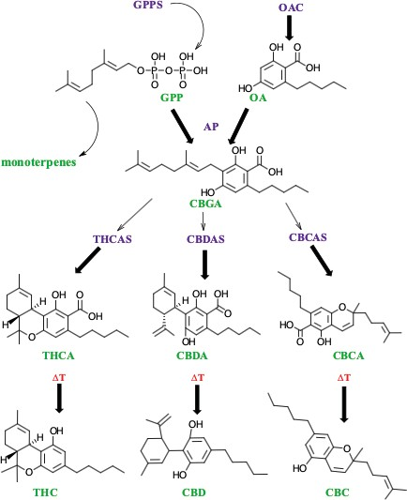
+ TKS
PT
Figure S1. Cannabinoid biosynthetic pathway. Purple inscriptions refer to the enzymes, including geranyl pyrophosphate synthase (GPPS), olivetolic acid cyclase (OAC), aromatic prenyltransferase (PT), tetrahydrocannabinolic acid synthase (THCAS), cannabidiolic acid synthase (CBDAS), and cannabichromenic synthase (CBCAS), that catalyze reactions. Green labels indicate the metabolites. A non-enzymatic conversion, which is expedited in the presence of heat, spurs the generation the decarboxylated cannabinoids: THC, CBD, and CBC. The figure is created using Chemdraw.

Slide 3
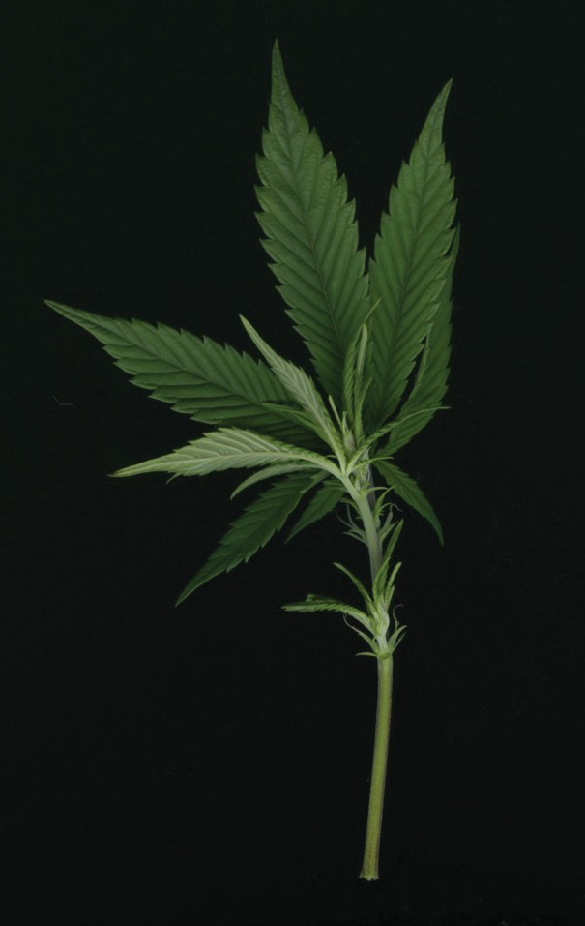
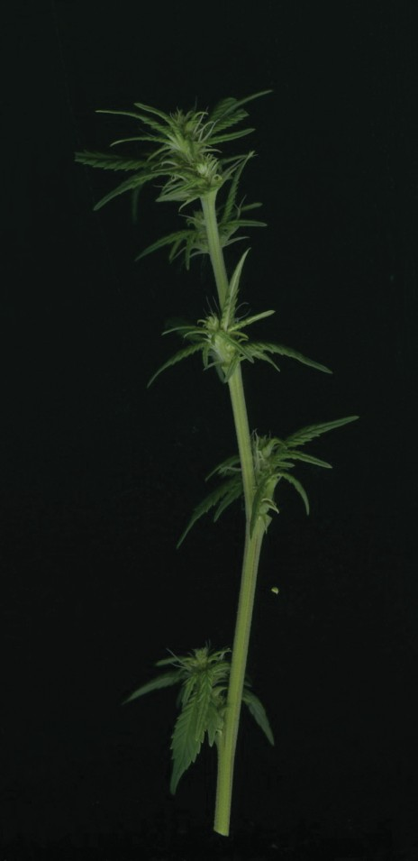
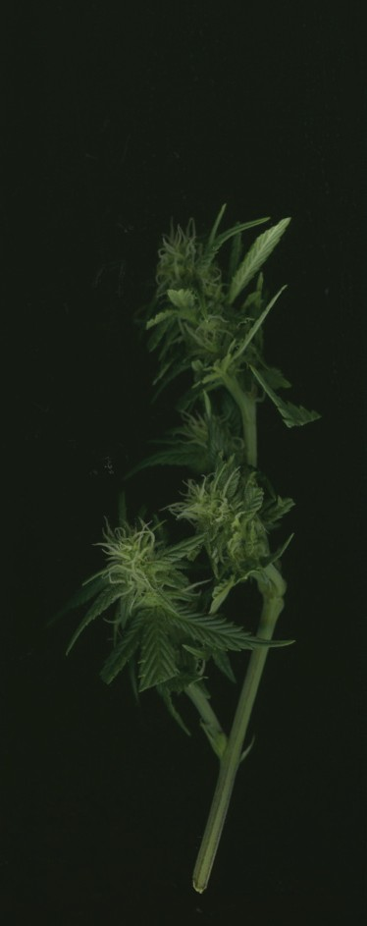
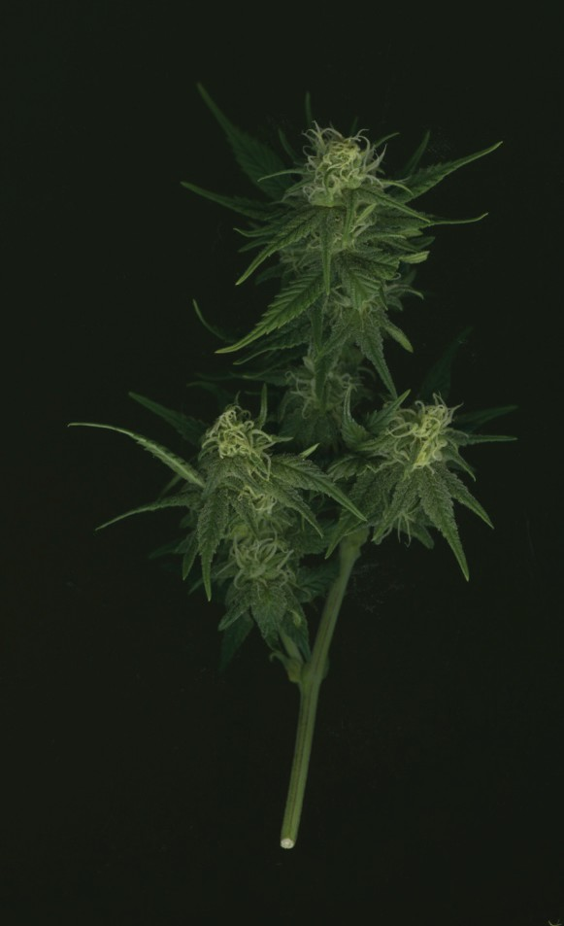
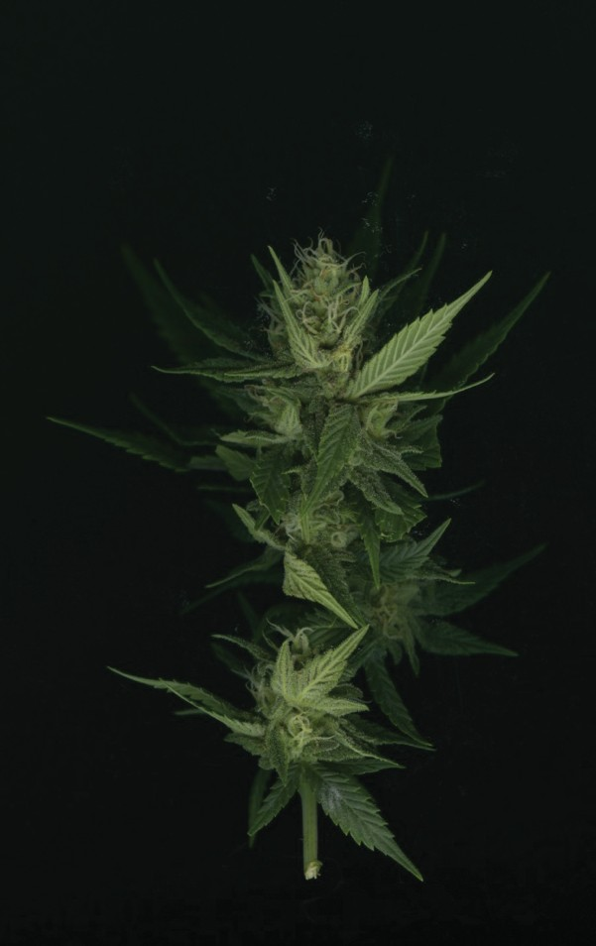
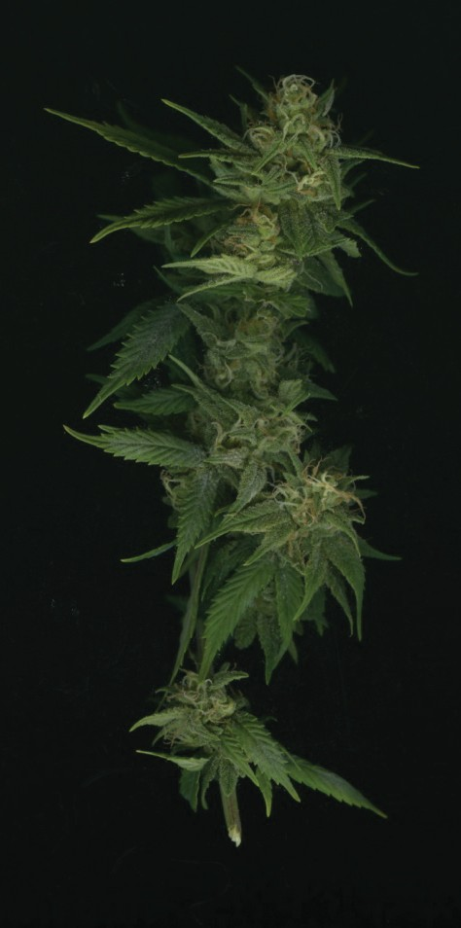
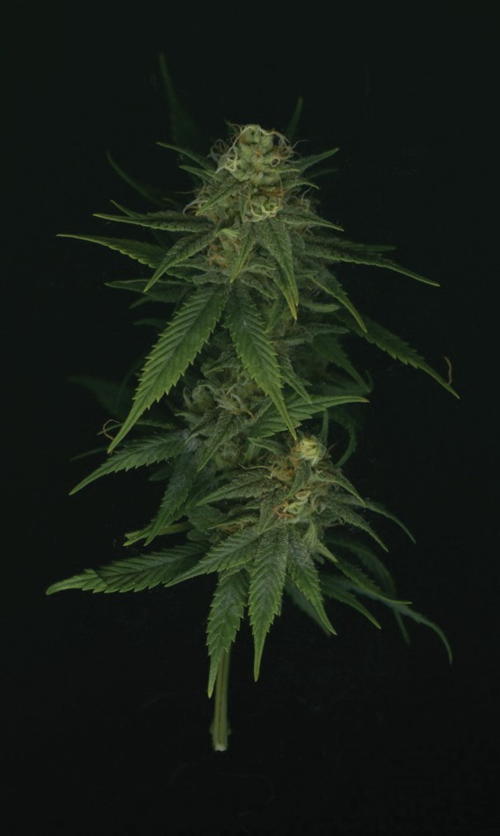
Figure S2. Representative pictures show flower development over a period of 7 weeks in the hemp variety CW. Scale bar is 2 cm. Note that there is barely flower tissue developed one week after transition to the short day condition.

Slide 4
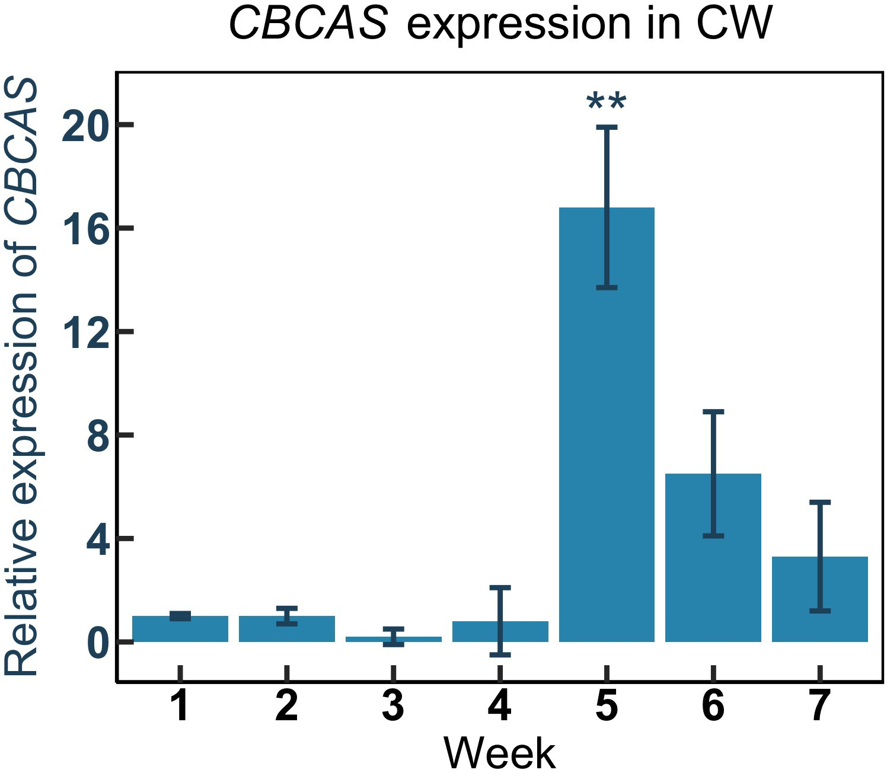
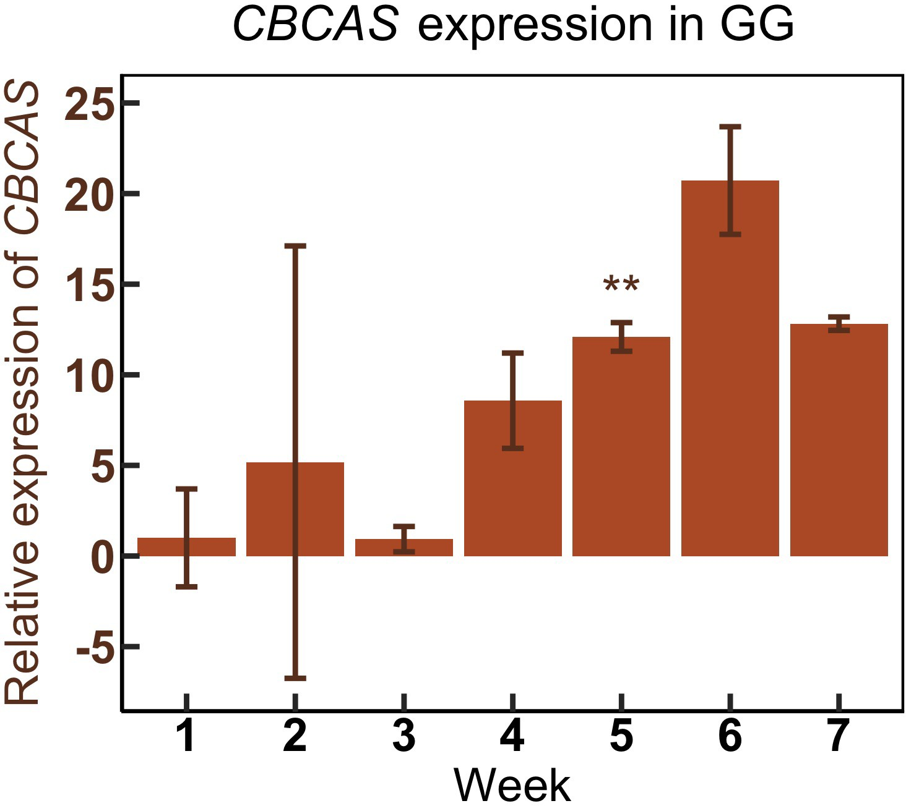
A
B
Figure S3. Real-time PCR analysis of CBCAS in two C. sativa varieties, CW (A) and GG (B). Data are presented as means ± SE (n = 4). ** indicates P < 0.01.

Slide 5
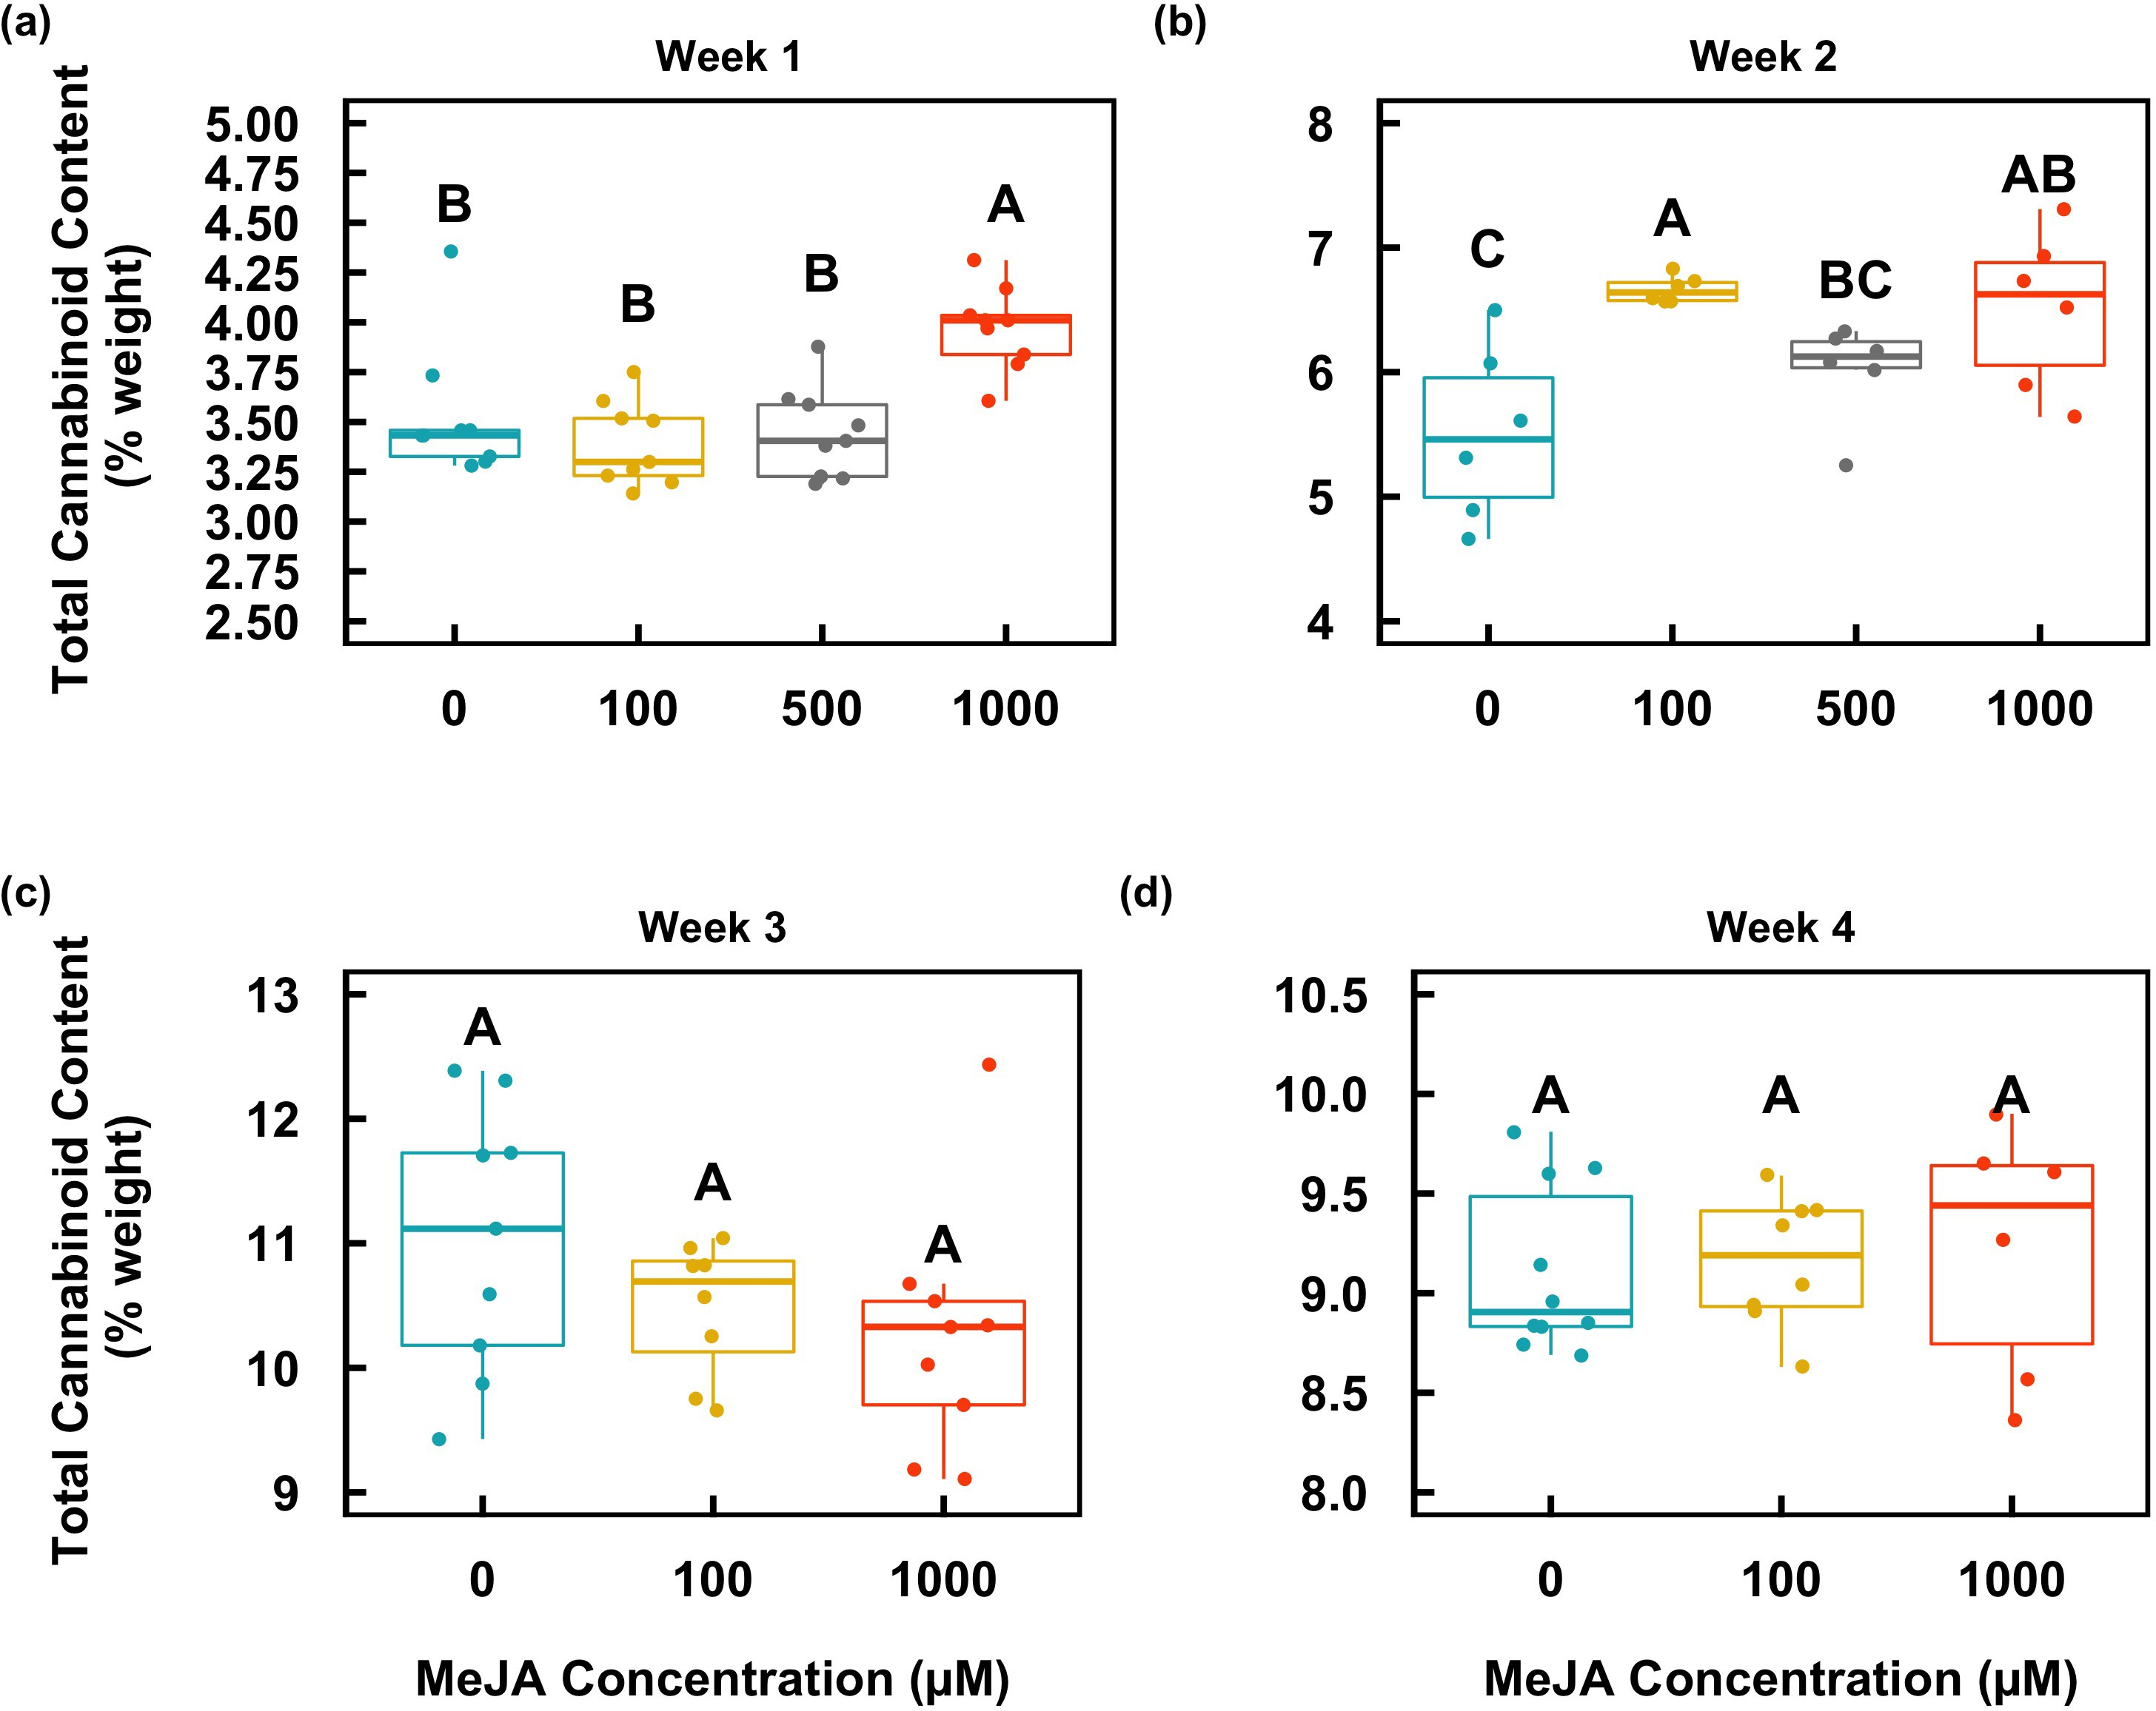
Figure S4. Total cannabinoid content in White Tangy Haze flowers over the period of four weeks (a-d) following application of MeJA. The box whiskers indicate variability outside the upper and lower quartiles (the upper and lower lines of the box) (n = 3). Different letters indicate statistical significance (P < 0.05) determined by one-way ANOVA followed by Fisher’s LSD. Percentage data was arcsin transformed prior to statistical analysis. The untransformed data are presented.

Slide 6
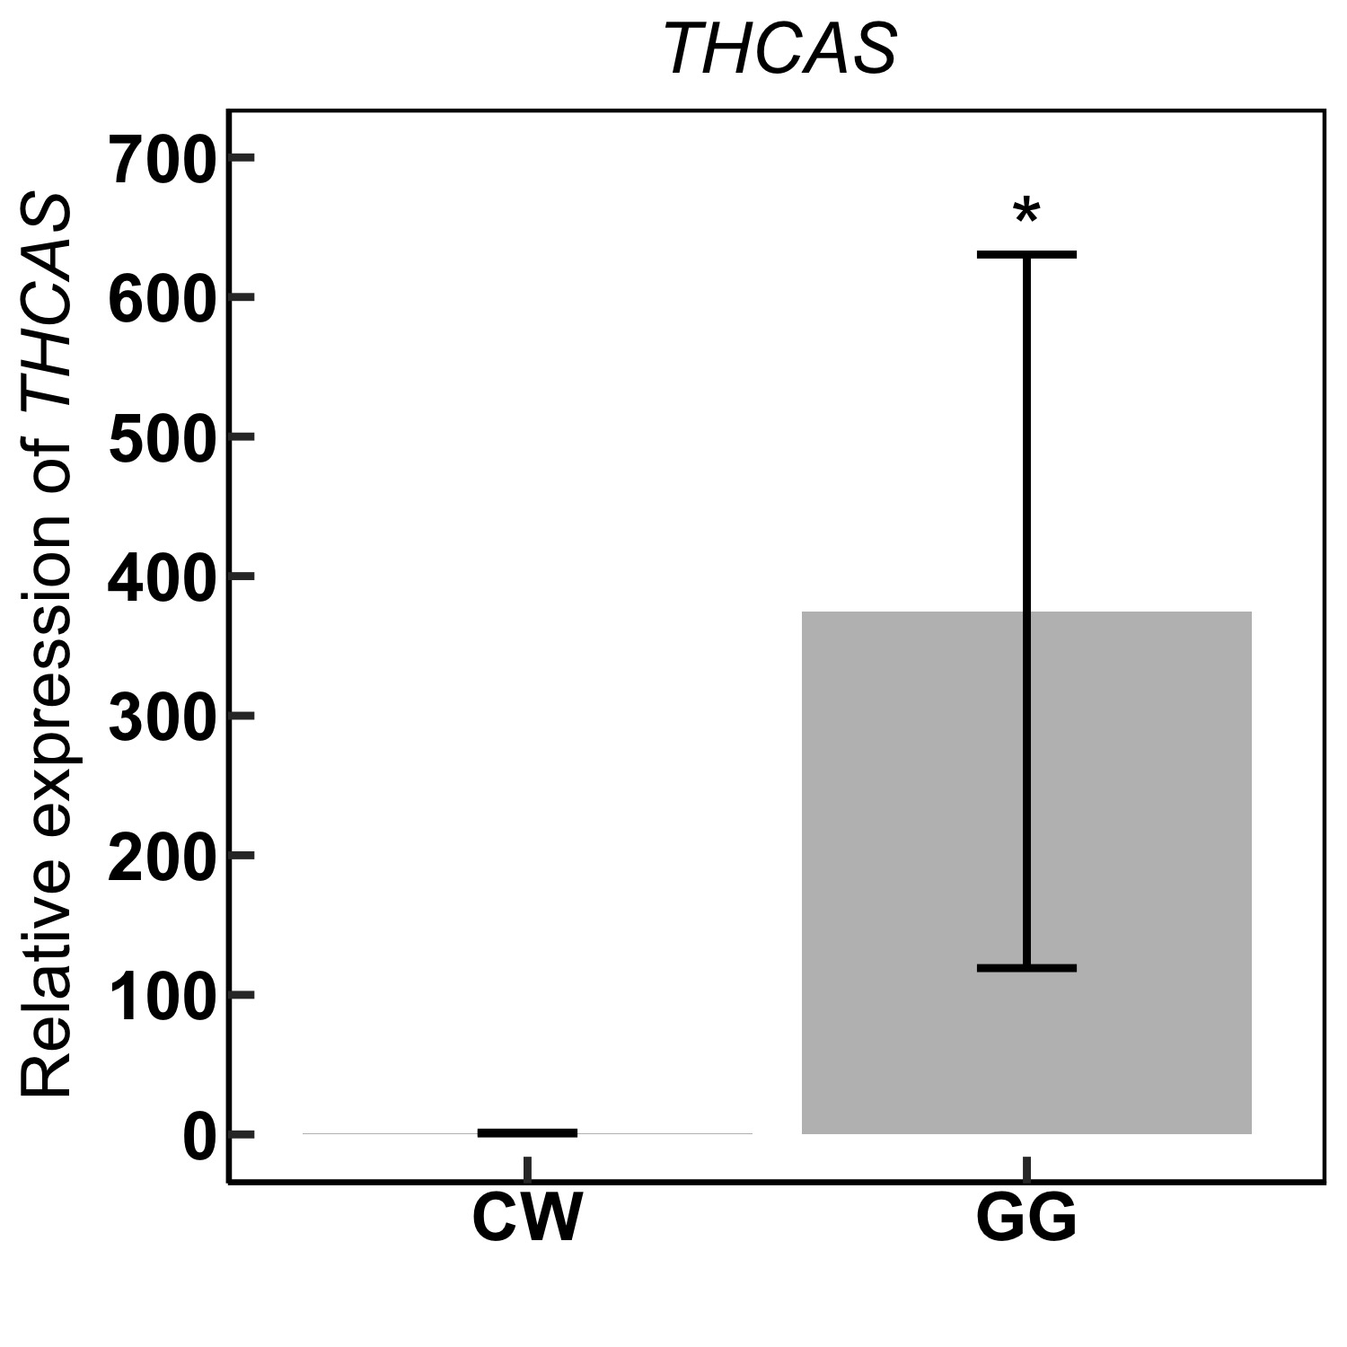
Figure S5. The comparison of THCAS expression in week 1 between CW and GG. THCAS expression is hundreds of folds higher in the medical marijuana variety GG than that in the hemp variety CW. Data are presented as means ± SE (n = 4). * indicates P < 0.05.

