Slide 1
Human metabolism of the semi-synthetic cannabinoids hexahydrocannabinol, hexahydrocannabiphorol and their acetates using hepatocytes and urine samples
Supplementary Information 4:
Mass Spectra and Chromatograms for (9R)-HHCP-O in Human Hepatocytes
Karin Lindbom^{1,=}, Caitlyn Norman^{1,=}, Steven Baginski², Lucas Krebs³, Darta Stalberga¹, Tobias Rautio⁴, Xiongyu Wu⁴, Robert Kronstrand^{1,5}, and Henrik Green^{1,5*}
¹ Division of Clinical Chemistry and Pharmacology, Department of Biomedical and Clinical Sciences, Linköping University, Linköping, Sweden
² Leverhulme Research Centre for Forensic Science, School of Science and Engineering, University of Dundee, Dundee, UK
³ Institute for Chemistry and Bioanalytics, School of Life Sciences, University of Applied Sciences Northwestern Switzerland, Muttenz, Switzerland
⁴ Department of Physics, Chemistry and Biology, Linköping university, Linköping, Sweden.
⁵ Department of Forensic Genetics and Forensic Toxicology, National Board of Forensic Medicine, Linköping, Sweden
* Corresponding author: henrik.green@liu.se
⁼ These authors contributed equally to this work.

Slide 2
Overlaid chromatogram of metabolites from 9R-HHCP-O in human hepatocytes
x10
5
1.5
PO1
1.4
1.3
1.2
1.1
1
0.9
Abundance (au)
PO2
0.8
0.7
0.6
0.5
PO3
(9R-HHCP)
0.4
0.3
0.2
(9R)-HHCP-O
0.1
0
0.5
1
1.5
2
2.5
3
3.5
4
4.5
5
5.5
6
6.5
7
7.5
8
8.5
9
9.5
10
10.5
11
11.5
12
12.5
13
13.5
14
14.5
15
15.5
16
Time (min)

Slide 3
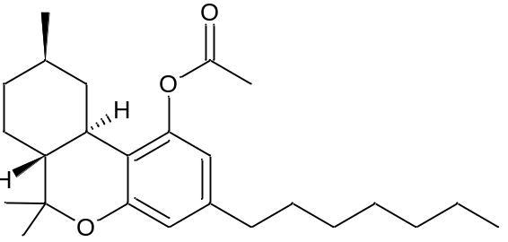
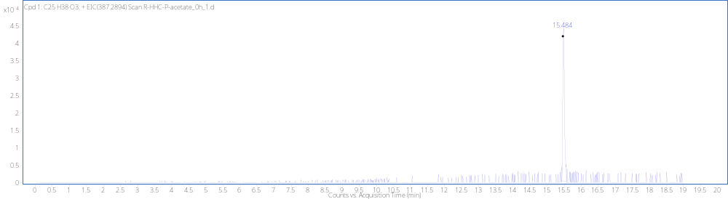
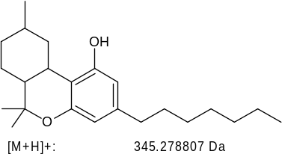
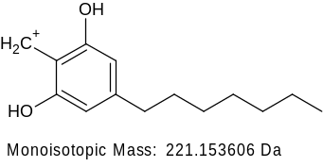
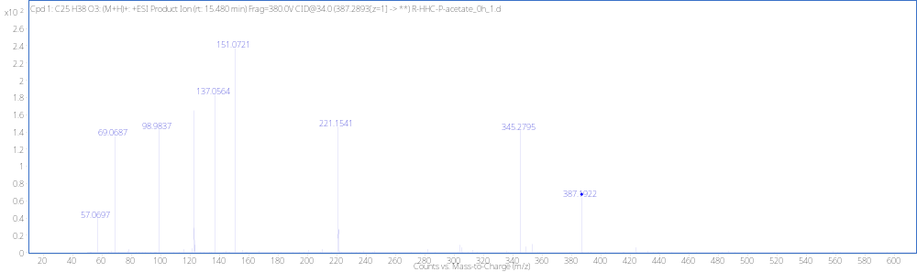
(9R)-HHCP-O RT 15.48
[M + H]⁺ (m/z)
Formula
567.2823
C₂₉H₄₂O₁₁

Slide 4
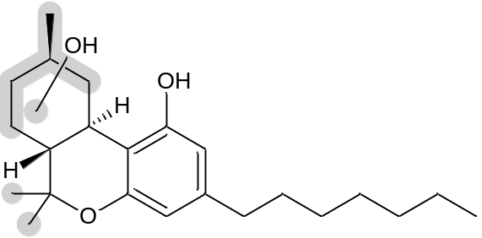
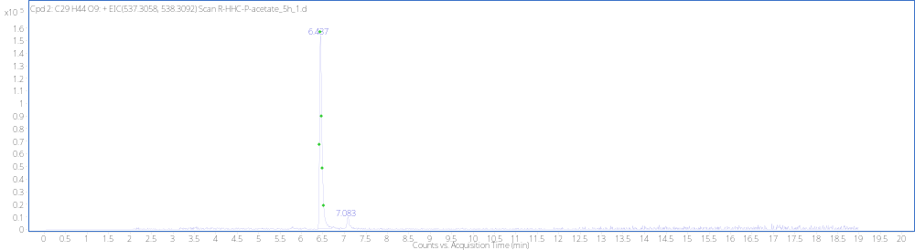
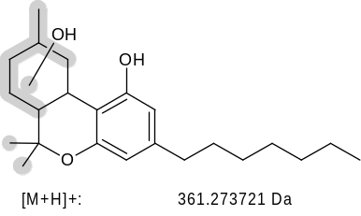
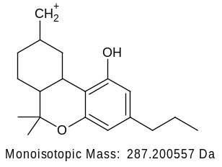
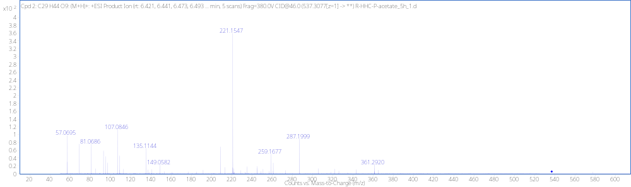
Acetate Loss + MonoOH + GLUC PO1 RT 6.44min
+GLUC
[M + H]⁺ (m/z)
Formula
537.3070
C₂₉H₄₄O₉

Slide 5
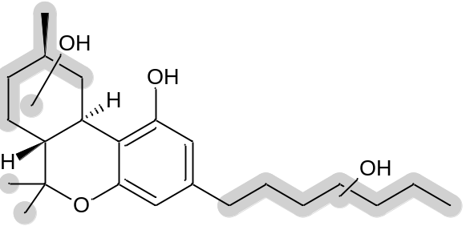
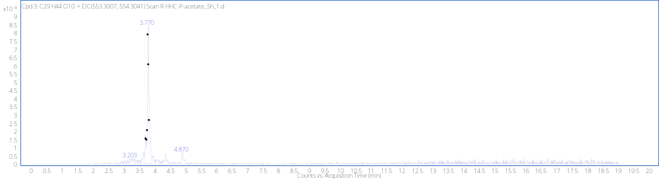
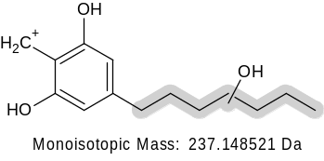
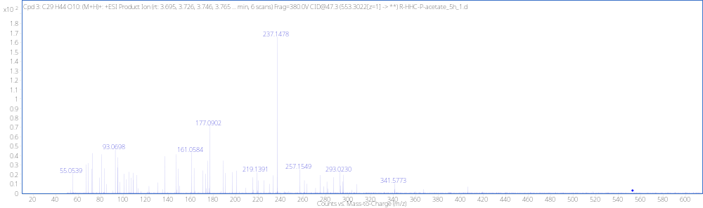
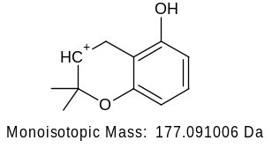
Acetate Loss + DiOH +GLUC PO2 RT 3.76min
+GLUC
[M + H]⁺ (m/z)
Formula
553.3013
C₂₉H₄₄O₁₀
-H₂O
219.1380

Slide 6
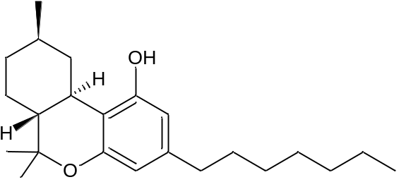
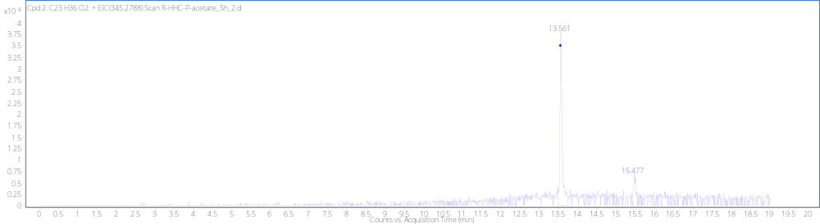
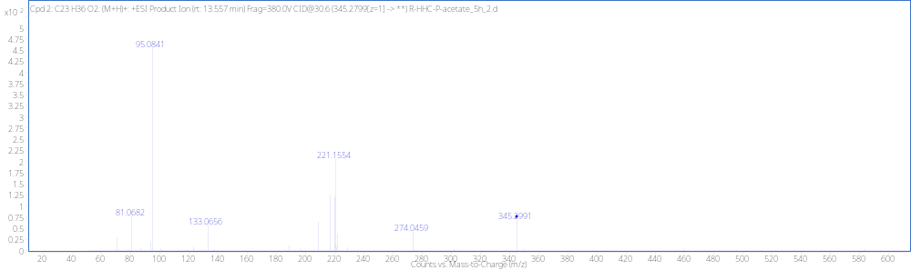
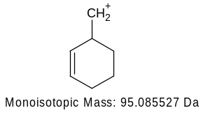
Acetate Loss (9R-HHCP) PO3 RT 13.56
[M + H]⁺ (m/z)
Formula
345.2795
C₂₃H₃₆O₂

Slide 7
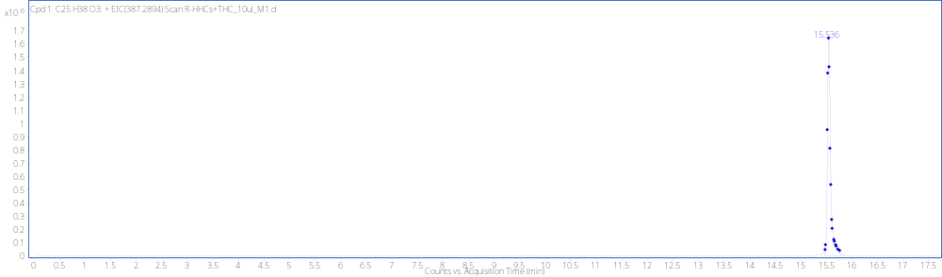
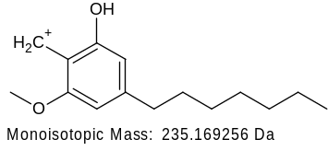
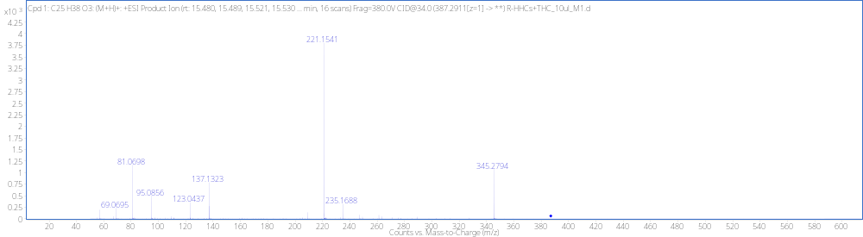
R-HHCP-O Reference Standard RT 15.54min
[M + H]⁺ (m/z)
Formula
567.2894
C₂₉H₄₂O₁₁

Slide 8
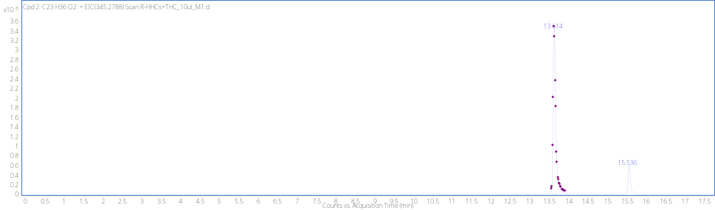
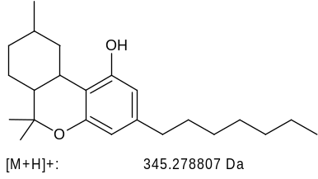
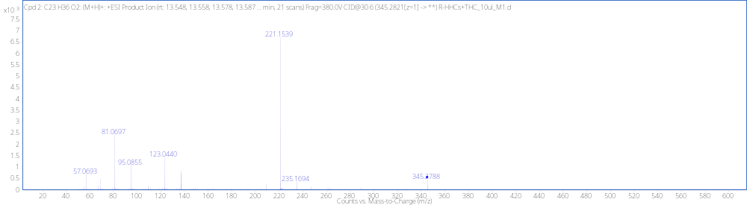
(9R)-HHCP Reference Standard RT 13.61min
[M + H]⁺ (m/z)
Formula
345.2788
C₂₃H₃₆O₂

