Slide 1
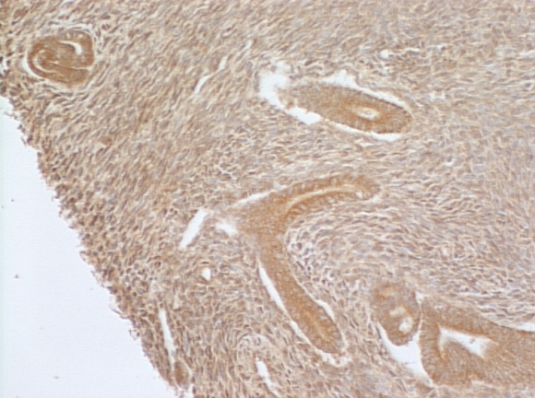
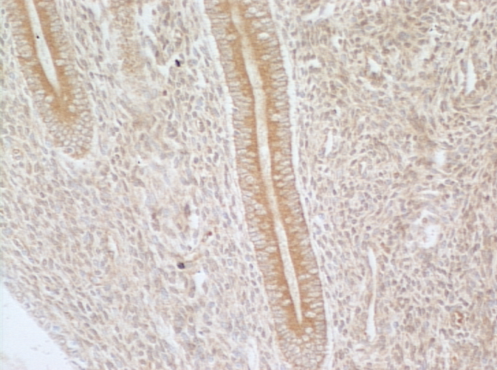
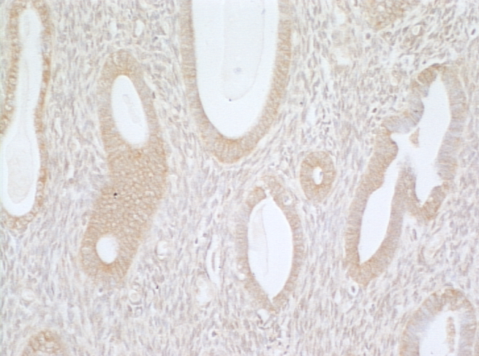
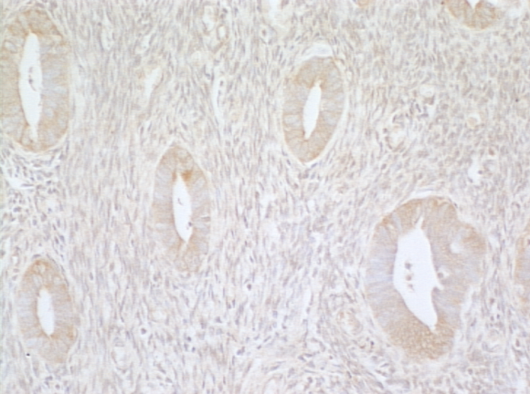
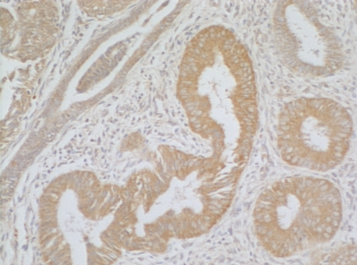
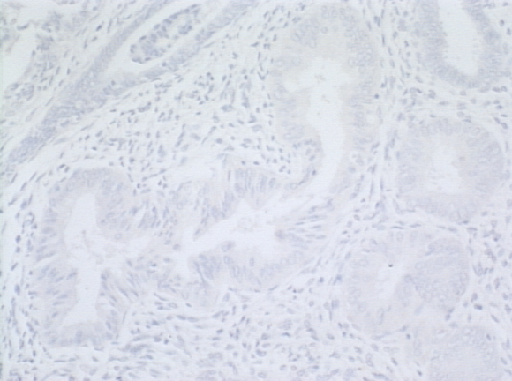
Ayakannu et al. Supplemental figure 1
a
Optimal dilution
s
g
1:1000
1:2000
1:3000
1:4000
b
Antibody specificity
FAAH
Rabbit serum

Slide 2
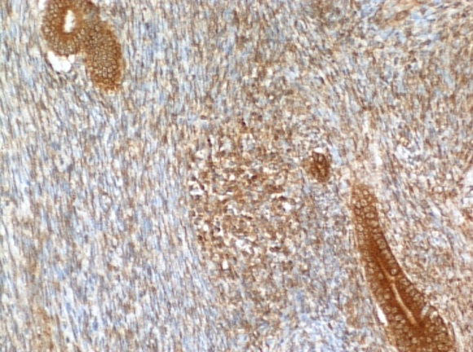
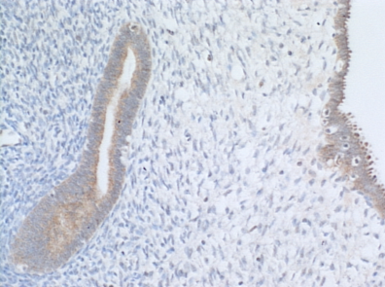
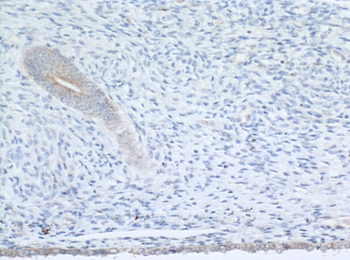
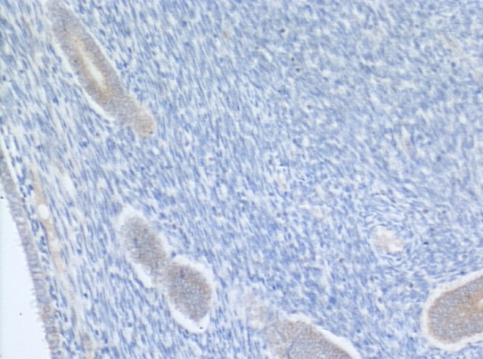
Ayakannu et al. Supplemental figure 2
a
Optimal dilution
s
g
1:25
1:50
1:100
1:200
b
Antibody specificity
NAPE-PLD
Rabbit IgG

