Slide 1
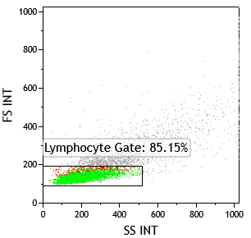
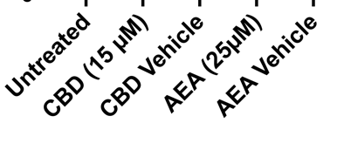
Supplementary Figure S1
A
Untreated
CBD (15µM)
CBD Vehicle
Gating Strategy
Forward Scatter
IL-17A Brilliant Violet 421
B
HC
RA
SLE
PsA
IFN-γ (%)
HC
RA
SLE
PsA
C
TNF-α (%)
(A) Representative example of flow cytometry analysis of Th17 cells. (B) IFNg and (C) TNFa expression in CD4+ T cells from the peripheral blood of healthy controls or from patients with RA, SLE or PsA. *p<0.05, **p<0.01, ***p<0.001,****p<0.0001; data is presented as mean±SEM; significant differences were determined using the unpaired Mann Whitney test.

