Slide 1
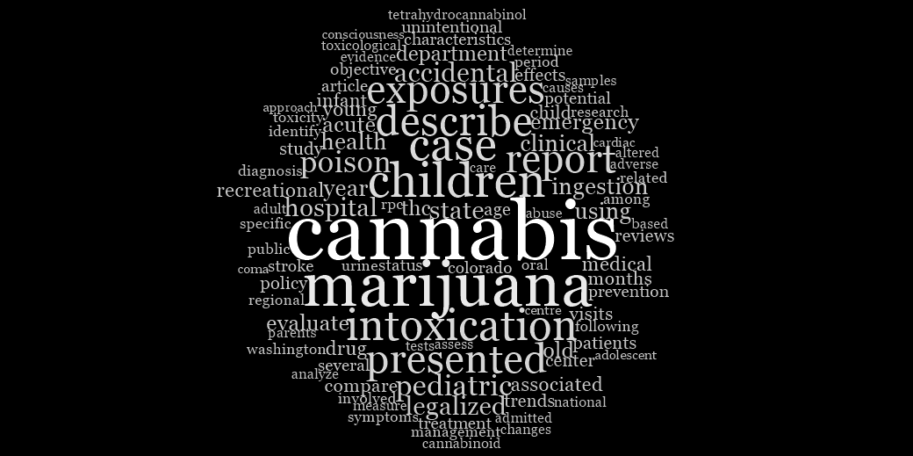
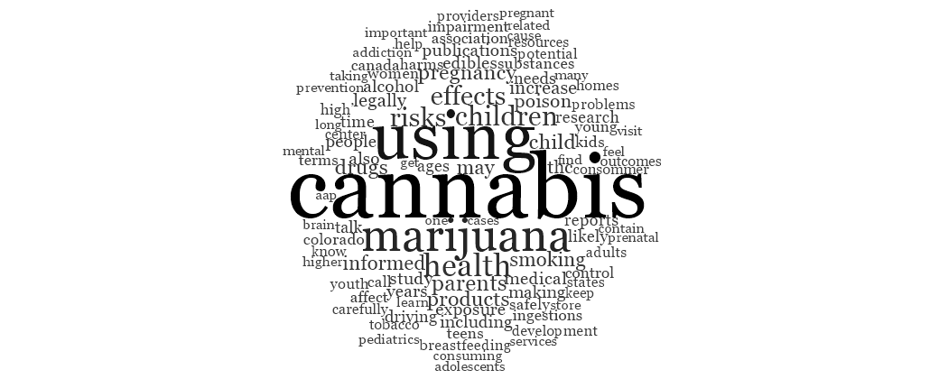
One hundred most common words present in (A) the stated objectives of academic information sources (n=94); and (B) information sources created for public audiences (n=27). Note: 37 included information sources did not meet the definitions for either “academic” or “for public audience”.
Top 10 words:
Cannabis
Marijuana
Children
Case
Intoxicat(ion)
Describe
Presented
Exposures
Report
Poison
A
Top 10 words:
Cannabis
Using
Marijuana
Health
Children
Effects
Risk
Parents
Child
Drugs
B

