Slide 1
Supplemental Figure 1-17: Plasma levels of different lipids in nine hospitalized patients at the ICU analyzed at different times in different patients (A–I) using LC-MS/MS as described
in material and methods. The normal range of the lipids is visualized as dotted lines, and the range median ± 2-fold upper and lower limit NRL95% as
gray background. Graphs of the final data set were created using Graphpad Prism (version 9.5.0).

Slide 2
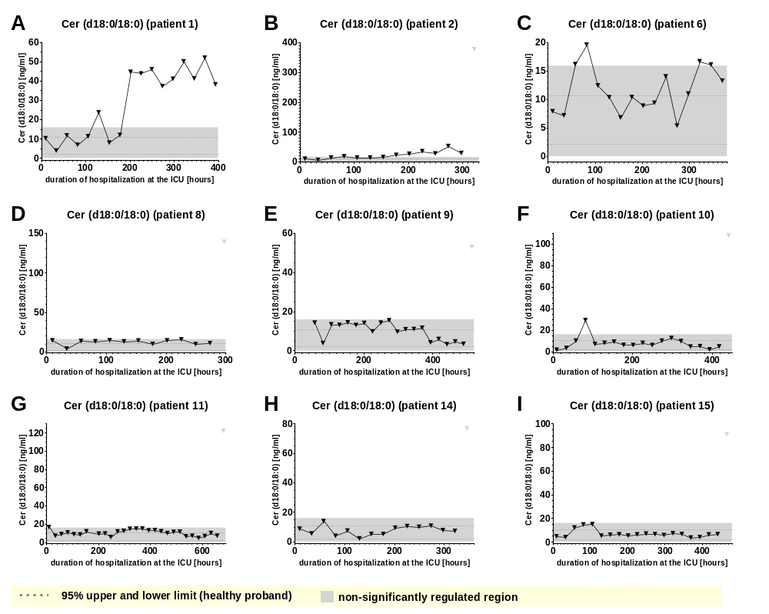
Supplemental Figure 1

Slide 3
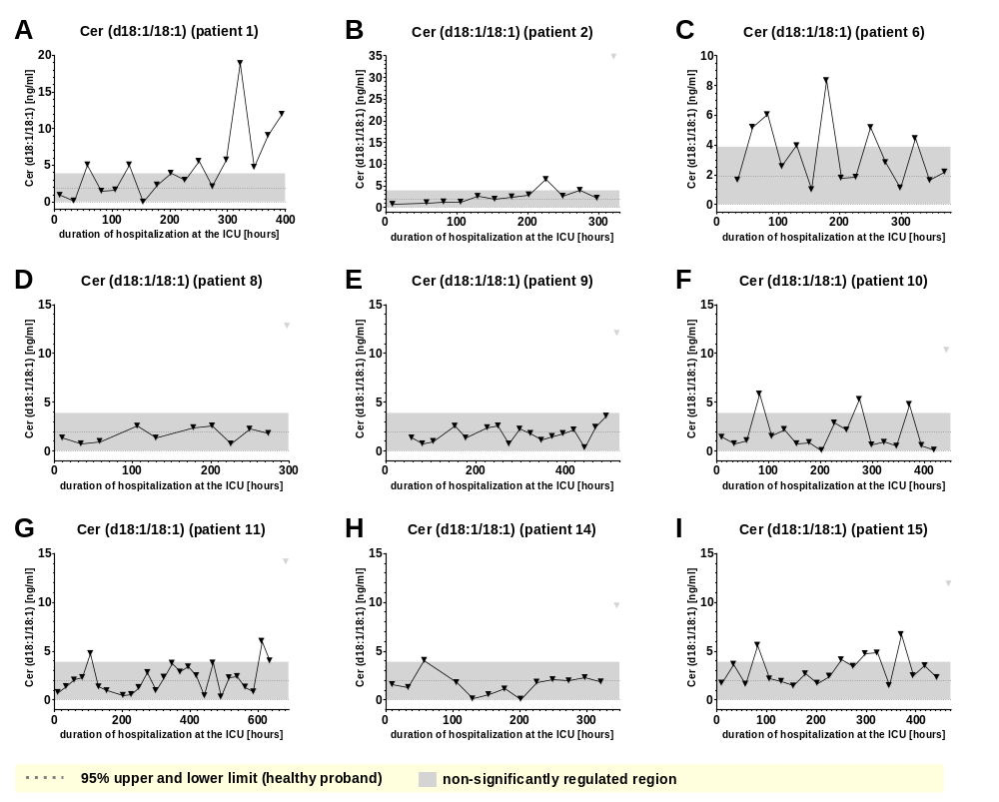
Supplemental Figure 2

Slide 4
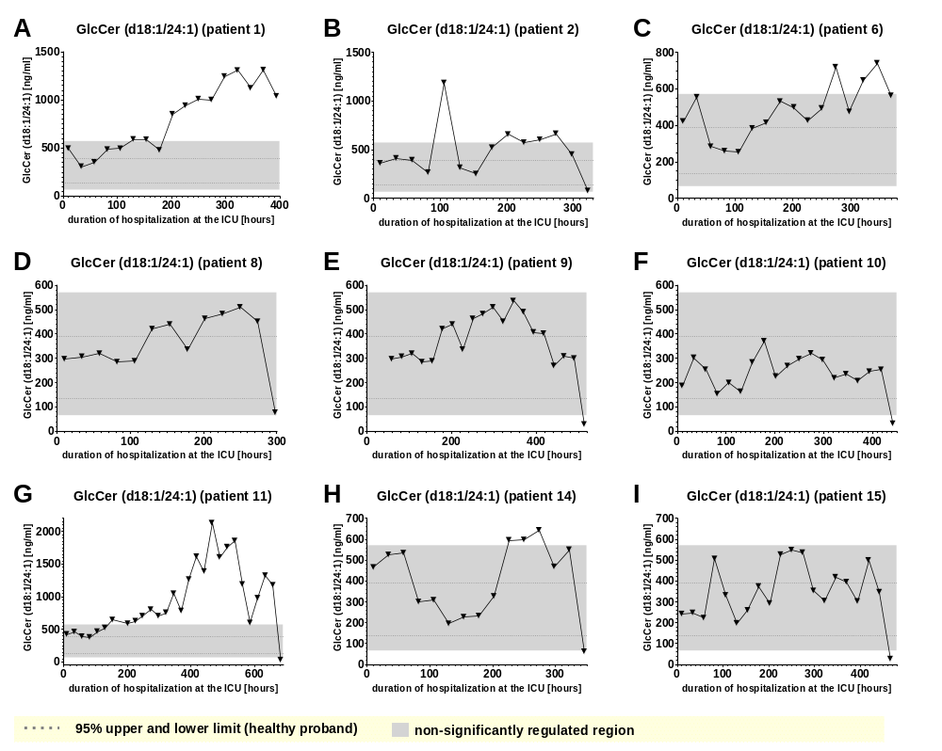
Supplemental Figure 3

Slide 5
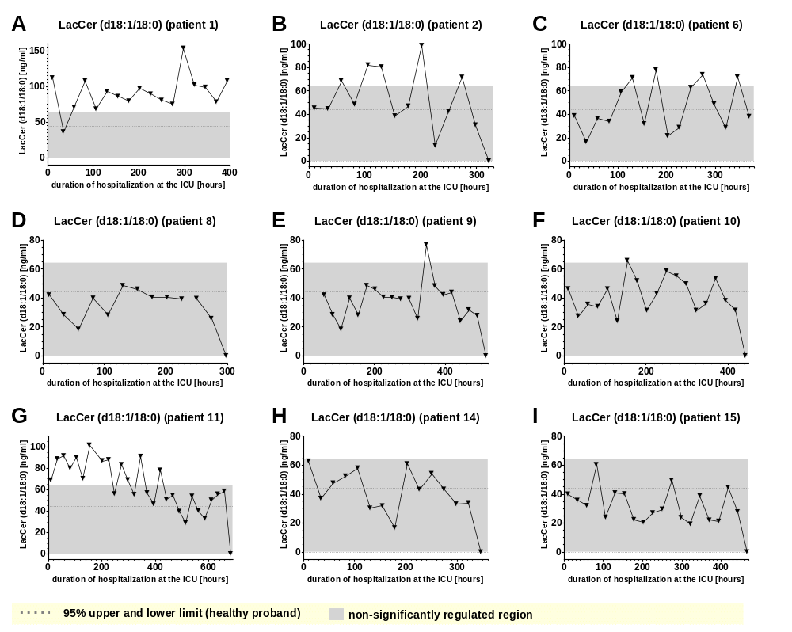
Supplemental Figure 4

Slide 6
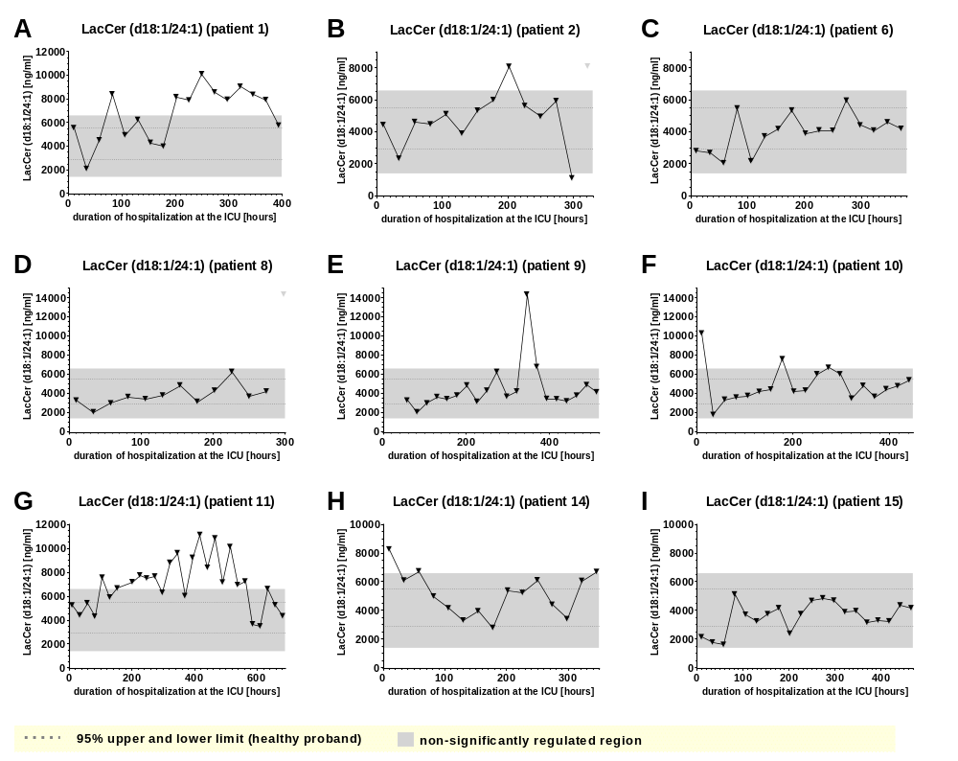
Supplemental Figure 5

Slide 7
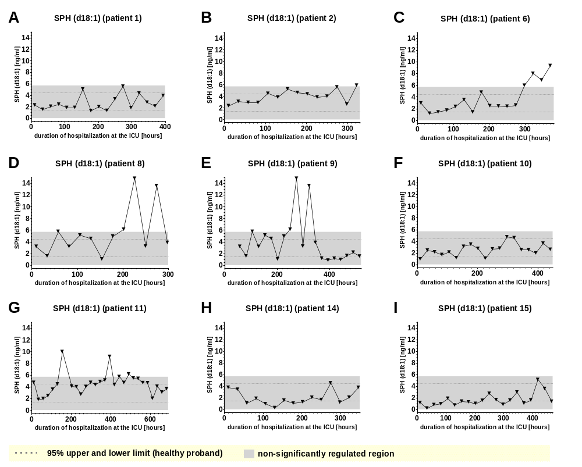
Supplemental Figure 6

Slide 8
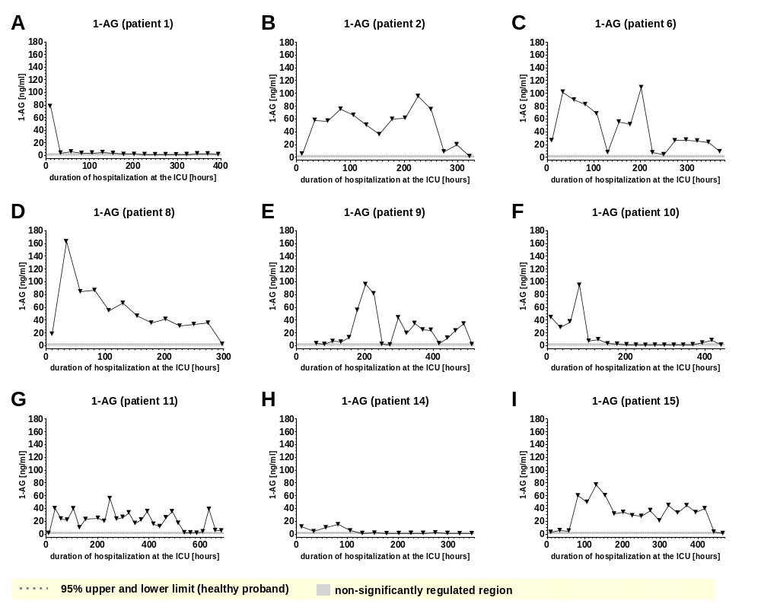
Supplemental Figure 7

Slide 9
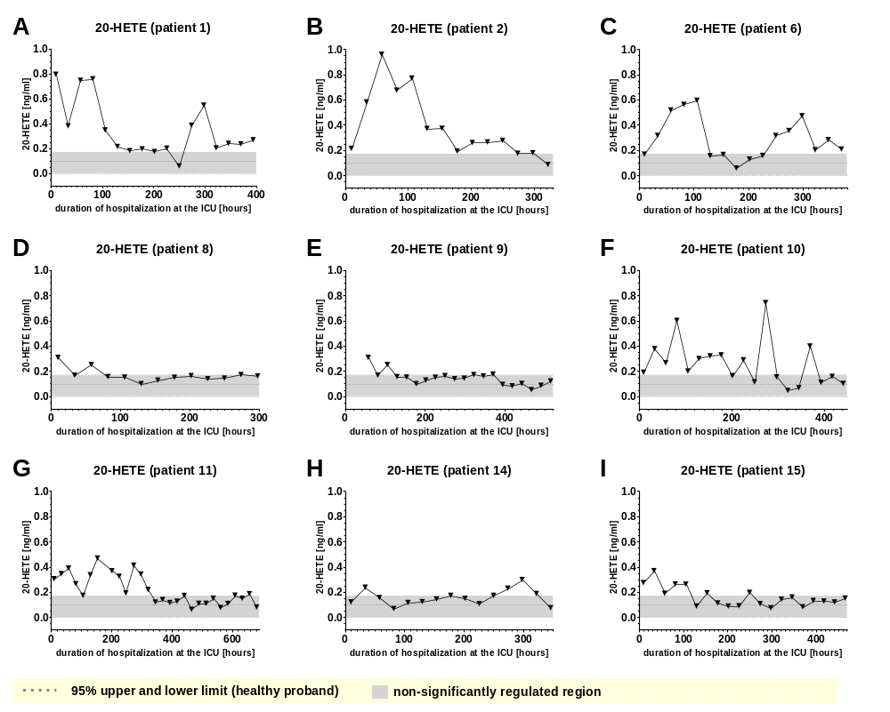
Supplemental Figure 8

Slide 10
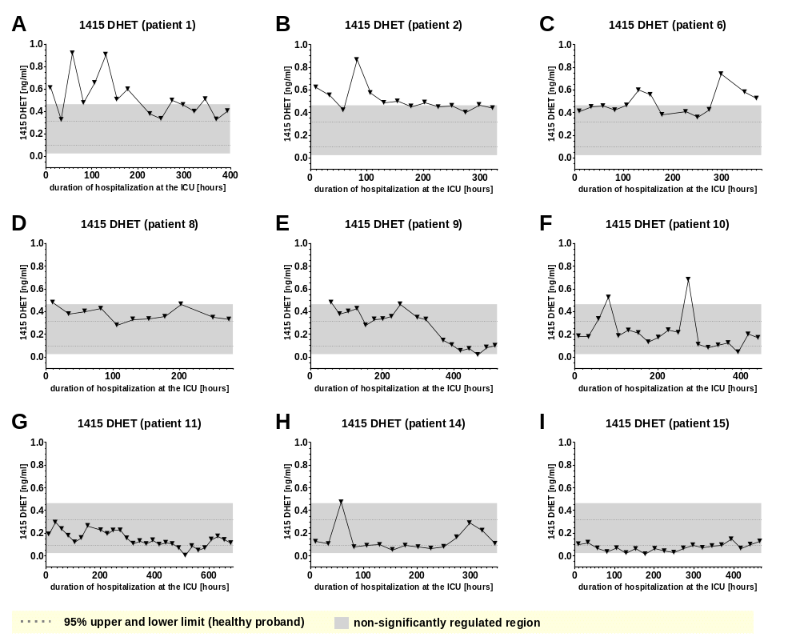
Supplemental Figure 9

Slide 11

Supplemental Figure 10

Slide 12
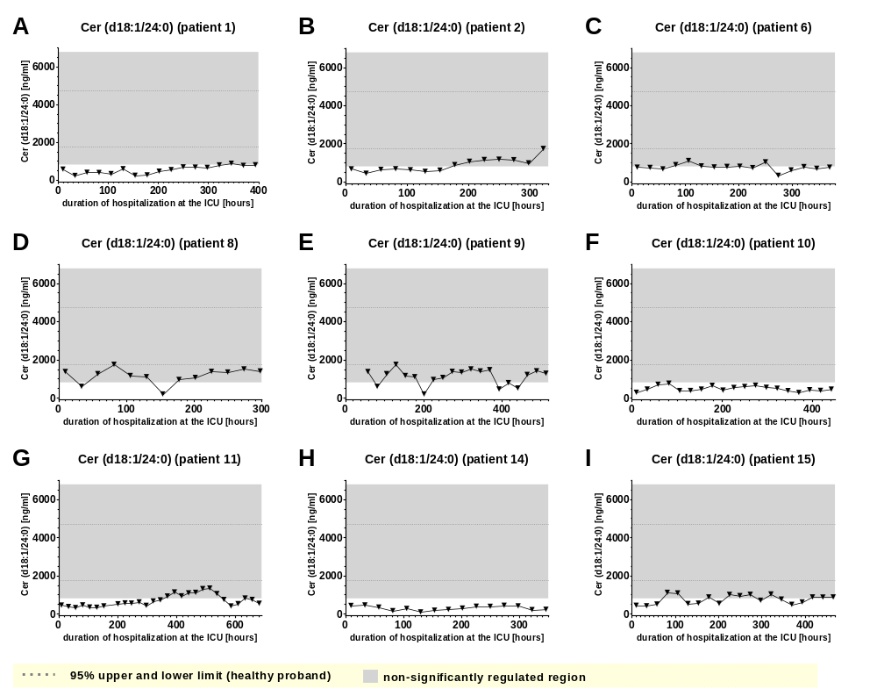
Supplemental Figure 11

Slide 13
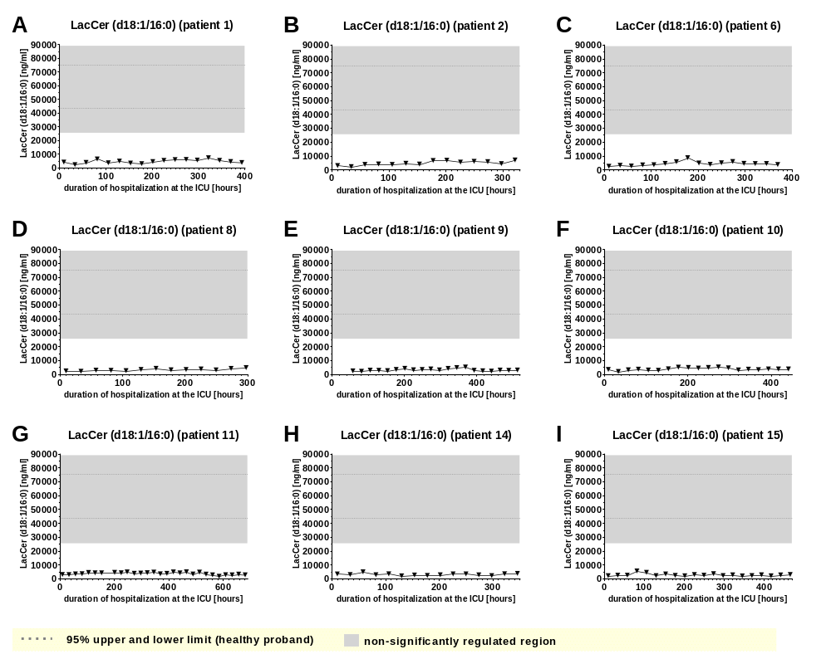
Supplemental Figure 12

Slide 14
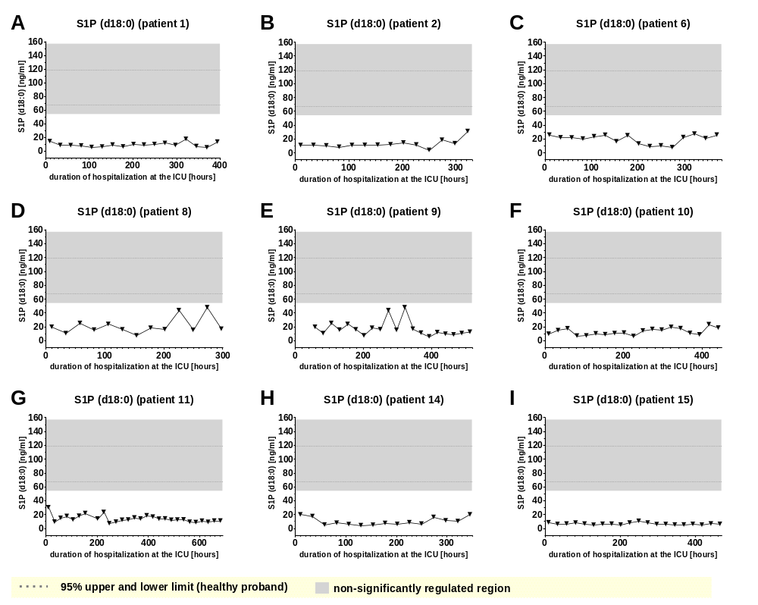
Supplemental Figure 13

Slide 15
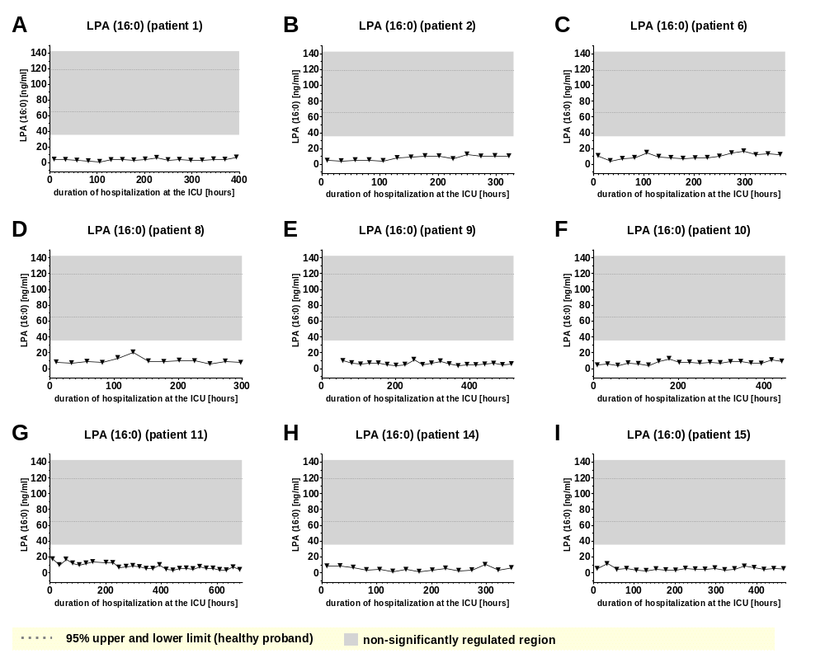
Supplemental Figure 14

Slide 16
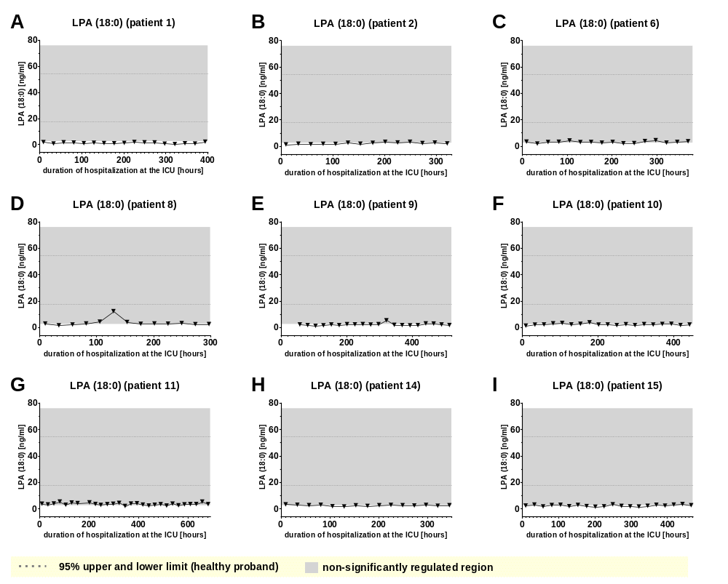
Supplemental Figure 15

Slide 17
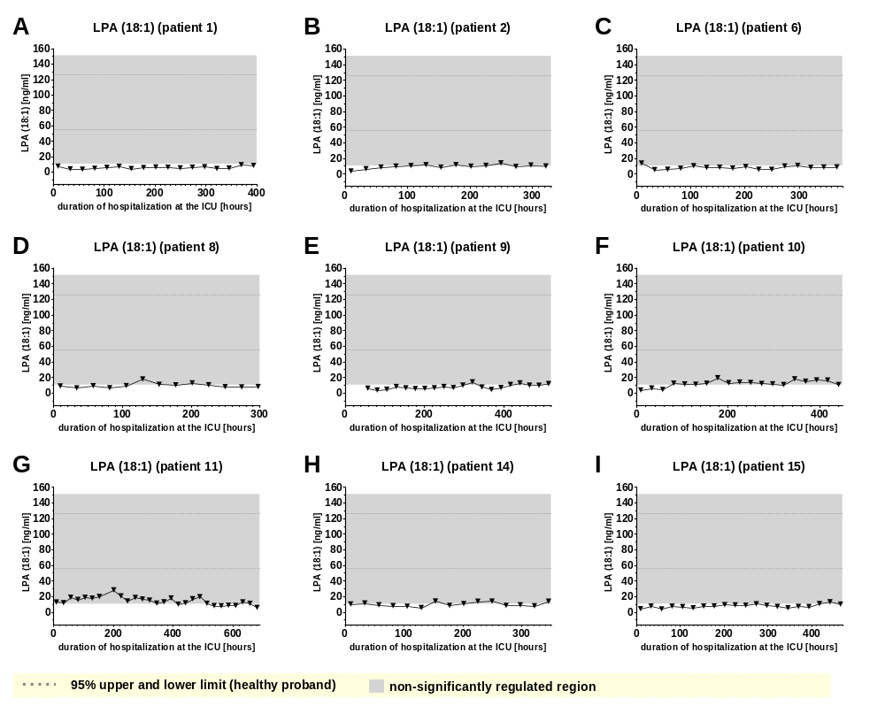
Supplemental Figure 16

Slide 18
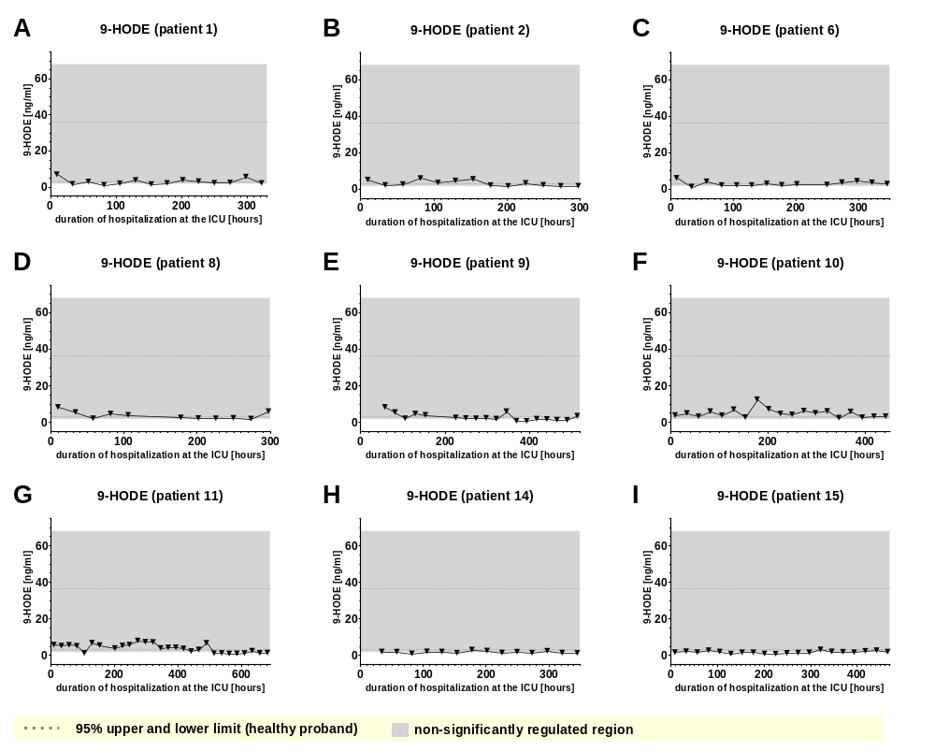
Supplemental Figure 17

Slide 19
Supplemental Figure 18-22: Plasma levels of different Lipids after stimulation of venous whole blood
with 100 ng/ml LPS for the time periods indicated. Samples were further handled as described in material and methods and plasma levels were determined using LC/MS/MS. Data are median of 10 independent experiments illustrated as box plots with upper and lower whiskers. LPS, lipopolysaccharide. Levels of significance of control versus sample treated with LPS: *p< 0.05; **p<0.01. Graphs and statistics of the final data set were created using R software (version 3.5.1, open-source software 2018).

Slide 20
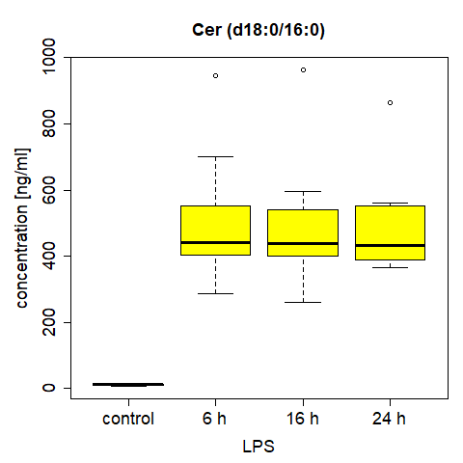
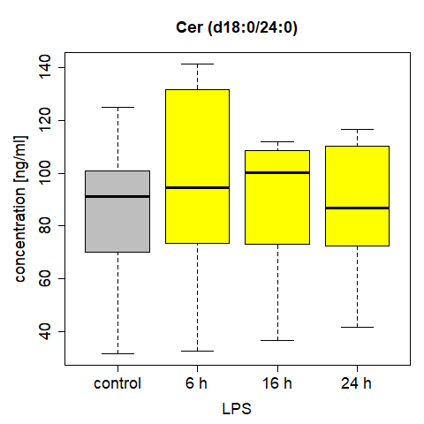
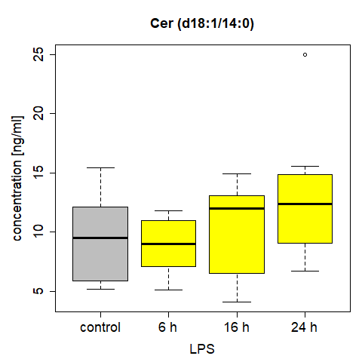
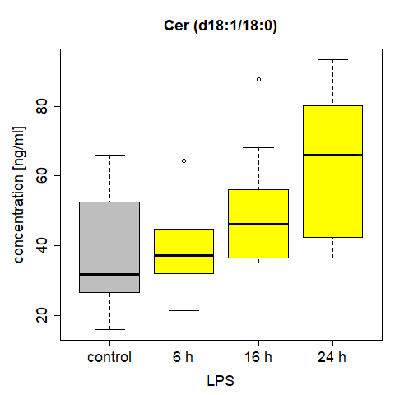
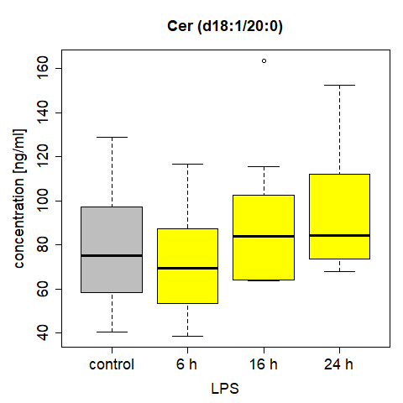
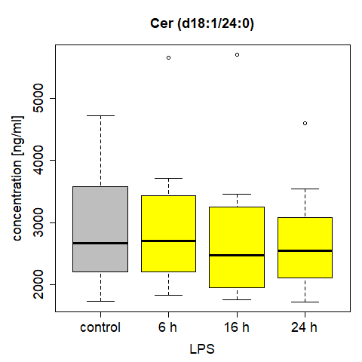
Supplemental Figure 18
A B C
**
**
**
D E F
**
**
**
**
*

Slide 21
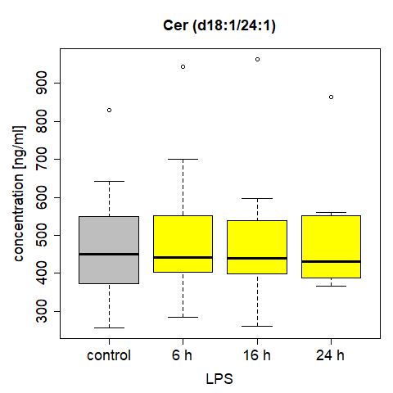
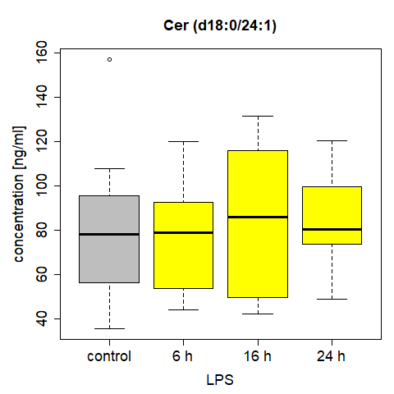
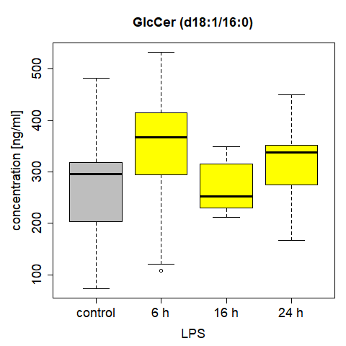
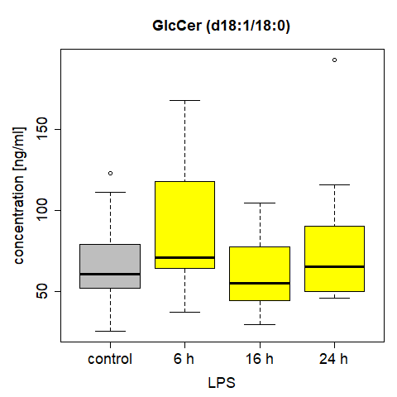
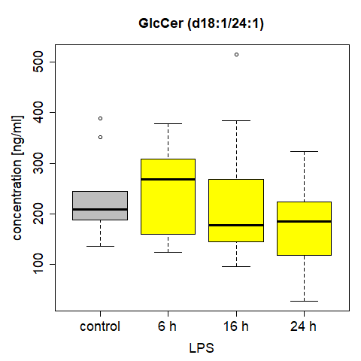
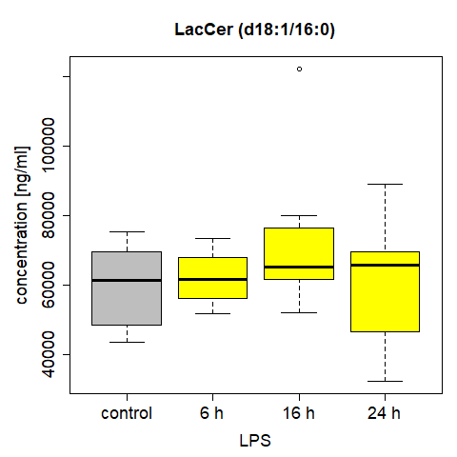
Supplemental Figure 19
A B C
D E F
*

Slide 22
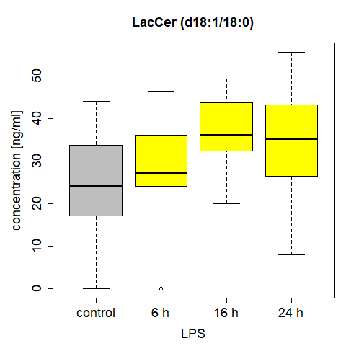
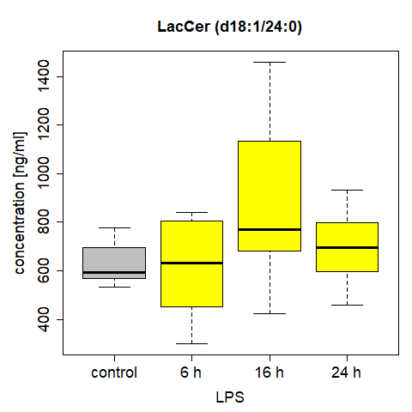
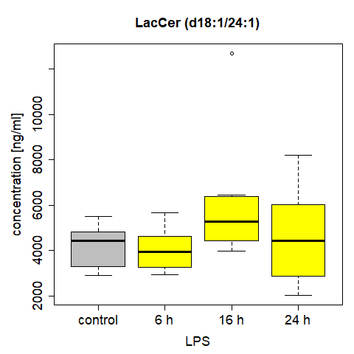
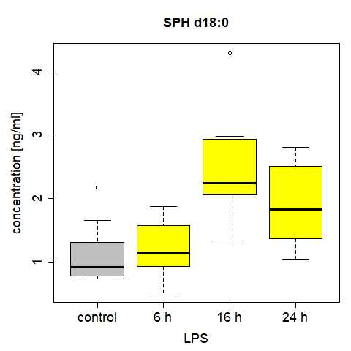
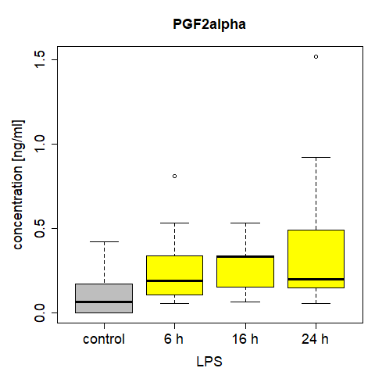
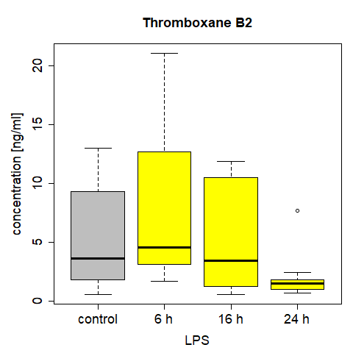
Supplemental Figure 20
A B C
*
*
*
*
D E F
**
**
*
*
*

Slide 23
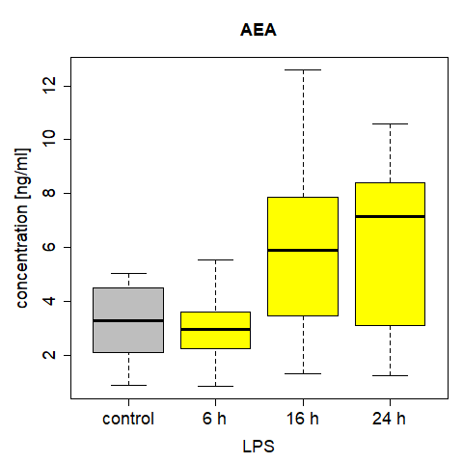
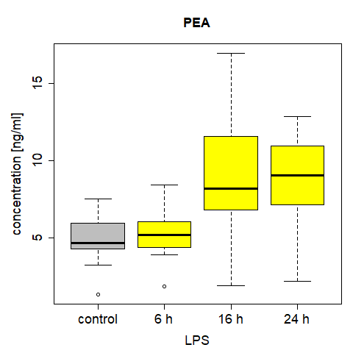
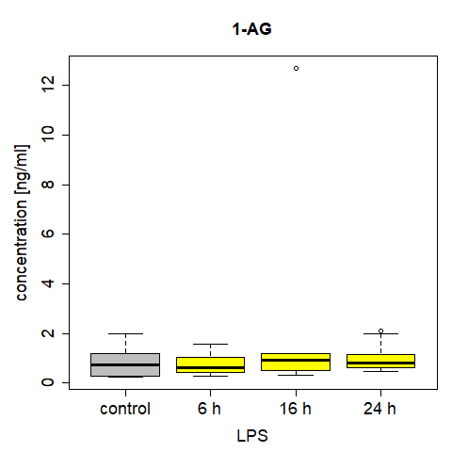
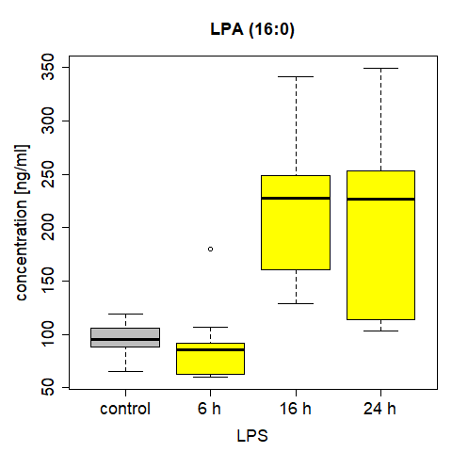
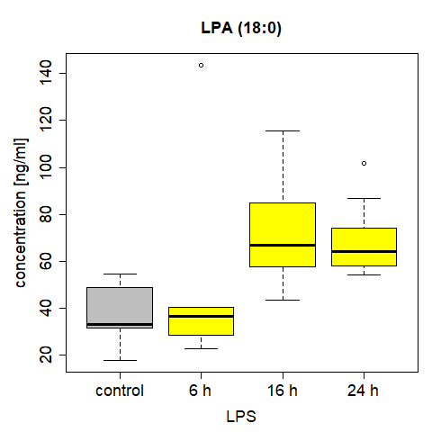
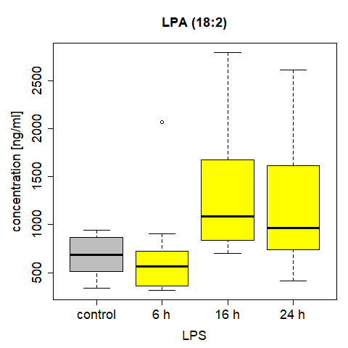
Supplemental Figure 21
A B C
**
**
**
**
D E F
E
**
**
**
**
**
*

Slide 24
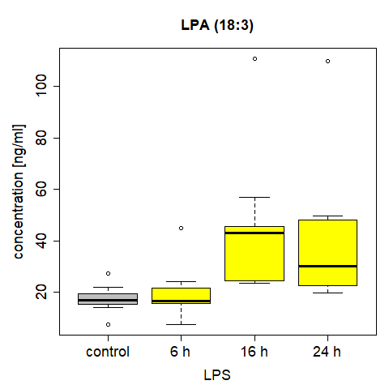
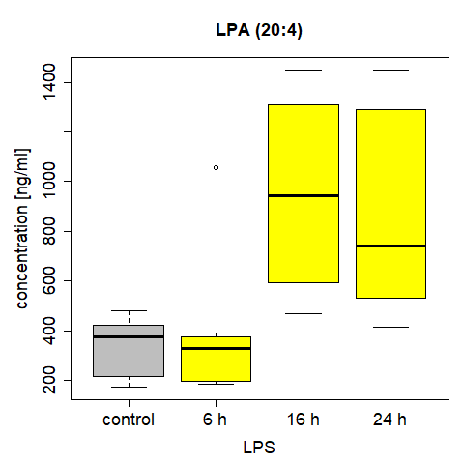
Supplemental Figure 22
A B
**
**
**
**

