Slide 1
Human metabolism of the semi-synthetic cannabinoids hexahydrocannabinol, hexahydrocannabiphorol and their acetates using hepatocytes and urine samples
Supplementary Information 3:
Mass Spectra and Chromatograms for (9R)-HHCP in Human Hepatocytes
Karin Lindbom^{1,=}, Caitlyn Norman^{1,=}, Steven Baginski², Lucas Krebs³, Darta Stalberga¹, Tobias Rautio⁴, Xiongyu Wu⁴, Robert Kronstrand^{1,5}, and Henrik Green^{1,5*}
¹ Division of Clinical Chemistry and Pharmacology, Department of Biomedical and Clinical Sciences, Linköping University, Linköping, Sweden
² Leverhulme Research Centre for Forensic Science, School of Science and Engineering, University of Dundee, Dundee, UK
³ Institute for Chemistry and Bioanalytics, School of Life Sciences, University of Applied Sciences Northwestern Switzerland, Muttenz, Switzerland
⁴ Department of Physics, Chemistry and Biology, Linköping university, Linköping, Sweden.
⁵ Department of Forensic Genetics and Forensic Toxicology, National Board of Forensic Medicine, Linköping, Sweden
* Corresponding author: henrik.green@liu.se
⁼ These authors contributed equally to this work.

Slide 2
Overlaid chromatogram of metabolites from 9R-HHCP in human hepatocytes
x10
6
(9R-HHCP)
1.4
1.3
1.2
1.1
1
0.9
0.8
Abundance (au)
0.7
0.6
0.5
P1_{A}
0.4
0.3
P2_{A}
0.2
0.1
P4
P2_{B}
P1_{B}
P3
0
0
0.5
1
1.5
2
2.5
3
3.5
4
4.5
5
5.5
6
6.5
7
7.5
8
8.5
9
9.5
10
10.5
11
11.5
12
12.5
13
13.5
14
Time (min)

Slide 3
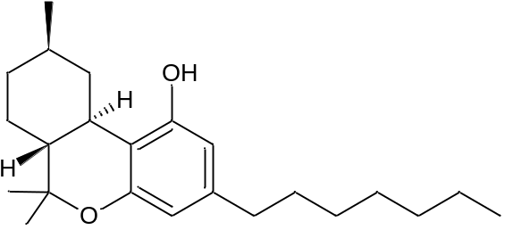
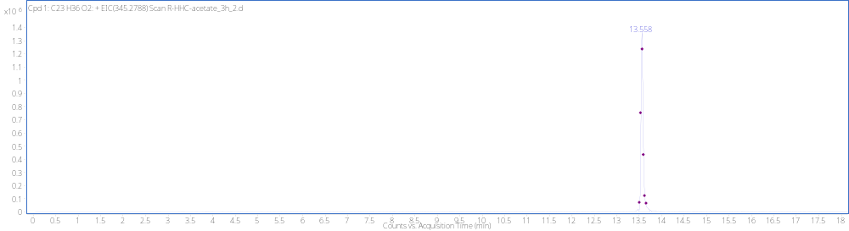
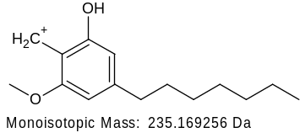
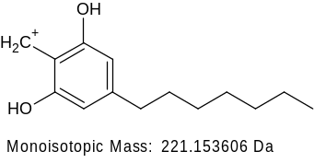
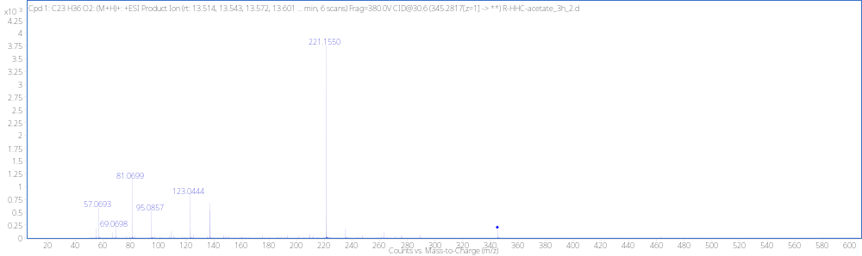
(9R)-HHCP RT 13.56
[M + H]⁺ (m/z)
Formula
345.2792
C₂₃H₃₆O₂

Slide 4
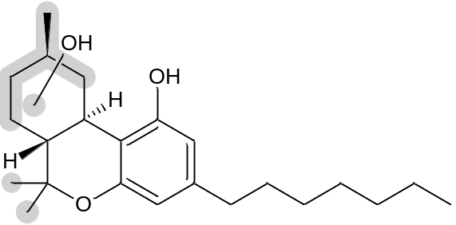
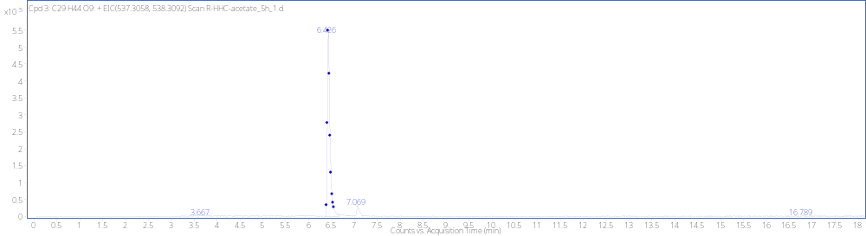
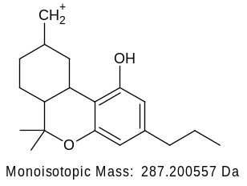
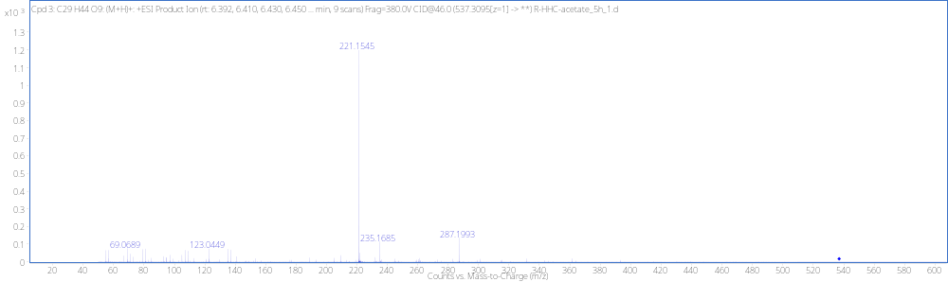
MonoOH+GLUC P1_{A} RT 6.43min
+GLUC
[M + H]⁺ (m/z)
Formula
537.3090
C₂₉H₄₄O₉

Slide 5
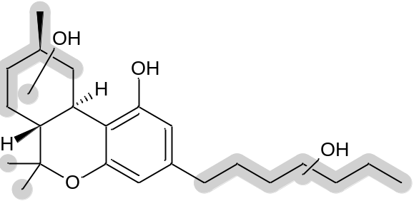
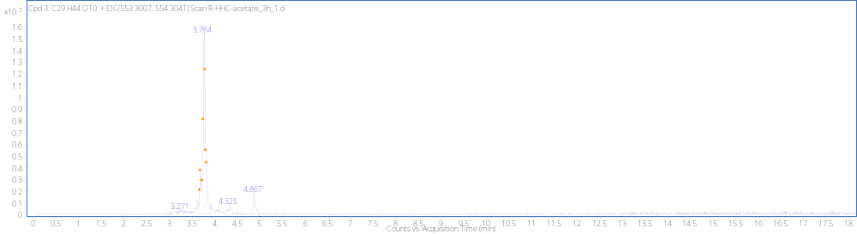
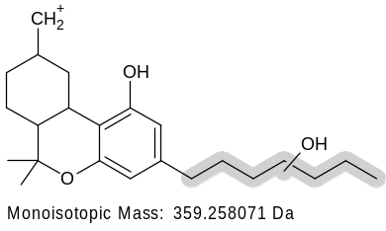
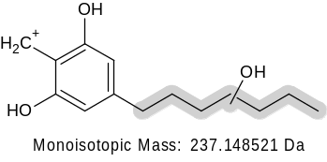
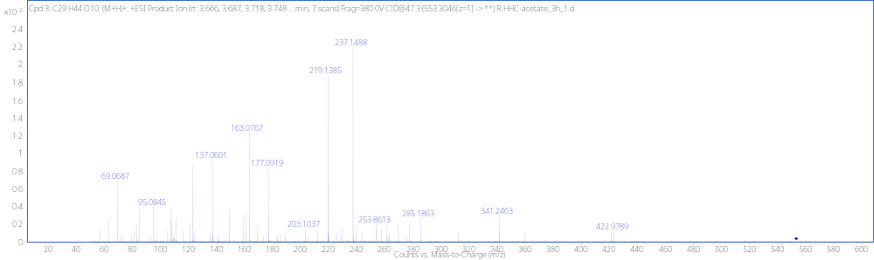
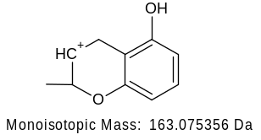
DiOH+ GLUC P2_{A} RT 3.72min
+GLUC
[M + H]⁺ (m/z)
Formula
553.3039
C₂₉H₄₄O₁₀
(not detected)
341.1248
-H₂O
-H₂O
219.1380

Slide 6
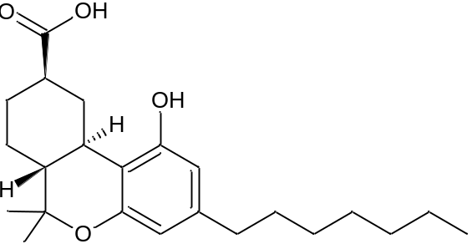
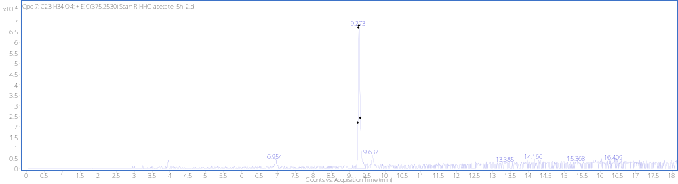
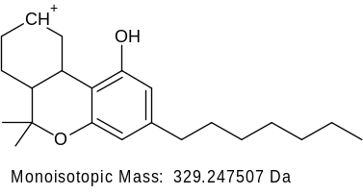
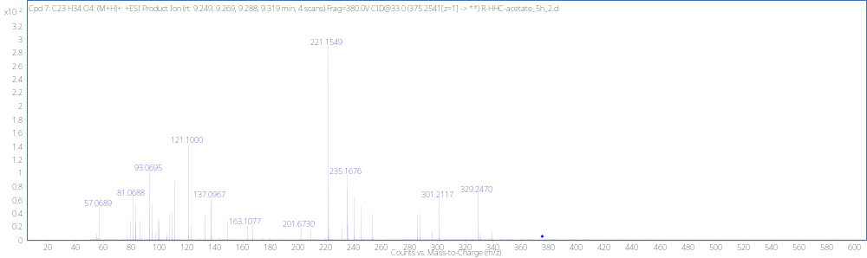
Dehyd + DiOH P3 RT 9.27
[M + H]⁺ (m/z)
Formula
375.2545
C₂₃H₃₄O₄

Slide 7
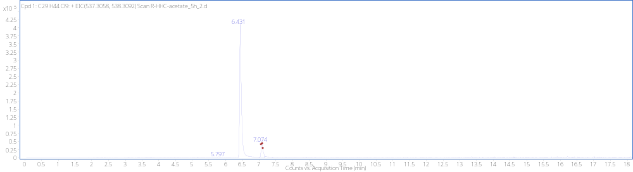
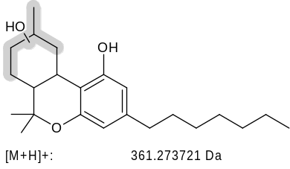
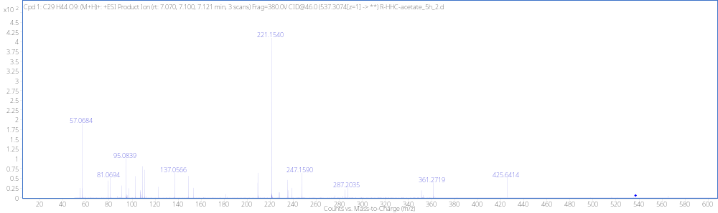
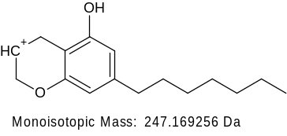
MonoOH+ GLUC P1_{B} RT 7.07min
+GLUC
[M + H]⁺ (m/z)
Formula
537.3084
C₂₉H₄₄O₉

Slide 8
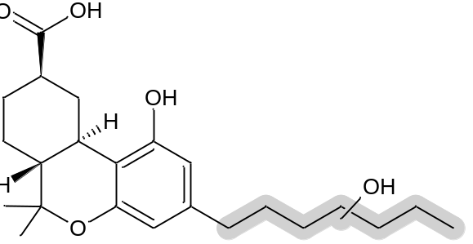
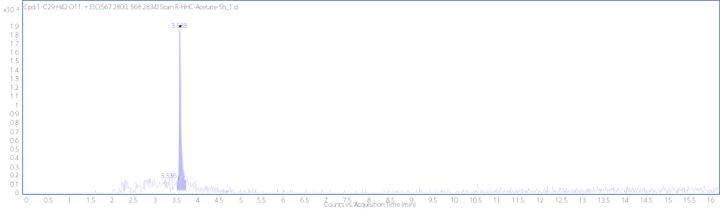
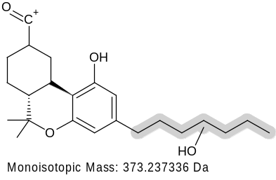
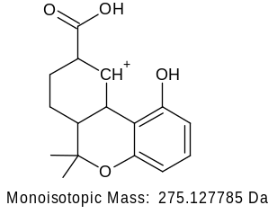
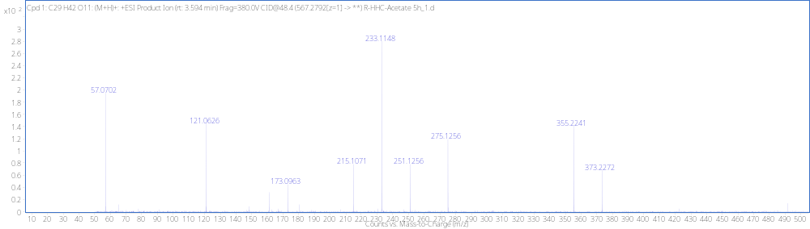
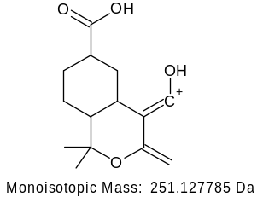
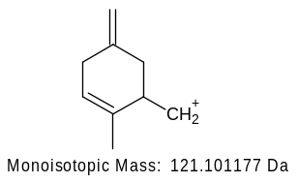
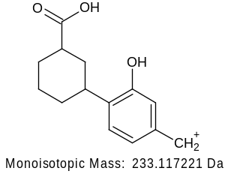
Dehyd+ TriOH+ GLUC P4 RT 3.58min
[M + H]⁺ (m/z)
Formula
567.2823
C₂₉H₄₂O₁₁
-H₂O
355.2268

Slide 9
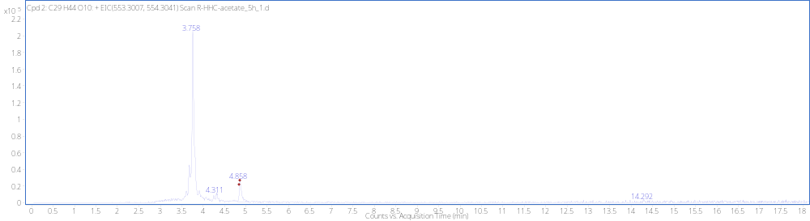
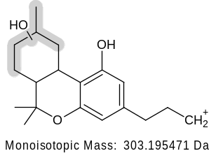
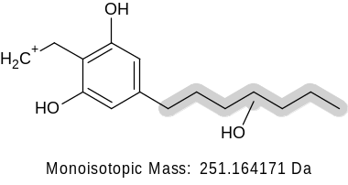
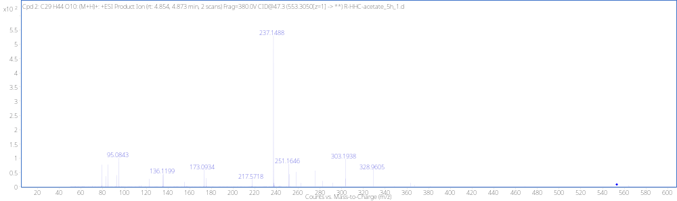
DiOH+GLUC P2_{B} RT 4.86min
+GLUC
[M + H]⁺ (m/z)
Formula
553.3036
C₂₉H₄₄O₁₀

Slide 10
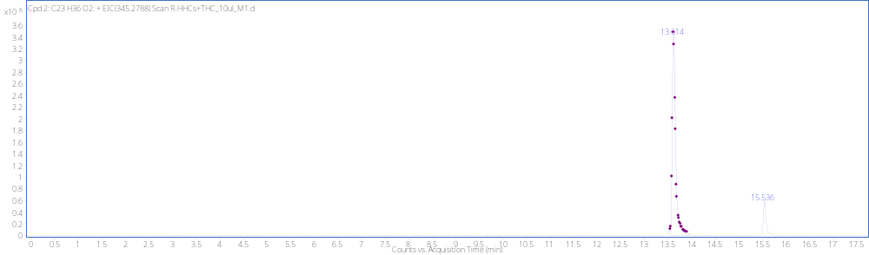
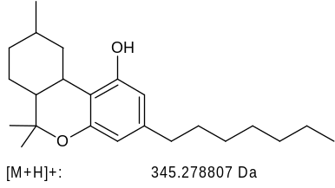
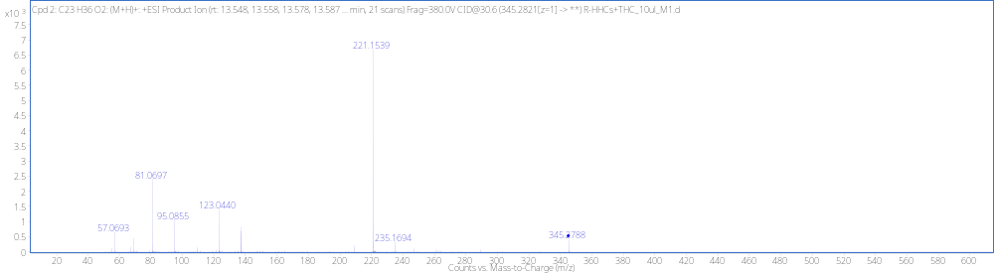
(9R)-HHCP Reference Standard RT 13.61min
[M + H]⁺ (m/z)
Formula
345.2788
C₂₃H₃₆O₂

