Slide 1
SUPPLEMENTARY DATA
ANANDAMIDE PREVENTS THE ADHESION OF FILAMENTOUS CANDIDA ALBICANS TO CERVICAL EPITHELIAL CELLS
Ronit Vogt Sionov, Mark Feldman, Reem Smoum,
Raphael Mechoulam, and Doron Steinberg

Slide 2
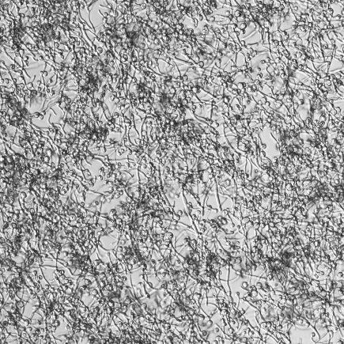
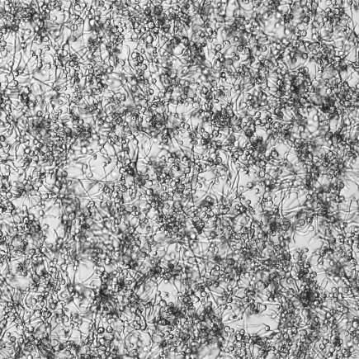
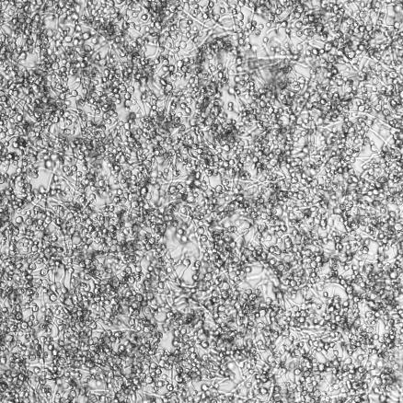

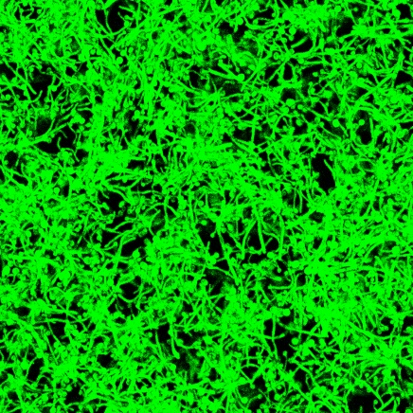
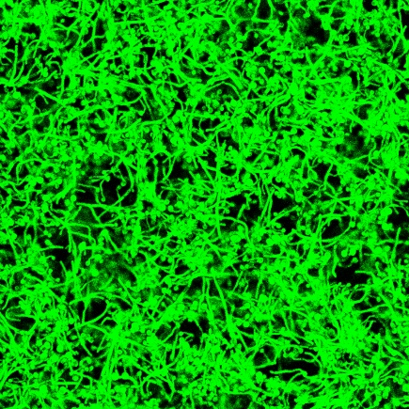
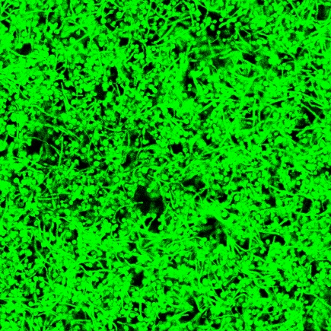
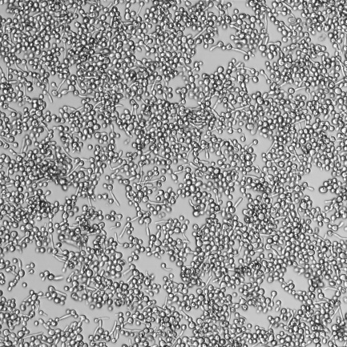
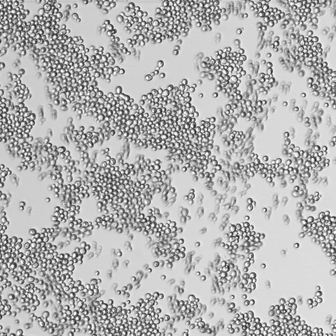
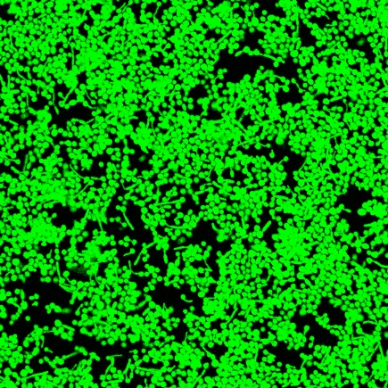
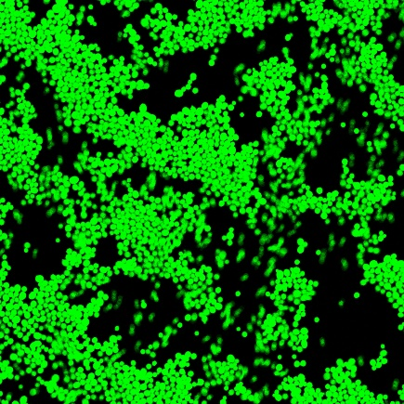
Control
10 μg/ml AraS
50 μg/ml AraS
a
c
e
50 μm
50 μm
50 μm
b
d
f
50 μm
50 μm
50 μm
125 μg/ml AraS
250 μg/ml AraS
g
i
50 μm
50 μm
h
j
50 μm
50 μm
Suppl. Figure 1. AraS prevents yeast-hypha transition. GFP-expressing Candida albicans taken from PDA plates in its yeast form was incubated with different concentrations of AraS at 37°C for 4 h, and the morphology studied by confocal microscopy. a, c, e, g, and i: Bright field. b, d, f, h, and j: green fluorescence.

Slide 3
a
Relative growth
b
Time (min)
Relative growth
c
Time (min)
Relative growth
Time (min)
Suppl. Figure 2. The vegetative growth of Candida albicans yeast form at 25°C in the presence of AEA (a), AraS (b) or 2-AG (c). C. albicans that have grown on PDA plates in yeast form were resuspended in RPMI to an OD_{600nm} of 0.2, and incubated at 25°C in the presence of various concentrations of AEA, AraS or 2-AG, and the OD_{595nm} was measured each 10 min for a period of 20h. n=3.

Slide 4
Suppl. Figure 3. AEA perturbs hyphal growth. C. albicans in yeast form was allowed to form hyphae by incubating them 4 h at 37°C, and thereafter a time-lapse study was performed using a Nikon spinning scan microscopy in the absence (a) or presence of 125 μg/ml AEA (b). Pictures were captured each 5 min for 3 h at 37°C starting 30 min after adding AEA. The time-lapse videos are uploaded as Supplementary Data in separate files. While hyphae continued to grow in the control samples, the presence of AEA arrested the hyphal growth.
Relative hyphae adhesion
HeLa/plastic
**
**
**
AEA (μg/ml)
Suppl. Figure 4. AEA preferentially inhibits hyphae adhesion to HeLa cervical epithelial cells. The relative ratio of hyphae adhesion to Hela cells versus tissue culture plates is presented. n=9. ** p<0.001.

Slide 5
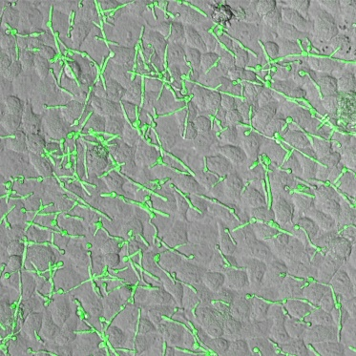
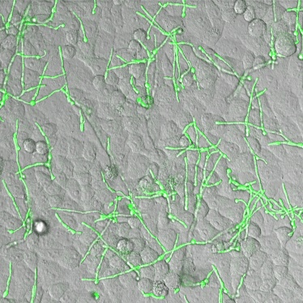
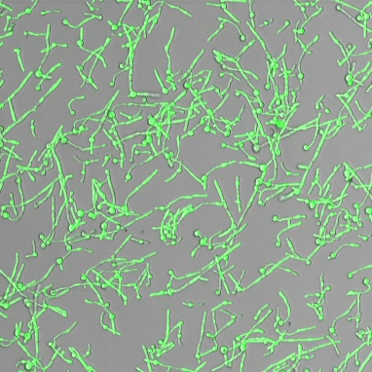
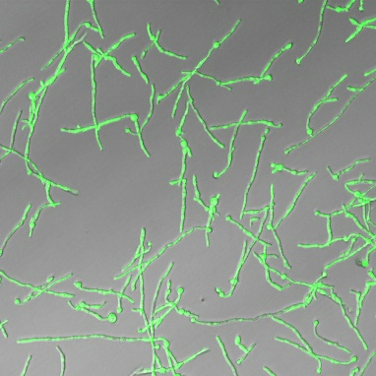
4 h hyphae on HeLa
18 h hyphae on HeLa
a
b
4 h hyphae on Plastic
18 h hyphae on Plastic
c
d
Suppl. Figure 5. Both short and long hyphae adheres to HeLa cervical epithelial cells. C. albicans in the yeast form was allowed to form hyphae for 4 and 18 h prior to their addition to HeLa epithelial monolayer. The average hyphal length after 4 h was around 30 μm, while the average hyphal length after 18 h was around 60 μm. After 1 h co-incubation, non-adherent hyphae were washed away, and the cultures inspected by confocal microscopy.

Slide 6
C. albicans (24 h)
*
*
*
*
*
Suppl. Figure 6. AraS and 2-AG, but not AEA, reduced biofilm formation of C. albicans on polystyrene plastic surface. C. albicans were incubated 24 h in the absence or presence of different concentrations of AEA, 2-AG and AraS in tissue culture plates. At the end of incubation, the amount of biofilm formed on the plastic surface was quantified. * p<0.05.

