Slide 1
Human metabolism of the semi-synthetic cannabinoids hexahydrocannabinol, hexahydrocannabiphorol and their acetates using hepatocytes and urine samples
Supplementary Information 7:
Mass Spectra and Chromatograms for HHC in Hydrolysed Urine Samples on Methanol Gradient
Karin Lindbom^{1,=}, Caitlyn Norman^{1,=}, Steven Baginski², Lucas Krebs³, Darta Stalberga¹, Tobias Rautio⁴, Xiongyu Wu⁴, Robert Kronstrand^{1,5}, and Henrik Green^{1,5*}
¹ Division of Clinical Chemistry and Pharmacology, Department of Biomedical and Clinical Sciences, Linköping University, Linköping, Sweden
² Leverhulme Research Centre for Forensic Science, School of Science and Engineering, University of Dundee, Dundee, UK
³ Institute for Chemistry and Bioanalytics, School of Life Sciences, University of Applied Sciences Northwestern Switzerland, Muttenz, Switzerland
⁴ Department of Physics, Chemistry and Biology, Linköping university, Linköping, Sweden.
⁵ Department of Forensic Genetics and Forensic Toxicology, National Board of Forensic Medicine, Linköping, Sweden
* Corresponding author: henrik.green@liu.se
⁼ These authors contributed equally to this work.

Slide 2
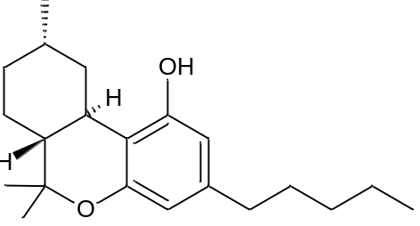
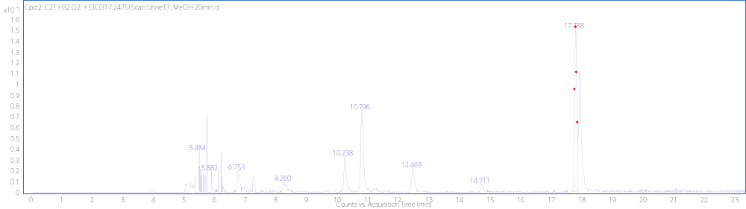
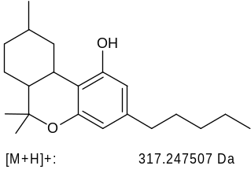
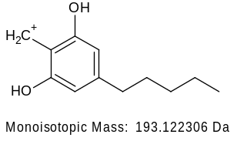
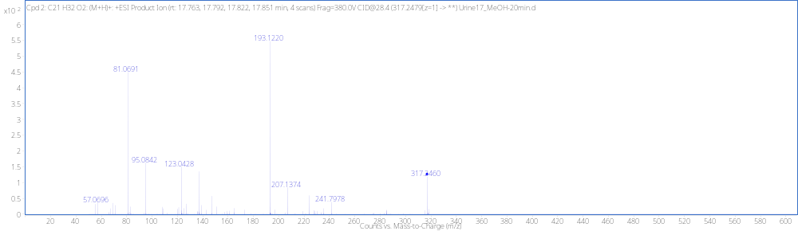
(9S)-HHC RT 17.82min
[M + H]⁺ (m/z)
Formula
317.2480
C₂₁H₃₂O₂

Slide 3
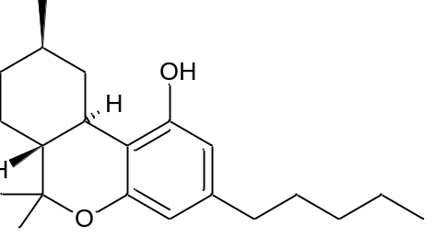
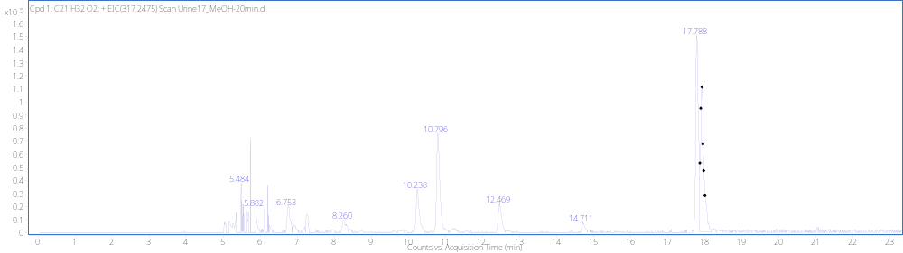
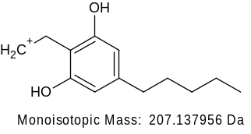
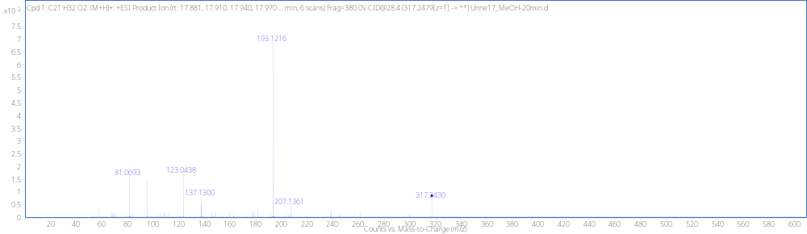
(9R)-HHC RT 18.00min
[M + H]⁺ (m/z)
Formula
317.2480
C₂₁H₃₂O₂

Slide 4
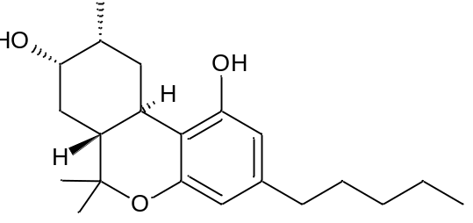
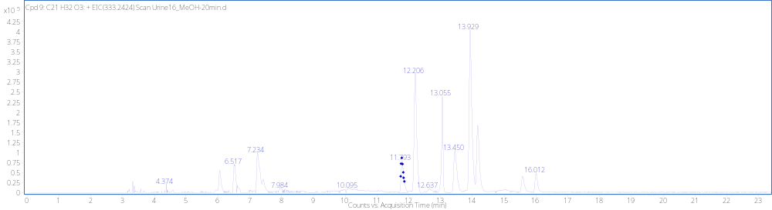
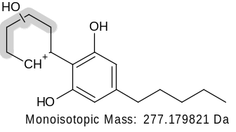
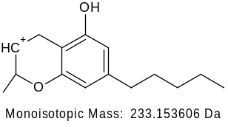
MonoOH (8-SR*)RT 11.762 min
[M + H]⁺ (m/z)
Formula
333.24275
C₂₁H₃₂O₃
(not detected)
-H₂O
259.1693
x10
2
Cpd 9: C21 H32 O3: (M+H)+: +ESI Product Ion (rt: 11.757, 11.776, 11.797, 11.817 ... min, 7 scans) Frag=380.0V CID@29.7 (333.2430[z=1] -> **) Urine16_MeOH-20min.d
2.6
193.1215
2.4
109.1008
2.2
2
1.8
1.6
93.0693
1.4
123.0436
1.2
1
259.1680
0.8
4.901
0.6
57.0672
207.1371
233.1549
315.2321
0.4
164.8732
0.2
0
20
40
60
80
100
120
140
160
180
200
220
240
260
280
300
320
340
360
380
400
420
440
460
480
500
520
540
560
580
600
Counts vs. Mass-to-Charge (m/z)

Slide 5
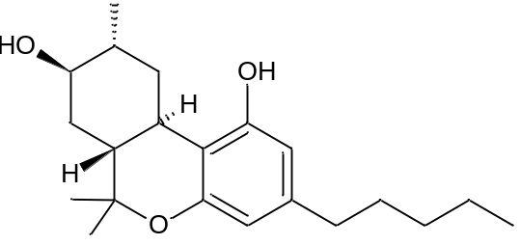
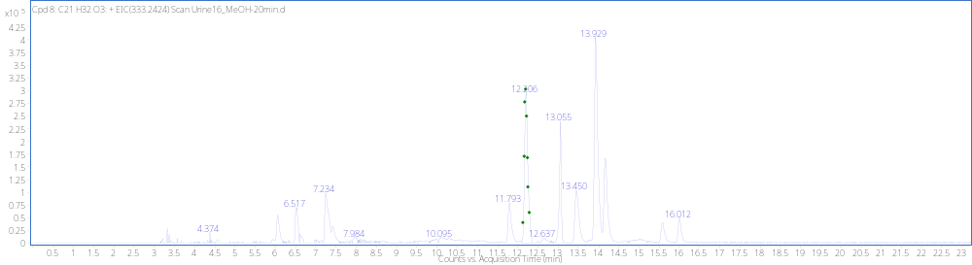
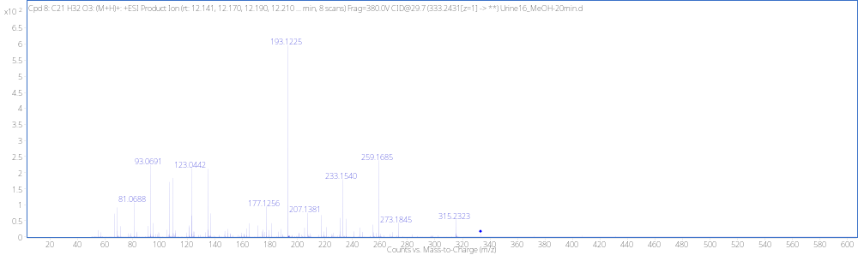
MonoOH (8RR) RT12.17min
[M + H]⁺ (m/z)
Formula
333.2428
C₂₁H₃₂O₃
(not detected)
-H₂O
259.1693

Slide 6
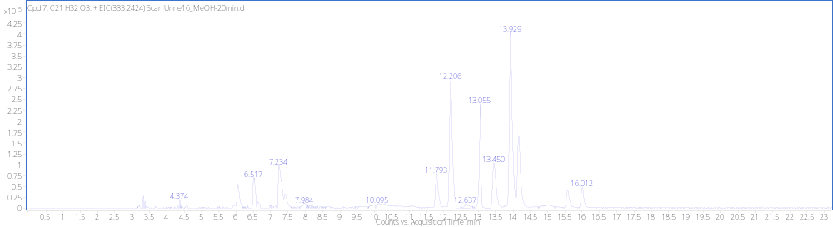
MonoOH (8SS) RT12.64min

Slide 7
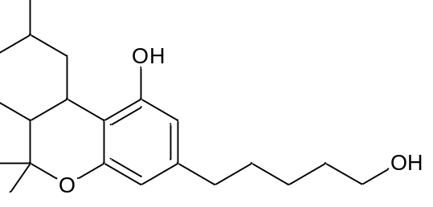
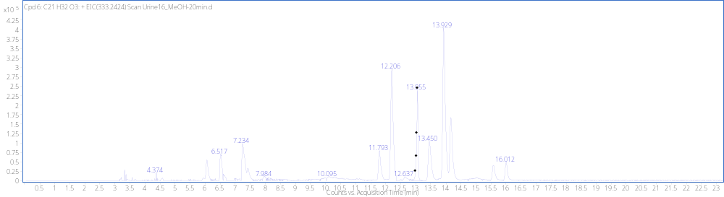
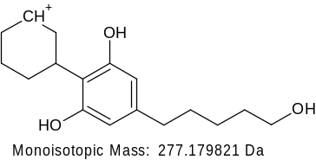
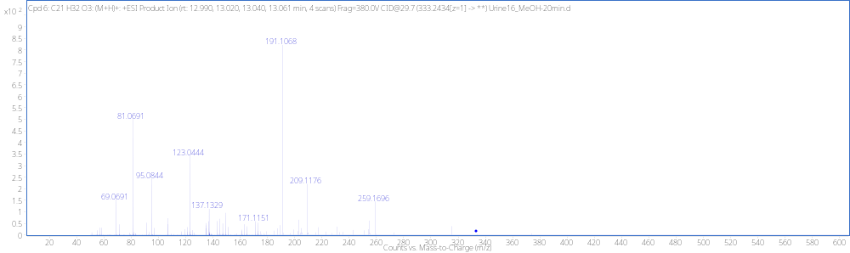
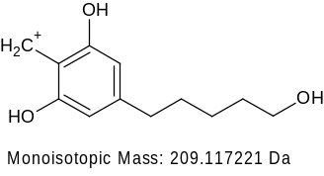
MonoOH (5’) RT 13.03min
[M + H]⁺ (m/z)
Formula
333.2428
C₂₁H₃₂O₃
(not detected)
-H₂O
259.1693
-H₂O
191.1067

Slide 8
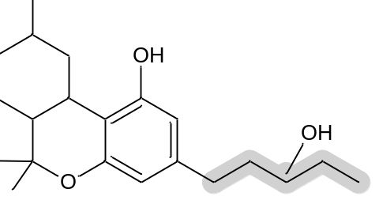
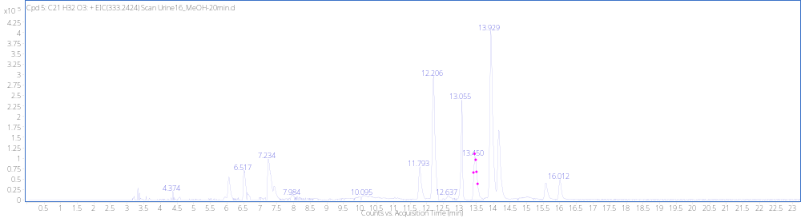
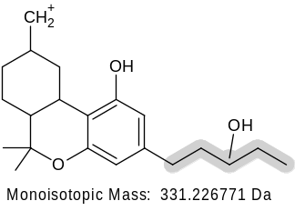
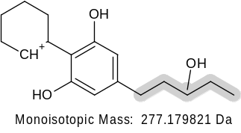
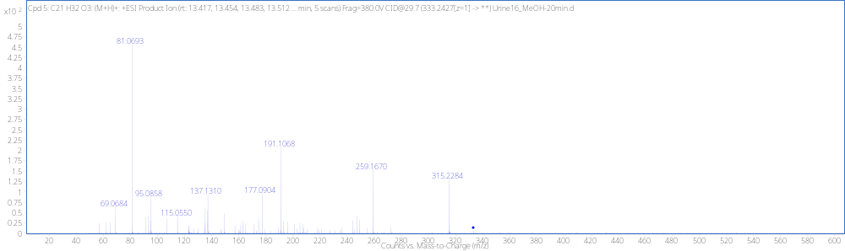
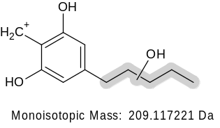
MonoOH (Tail) RT 13.41min
[M + H]⁺ (m/z)
Formula
333.2424
C₂₁H₃₂O₃
(not detected)
315.2319
-H₂O
259.1693
(not detected)
-H₂O
(not detected)
-H₂O
191.1067

Slide 9
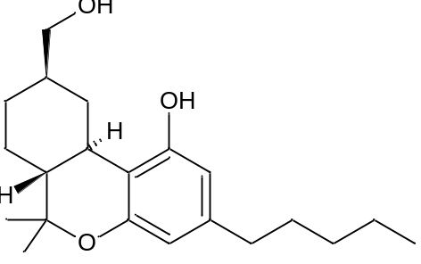
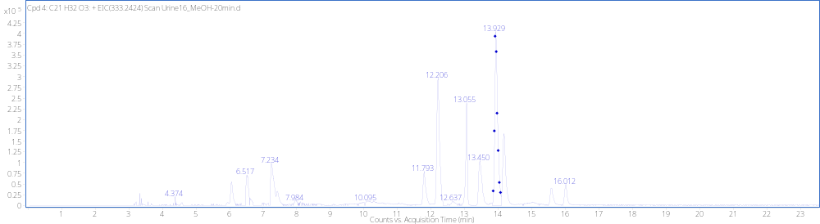
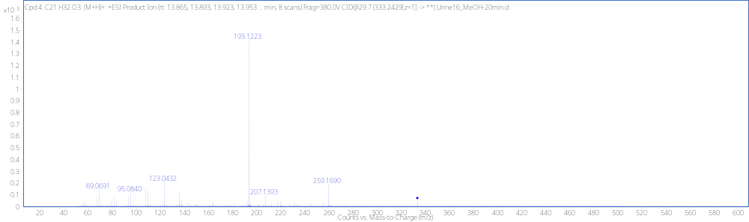
MonoOH (11-R) RT 13.89min
[M + H]⁺ (m/z)
Formula
333.2427
C₂₁H₃₂O₃
(not detected)
-H₂O
259.1693

Slide 10
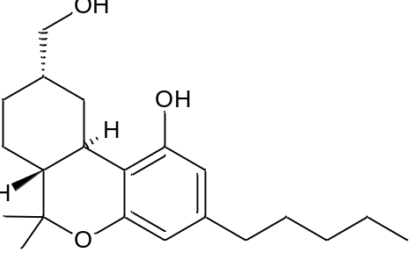
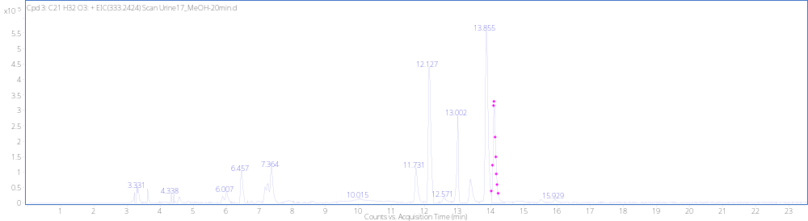
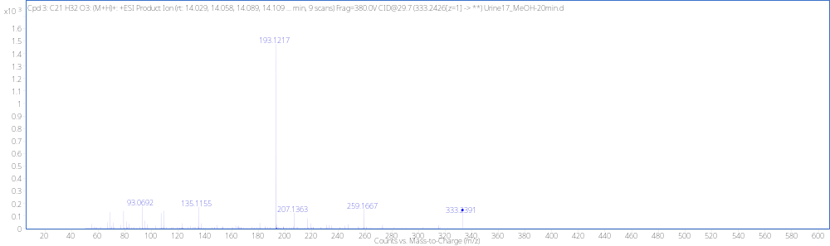
MonoOH (11-S) RT 14.14min
[M + H]⁺ (m/z)
Formula
333.2430
C₂₁H₃₂O₃
(not detected)
-H₂O
259.1693

Slide 11
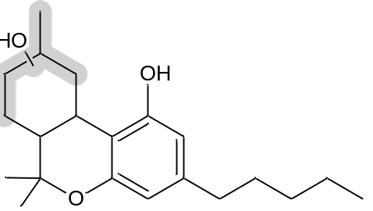
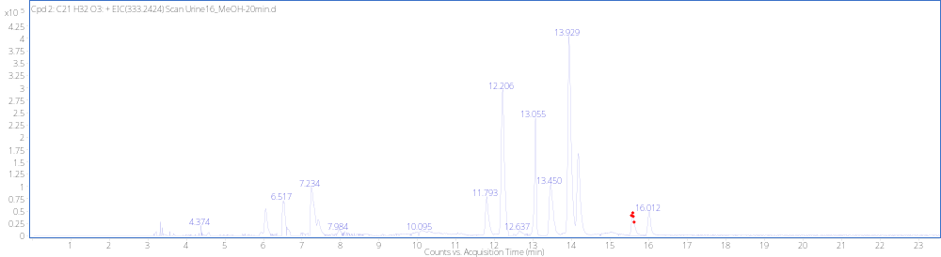
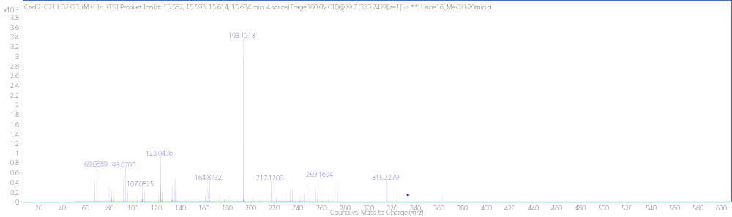
MonoOH RT 15.55min
[M + H]⁺ (m/z)
Formula
333.2428
C₂₁H₃₂O₃
(not detected)
-H₂O
259.1693

Slide 12
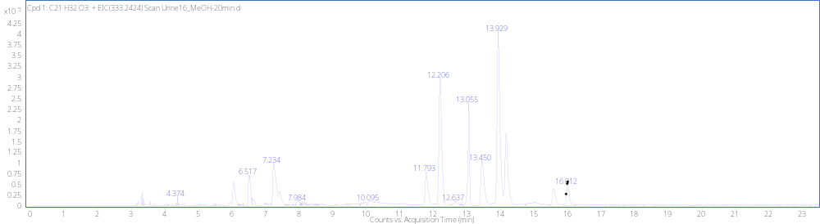
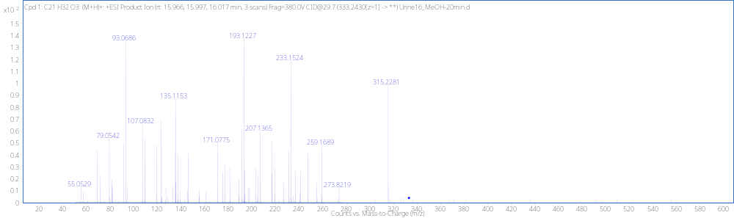
MonoOH RT 15.97min
[M + H]⁺ (m/z)
Formula
333.2425
C₂₁H₃₂O₃
(not detected)
-H₂O
259.1693

Slide 13
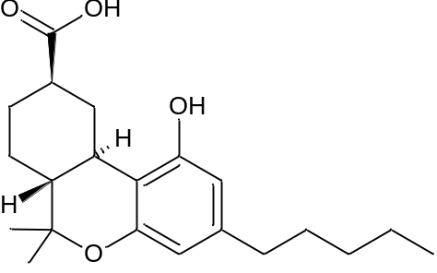
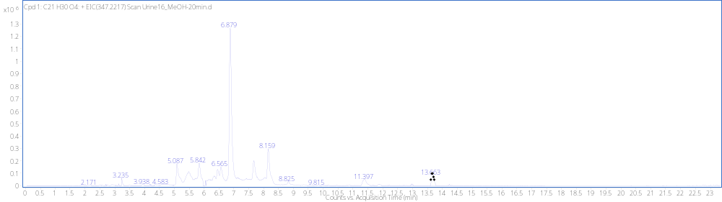
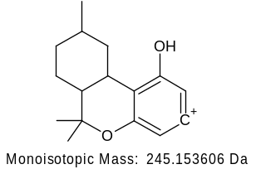
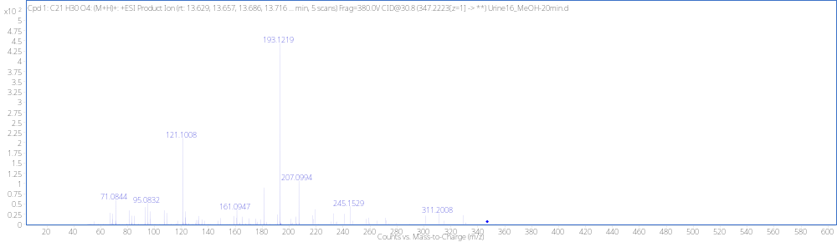
(R)-Carboxylic acid RT13.64min
[M + H]⁺ (m/z)
Formula
347.2220
C₂₁H₃₀O₄

Slide 14
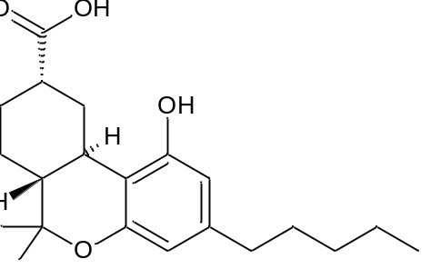
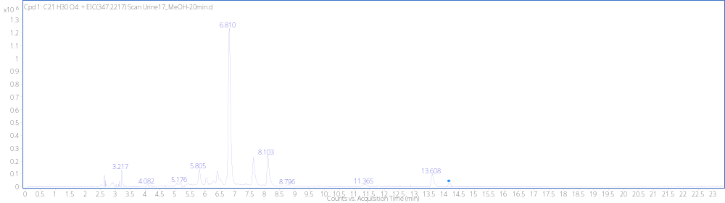
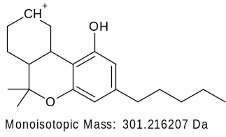
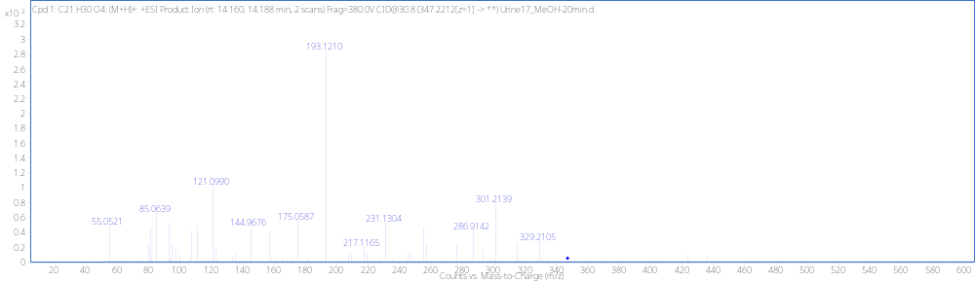
(S)-Carboxylic acid RT 14.16min
[M + H]⁺ (m/z)
Formula
347.2212
C₂₁H₃₀O₄

Slide 15
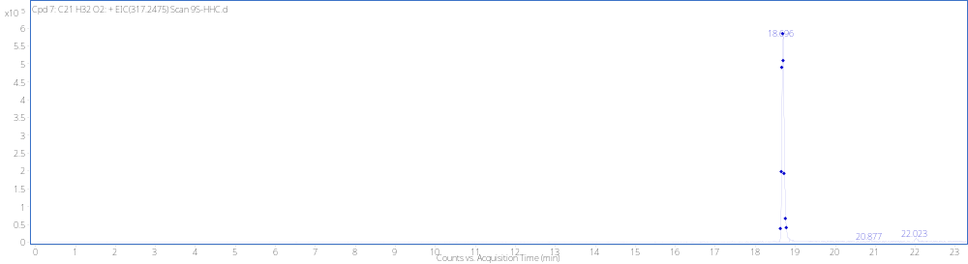
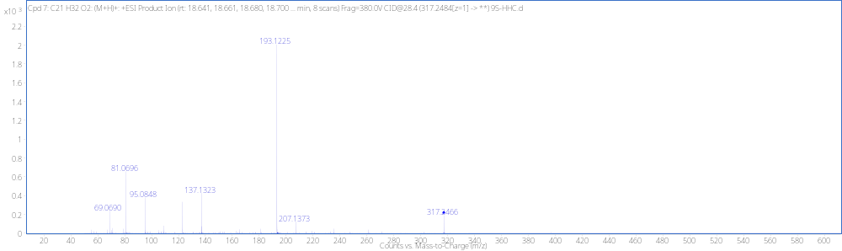
(9S)-HHC Reference Standard RT 18.70min
[M + H]⁺ (m/z)
Formula
317.2475
C₂₁H₃₂O₂

Slide 16
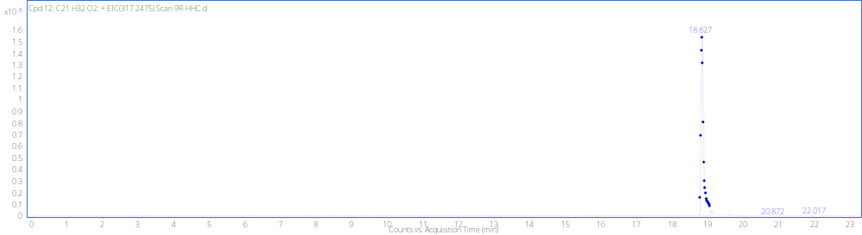

(9R)-HHC Reference Standard RT 18.83min
[M + H]⁺ (m/z)
Formula
317.2475
C₂₁H₃₂O₂

Slide 17





8-OH (R,S) Reference Standard RT 11.98min
[M + H]⁺ (m/z)
Formula
333.2424
C₂₁H₃₂O₃
(not detected)
-H₂O
315.2319
(not detected)
-H₂O
259.1693

Slide 18


8-OH (R,R) Reference Standard RT 12.06min
[M + H]⁺ (m/z)
Formula
333.2424
C₂₁H₃₂O₃
(not detected)
-H₂O
315.2319
(not detected)
-H₂O
259.1693

Slide 19



8-OH (S,S) Reference Standard RT 12.53min
[M + H]⁺ (m/z)
Formula
333.2424
C₂₁H₃₂O₃
(not detected)
-H₂O
315.2319
(not detected)
-H₂O
259.1693

Slide 20


11-OH (R) Reference Standard RT 14.70min
[M + H]⁺ (m/z)
Formula
333.2424
C₂₁H₃₂O₃
(not detected)
-H₂O
259.1693

Slide 21


(R)-Carboxylic acid Reference Standard RT 14.42min
[M + H]⁺ (m/z)
Formula
347.2217
C₂₁H₃₀O₄

Slide 22


(R)-Carboxylic acid Reference Standard RT 15.00min
[M + H]⁺ (m/z)
Formula
347.2217
C₂₁H₃₀O₄

Slide 23


(9-R/S)(5’-OH) Reference Standard RT 10.14/10.22min*
2
+ EIC(333.24242) Scan R and S-5OH-HHC_MeOH_2.d
[M + H]⁺ (m/z)
Formula
x10
10.136
1
333.2424
C₂₁H₃₂O₃
0.9
10.217
0.8
0.7
0.6
0.5
0.4
0.3
0.2
0.1
0
-0.1
9.6
9.7
9.8
9.9
10
10.1
10.2
10.3
10.4
10.5
10.6
10.7
10.8
10.9
11
11.1
11.2
11.3
11.4
11.5
11.6
Counts (%) vs. Acquisition Time (min)
-H₂O
191.1067
*This sample was run on a shorter gradient

Slide 24
Spiked Urine Sample (8-OH)
x10
5
Cpd 9: C21 H32 O3: + EIC(333.2424) Scan Urine16_MeOH-20min.d
11-OH-(R)
4.25
Original
13.929
4
3.75
8-OH (R,R)
3.5
12.206
3.25
5’OH
3
2.75
13.055
2.5
11-OH-(S)
2.25
2
OH (Tail)
14.168
1.75
8-OH (S,R)*
1.5
8-OH (S,S)
13.450
1.25
11.793
OH (Core)
1
16.012
0.75
15.578
0.5
12.637
0.25
0
9
9.5
10
10.5
11
11.5
12
12.5
13
13.5
14
14.5
15
15.5
16
16.5
17
17.5
18
Counts vs. Acquisition Time (min)
x10
5
8-OH (R,S)
3.75
(R,S)
3.5
3.25
3
2.75
2.5
2.25
2
1.75
1.5
1.25
1
8-OH (R,S)
0.75
0.5
0.25
0
9
9.2
9.4
9.6
9.8
10
10.2
10.4
10.6
10.8
11
11.2
11.4
11.6
11.8
12
12.2
12.4
12.6
12.8
13
13.2
13.4
13.6
13.8
14
14.2
14.4
14.6
14.8
15
15.2
15.4
15.6
15.8
16
16.2
16.4
16.6
16.8
17
17.2
17.4
17.6
17.8
18
x10
5
8-OH (R,R)
Counts vs. Acquisition Time (min)
5.5
(R,R)
5
4.5
4
3.5
3
2.5
2
1.5
8-OH (R,R)
1
0.5
0
9
9.2
9.4
9.6
9.8
10
10.2
10.4
10.6
10.8
11
11.2
11.4
11.6
11.8
12
12.2
12.4
12.6
12.8
13
13.2
13.4
13.6
13.8
14
14.2
14.4
14.6
14.8
15
15.2
15.4
15.6
15.8
16
16.2
16.4
16.6
16.8
17
17.2
17.4
17.6
17.8
18
x10
5
(S,S)
Counts vs. Acquisition Time (min)
4.25
4
3.75
3.5
8-OH (S,S)
3.25
3
2.75
2.5
2.25
2
1.75
1.5
1.25
1
0.75
8-OH (S,S)
0.5
0.25
0
9
9.2
9.4
9.6
9.8
10
10.2
10.4
10.6
10.8
11
11.2
11.4
11.6
11.8
12
12.2
12.4
12.6
12.8
13
13.2
13.4
13.6
13.8
14
14.2
14.4
14.6
14.8
15
15.2
15.4
15.6
15.8
16
16.2
16.4
16.6
16.8
17
17.2
17.4
17.6
17.8
18
Counts vs. Acquisition Time (min)

Slide 25
Spiked Urine Sample (5’OH)
x10
5
Cpd 9: C21 H32 O3: + EIC(333.2424) Scan Urine16_MeOH-20min.d
11-OH-(R)
4.25
Original
13.929
4
3.75
8-OH (R,R)
3.5
12.206
3.25
5’OH
3
2.75
13.055
2.5
11-OH-(S)
2.25
2
OH (Tail)
14.168
1.75
8-OH (S,R)*
1.5
8-OH (S,S)
13.450
1.25
11.793
OH (Core)
1
16.012
0.75
15.578
0.5
12.637
0.25
0
9
9.5
10
10.5
11
11.5
12
12.5
13
13.5
14
14.5
15
15.5
16
16.5
17
17.5
18
Counts vs. Acquisition Time (min)
x10
1
11-OH-(R)
*
4
8-OH (R,R)
3
5’OH
11-OH-(S)
2
1
8-OH (S,S)
OH (Tail)
0
9.2
9.3
9.4
9.5
9.6
9.7
9.8
9.9
10
10.1
10.2
10.3
10.4
10.5
10.6
10.7
10.8
10.9
11
11.1
Time (min)
*
x10
2
5’OH
1
0.8
0.6
0.4
8-OH (R,R)
11-OH-(R)
0.2
8-OH (S,S)
11-OH-(S)
OH (Tail)
0
*This sample was run on a shorter gradient
9.2
9.3
9.4
9.5
9.6
9.7
9.8
9.9
10
10.1
10.2
10.3
10.4
10.5
10.6
10.7
10.8
10.9
11
11.1
Time (min)

