Slide 1
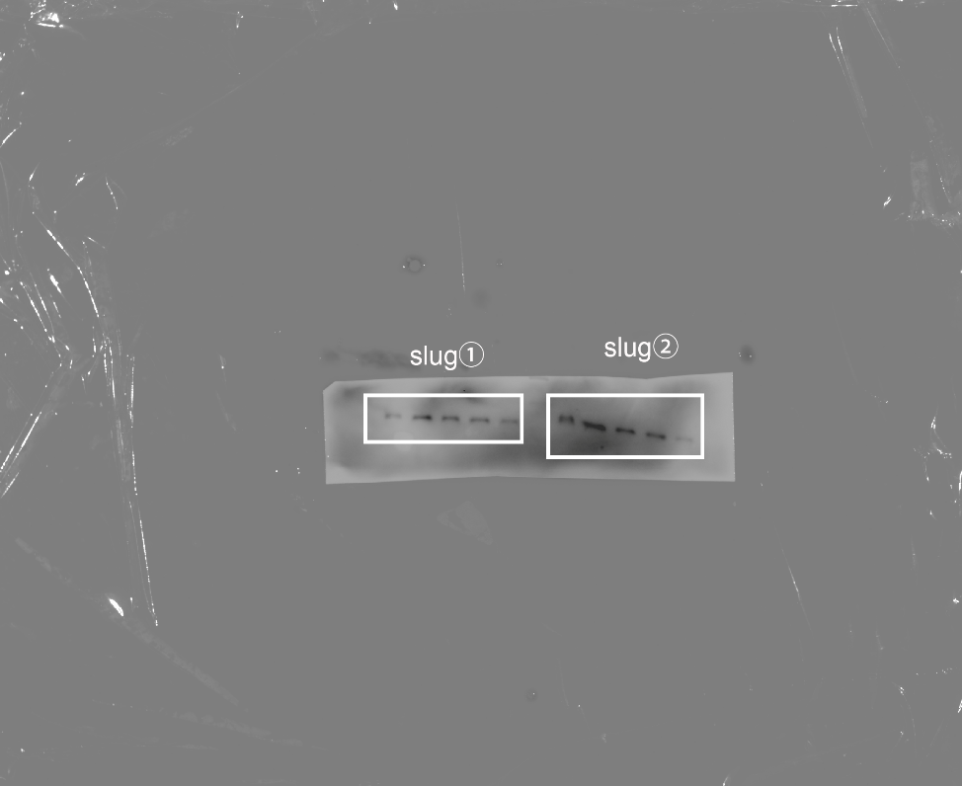
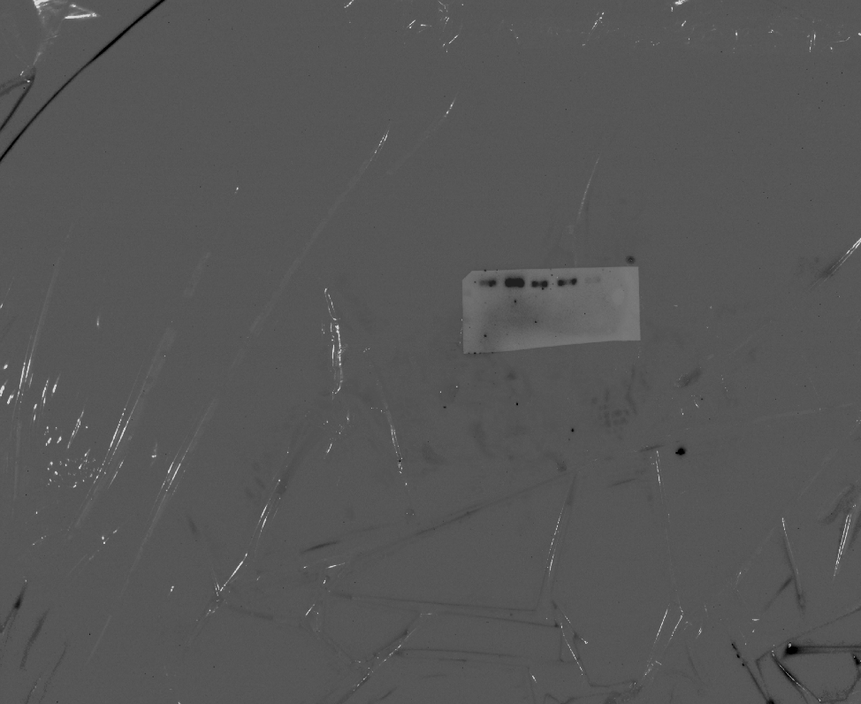
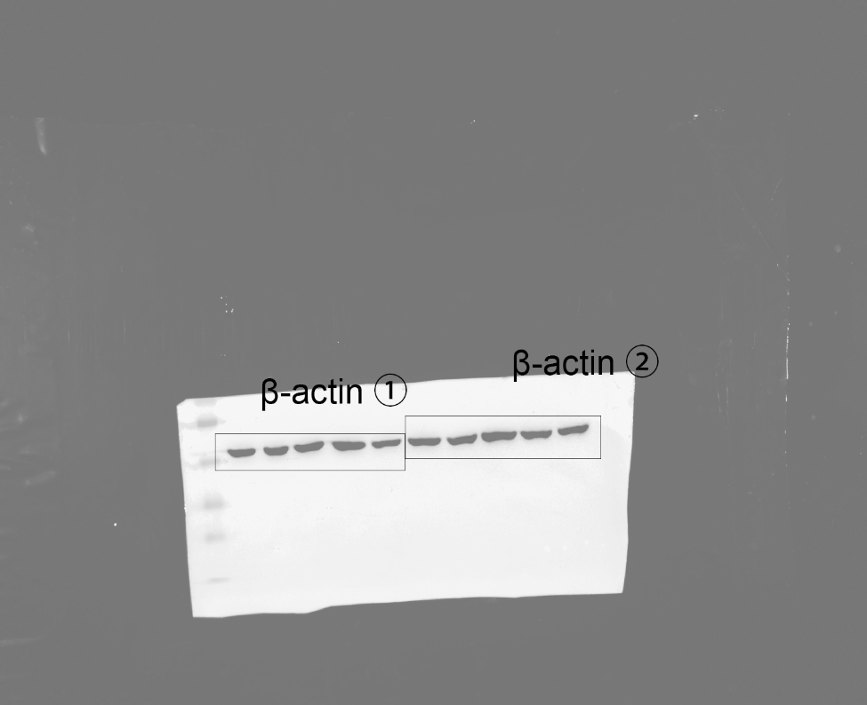
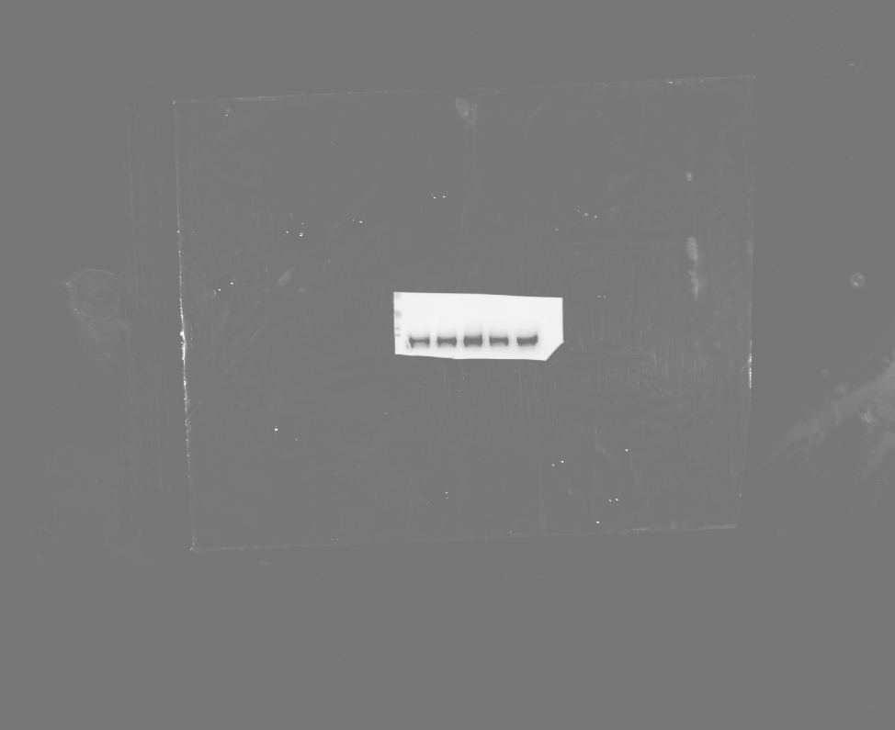
Figure 5A.
Sequence of protein bands from western blot:
1: Primary lung fibroblasts treated with vehicle;
2: Primary lung fibroblasts treated with TGF-β;
3: Primary lung fibroblasts treated with TGF-β+ACPA (10 μM);
4: Primary lung fibroblasts treated with TGF-β+ACPA 30 (μM);
5: Primary lung fibroblasts treated with TGF-β+ACPA 100 (μM).
Sample ①
Sample ②
Sample ③
slug
1 2 3 4 5
1 2 3 4 5
1 2 3 4 5
β-actin
1 2 3 4 5
1 2 3 4 5
1 2 3 4 5
1 2 3 4 5
1 2 3 4 5

Slide 2
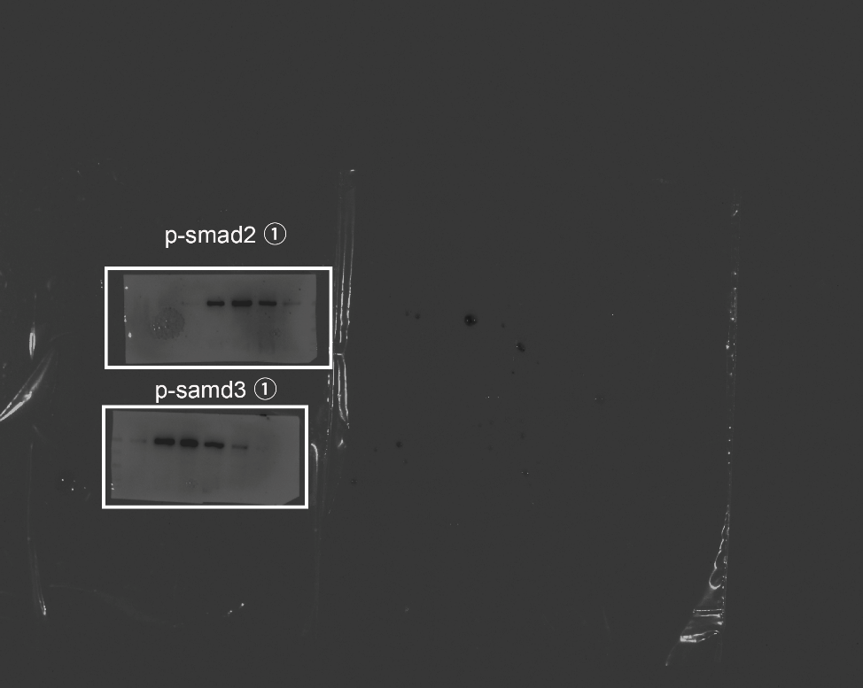
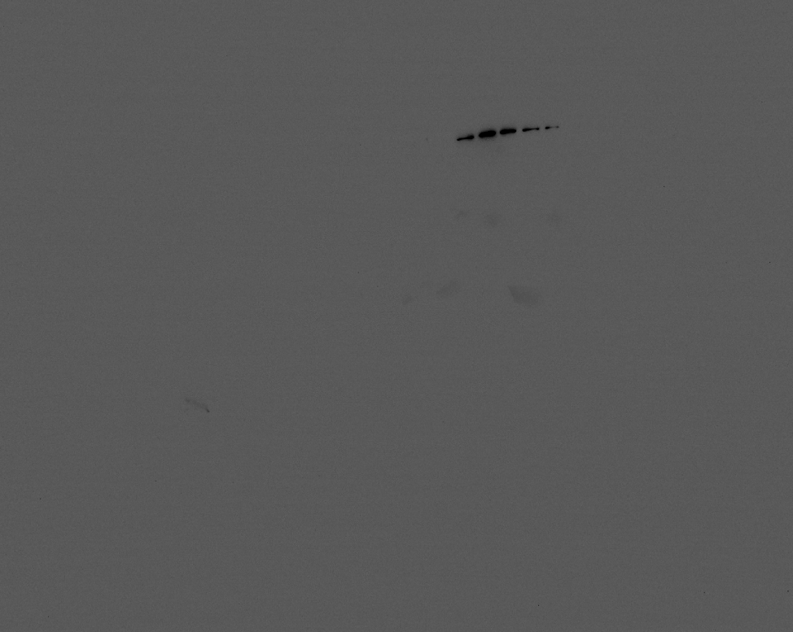
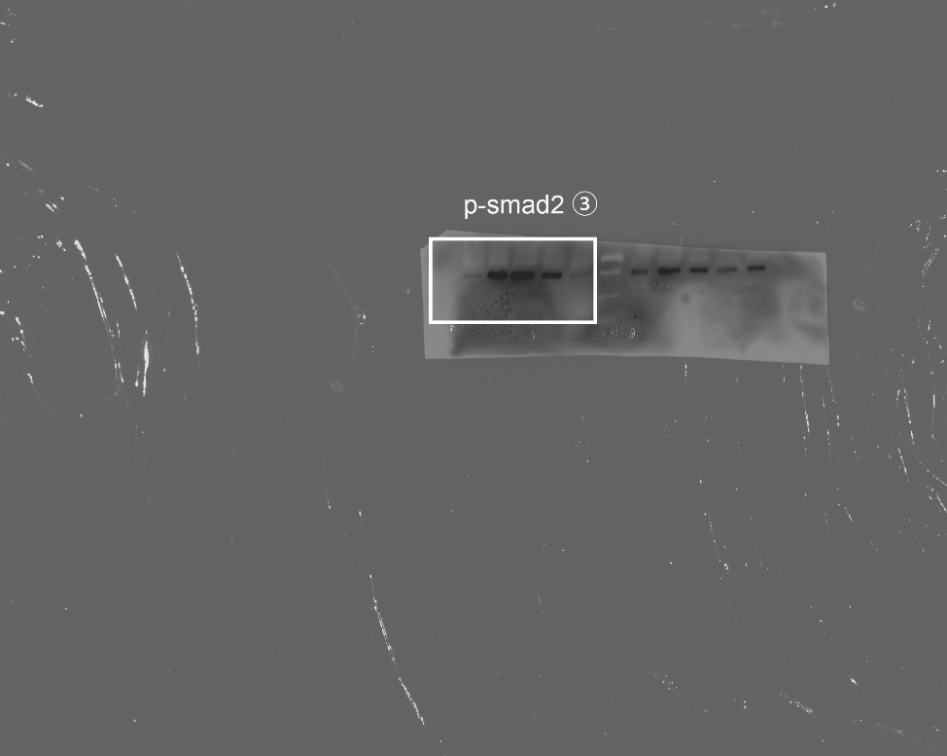
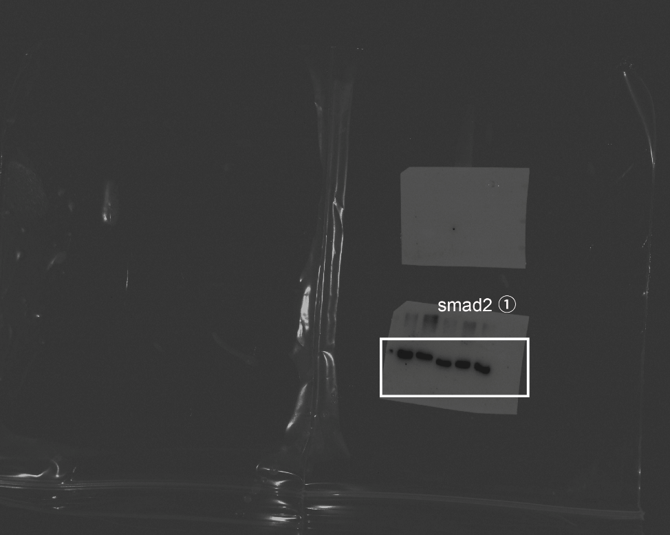
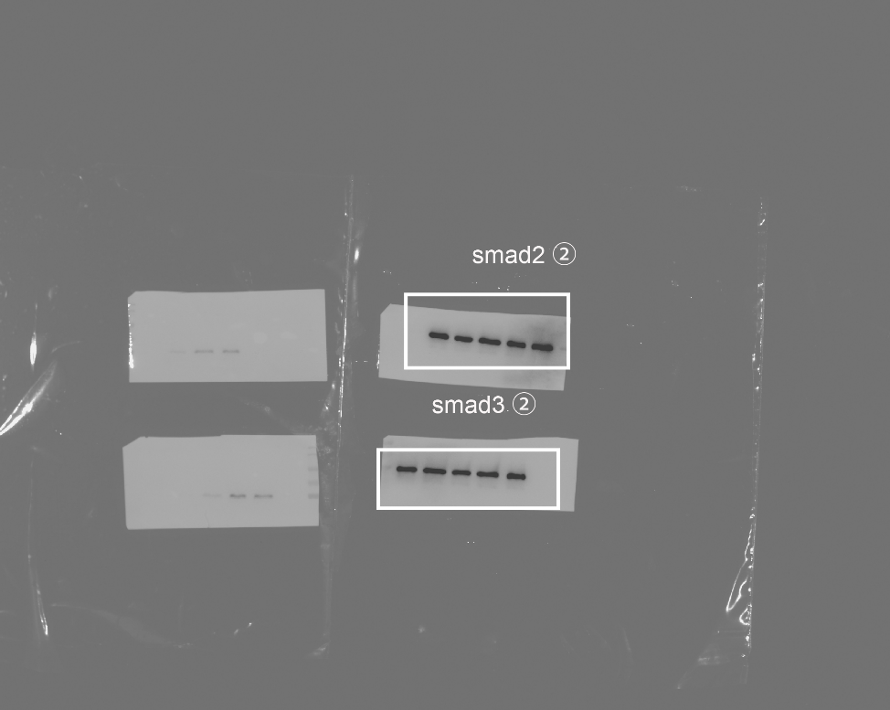
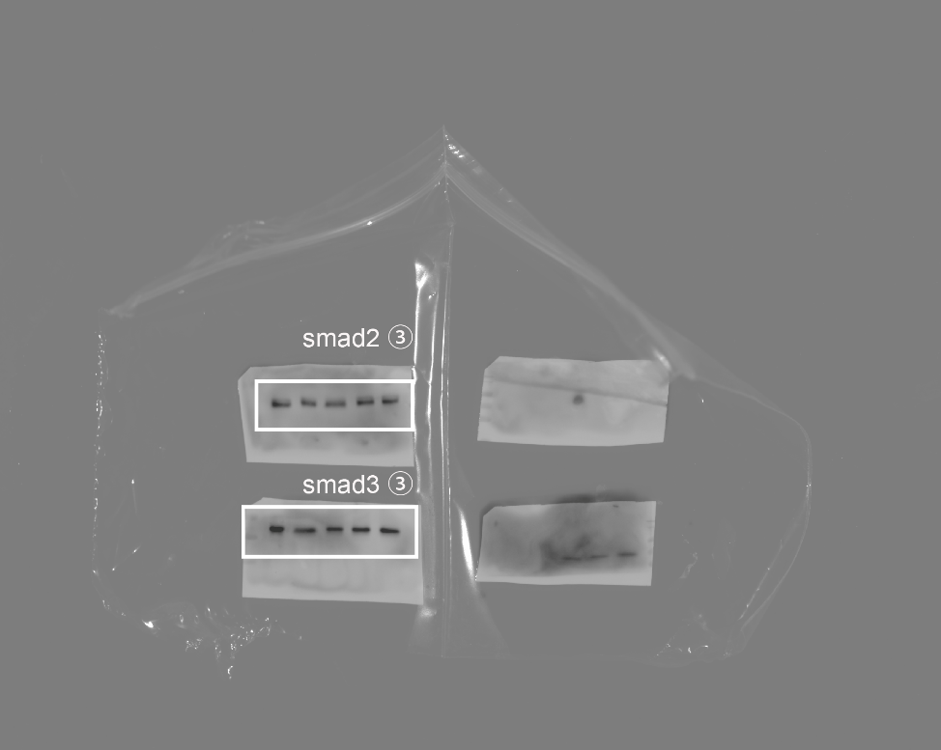
Figure 5A.
Sample ①
Sample ②
Sample ③
1 2 3 4 5
p-smad2
1 2 3 4 5
1 2 3 4 5
1 2 3 4 5
smad2
1 2 3 4 5
1 2 3 4 5
1 2 3 4 5
1 2 3 4 5
1 2 3 4 5

Slide 3
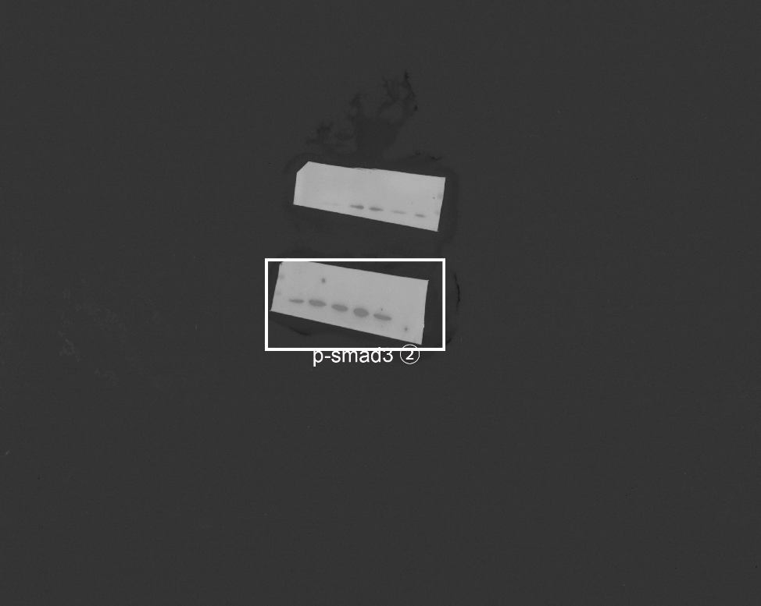
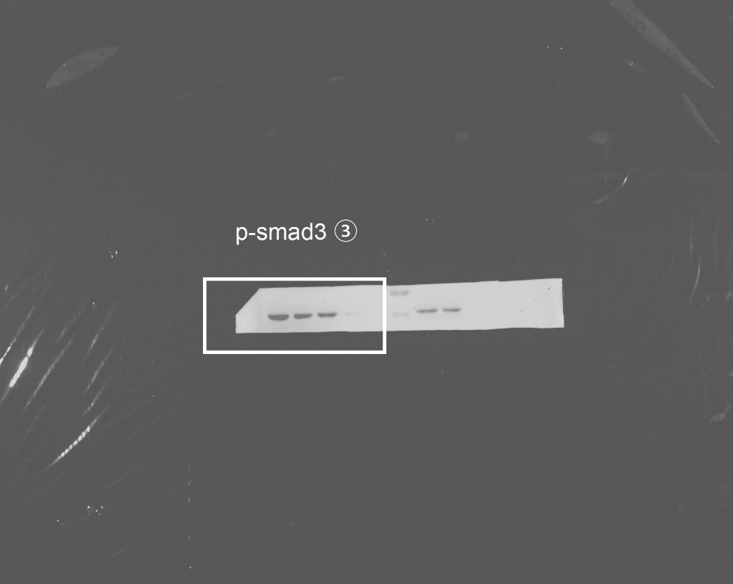
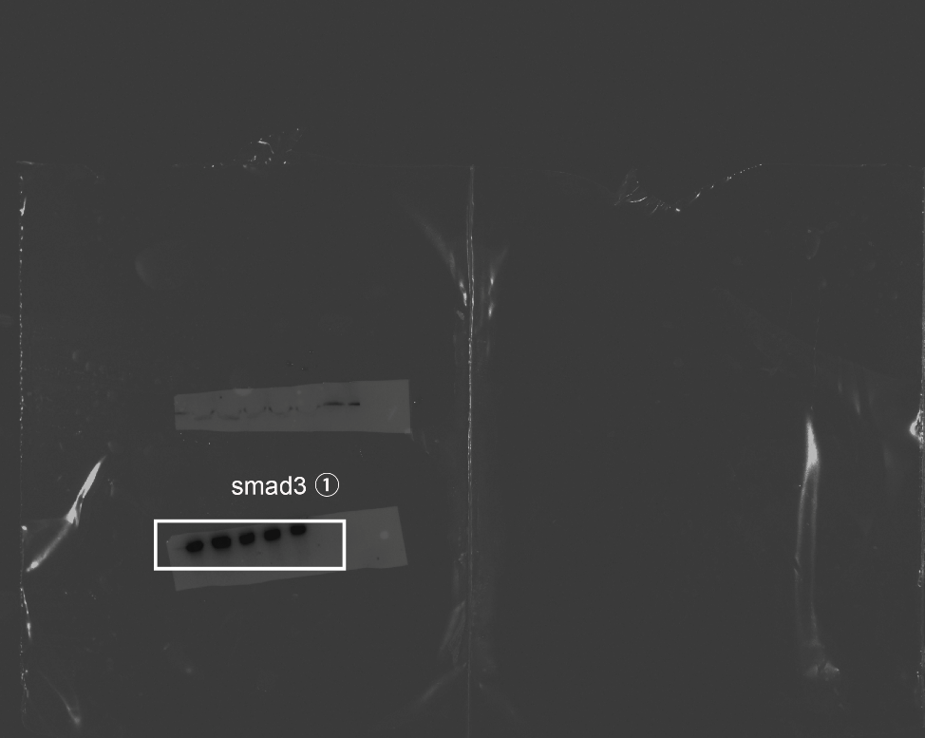
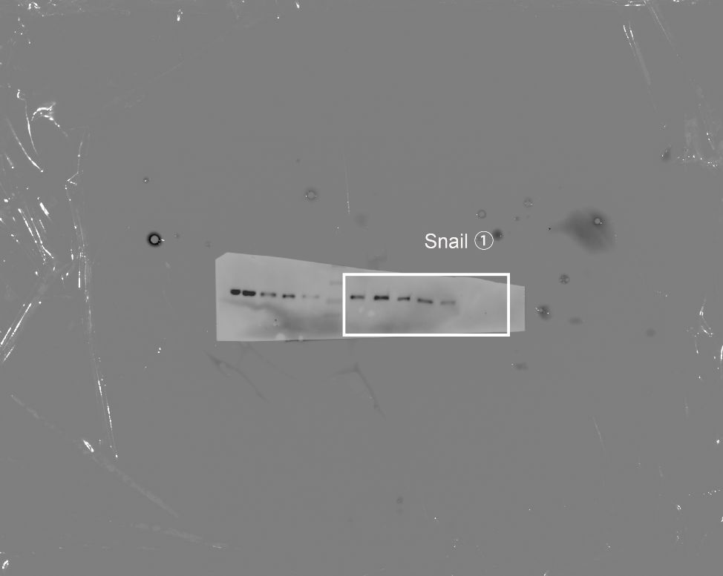
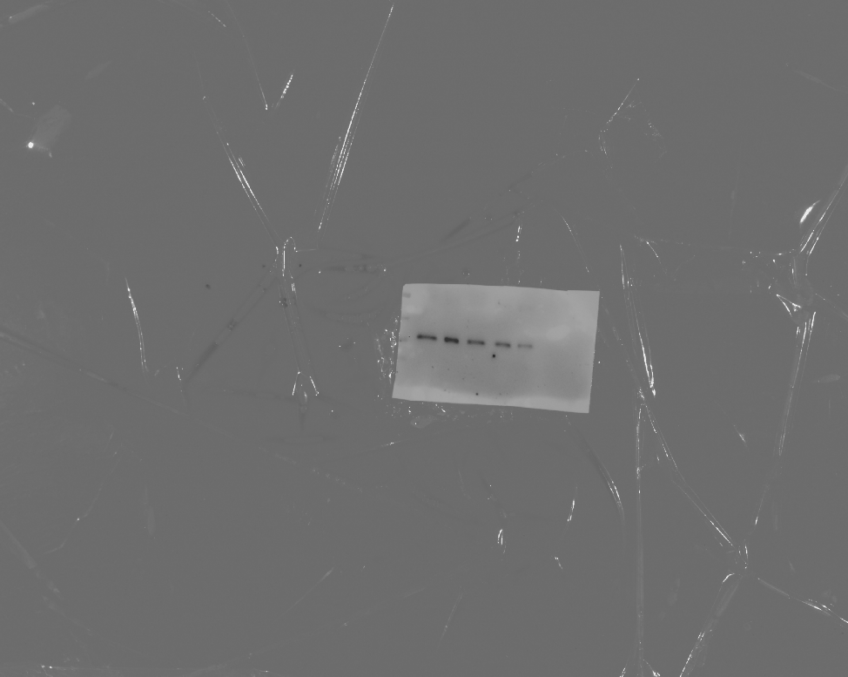
Figure 5A.
Sample ①
Sample ②
Sample ③
p-smad3
1 2 3 4 5
1 2 3 4 5
1 2 3 4 5
1 2 3 4 5
smad3
1 2 3 4 5
1 2 3 4 5
1 2 3 4 5
1 2 3 4 5
1 2 3 4 5
snail
1 2 3 4 5
1 2 3 4 5
1 2 3 4 5

