Slide 1
The Journal of Pharmacology and Experimental Therapeutics
Supplemental Figures
Pharmacokinetic and pharmacodynamic properties of cannabigerol in male mice
Alex Mabou Tagne^{1#}, Faizy Ahmed^{1#}, Adren Tran¹, Francesca Galvani¹, Lana Debbaneh¹, Emma Raine Perranoski¹, David Sarlah², Aditi Das³, Elisa Pabon⁴, Ziva Cooper⁴, and Daniele Piomelli^{1,5,6&}
¹Department of Anatomy and Neurobiology, University of California Irvine, Irvine, CA, USA.
²Department of Chemistry, Rice University, Houston, Texas, USA
³School of Chemistry and Biochemistry, Georgia Institute of Technology, Atlanta, GA, USA
⁴Jane & Terry Semel Institute for Neuroscience & Human Behavior, Dept of Psychiatry and Biobehavioral Sciences, Dept of Anesthesiology and Perioperative Medicine, David Geffen School of Medicine, UCLA
⁵Department of Biological Chemistry, University of California Irvine, Irvine, CA, USA.
⁶Department of Pharmaceutical Sciences, University of California Irvine, Irvine, CA, USA.
# Equal contribution
& Lead contact: Daniele Piomelli (piomelli@hs.uci.edu). Gillespie Neuroscience Res. Facility (room 3101), 837 Health Sciences Rd., Irvine, CA 92697.

Slide 2
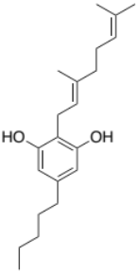
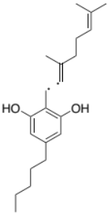
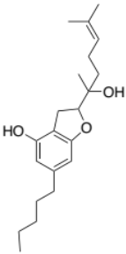

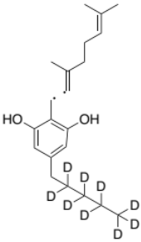
Supplemental Figure 1. Calibration curves for CBG (A) and cyclo-CBG (B), generated using serial dilutions of standards ranging from 0.02 to 1000 ng/mL and analyzed using Agilent MassHunter Quant software.
C₉H₁₅•
Qualifier – m/z 123.12*
CBG: C₂₁H₃₂O₂
Molecular Weight: 316.49
m/z: 316.24
C₁₂H₁₇O₂•
Quantifier – m/z: 193.12
C₉H₁₅^{3•}
Qualifier – m/z 123.12
C₁₂H₁₆O₂•
Quantifier – m/z 193.12
Cyclo-CBG: C₂₁H₃₂O₃
Exact Mass: 332.24
m/z: 332.24
C₉H₁₅•
Qualifier – m/z 123.12*
CBG-²H₉ : C₂₁H₂₃D₉O₂
Molecular Weight: 325.54
m/z: 325.30
C₁₂H₈D₉O₂•
Quantifier – m/z 202.18

Slide 3
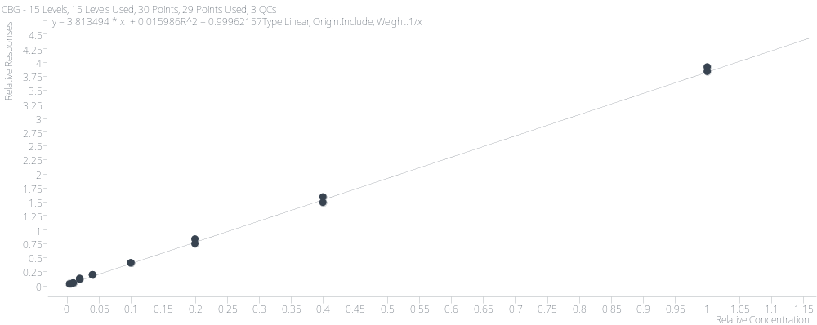
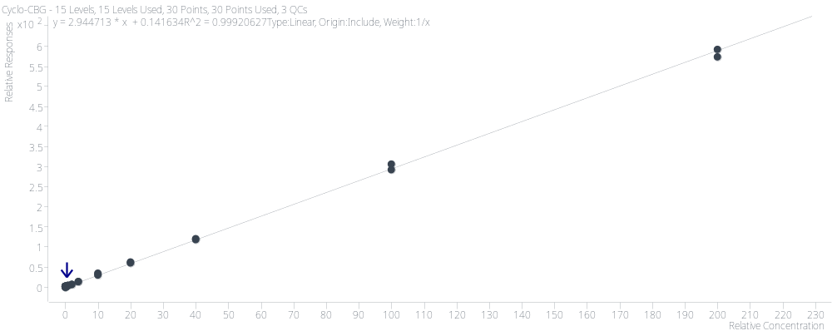
Supplemental Figure 2. MSD fragmentation patterns for CBG, cyclo-CBG, and [²H₉]-CBG.
A
1/x weighted R² = 0.9996
1/x² weighted R² = 0.993
LOD = 0.05 ng/mL
LOQ = 0.1 ng/mL
B
1/x weighted R² = 0.9992
1/x² weighted R²= 0.948
LOD = 0.2 ng/mL
LOQ = 0.5 ng/mL

Slide 4
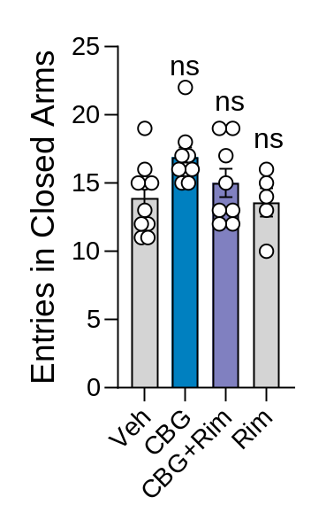
Supplemental Figure 3. Acute CBG does not affect closed arms entries in the EPM test. Mice received vehicle (Veh), CBG (10 mg/kg), rimonabant (Rim; 10 mg/kg), or Rim 30 min prior to CBG (Rim + CBG). EPM was conducted 30 min after CBG (or 60 min after Rim alone). Data are shown as mean ± SEM (n = 5–10/group) and analyzed by one-way ANOVA with Šídák’s post hoc test. ns, not significant.

